Slide 1
Wifi
Network Name: RSE Guest
Password: RSE826826

Slide 2
Burden of Disease
Methodological workshop
Royal Society of Edinburgh
Scotland
15th-16th September, 2016
Grant Wyper
Senior Researcher
gwyper@nhs.net
Burden of Disease Methodological Workshop, 15-16th September 2016
Royal Society of Edinburgh, Scotland

Slide 3


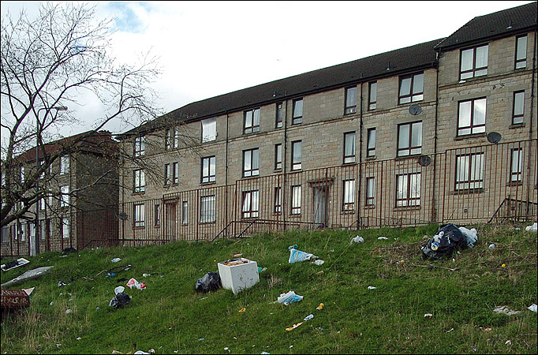
Welcome to Scotland

Slide 4

Scottish National Burden of Disease, Injuries and Risk Factors Study
Development and preliminary findings
Dr Diane Stockton
Principal Investigator
diane.stockton@nhs.net

Slide 5
Scottish Public Health
Observatory collaboration
NHS National Services Scotland, provides health information, health intelligence, statistical services and advice that support the NHS in Scotland in progressing quality improvement in health and care and facilitating robust planning and decision making. They maintain and analyse all routinely collected national health data.
NHS Health Scotland is the national agency for improving population health and reducing inequalities in health. Its work covers every aspect of health improvement, from gathering evidence, to planning, delivery and evaluation, and spans all the wider determinants that can impact on health .

Slide 6
Scottish BOD project team
Principal investigator Project Board (Advisors) Principal researcher Analytical and research team | Diane Stockton Colin Fischbacher Gerry McCartney Richard Dobbie Ian Grant Oscar Mesalles-Naranjo Grant Wyper Elaine Tod

Slide 7
Introducing our other Scottish colleagues
Project Board:
Prof Harry Campbell – Project Board chair
Oliver Harding – consultant in a local public health department
Marjorie Marshall – Scottish Government economist
Future users of the BOD results:
Mag McFadden –Scottish Government analyst
Neil Craig – Health economist
Louise Marryat – Researcher

Slide 8
Scottish National Burden of Disease, Injuries and Risk Factors study
Idea formed in 2011
Project started in July 2013
Initially funded through an NHS grant for 2 years…
Publishing results in January 2017

Slide 9
Aims (1)
Provide comprehensive data on health needs to support rational resource allocation.
To identify inequalities in the burden of disease across sub-populations and socio-economic groups.
To analyse the contribution to this burden of selected risk factors.
To provide epidemiological information against which to compare the relative impacts of interventions in reducing the burden of disease and to inform economic evaluation of those interventions.

Slide 10
Aims (2)
To help address the future challenges posed by the ageing of the population, changes in disease and risk factor patterns, and the increasing costs of health services through the production of projections of the disease burden.
To assess whether the large effort to undertake a Burden of Disease study for Scotland, is warranted, by comparing our results to the results that can be obtained for Scotland from the GBD study.

Slide 11
Scottish BOD study – DALY components
  List of diseases (GBD organisational disease classification)
  Mortality (Scottish data and Scottish age-gender-deprivation specific life tables)
  Morbidity
    Prevalence (Scottish data, clinical advice and literature reviews)
    Severity distributions (GBD severity distributions used but some exploratory analysis looking at impact of using local distributions)
    Disability weights (GBD weights used)
    Comorbidity (Scottish data and methods)
  Uncertainty (Scottish methods)

Slide 12
Scottish National Burden of Disease, Injuries and Risk Factors Study
Preliminary findings

Slide 13
PRELIMINARY RESULTS
  Top 10 crude DALYS in Scotland (44% of estimated burden)
Disease | GBD 2013 | Scotland 2012
Ischemic heart disease | 130,476 | 110,869 | ê
Chronic obstructive pulmonary disease | 65,281 | 65,843 | s
Trachea, bronchus, and lung cancers | 75,835 | 65,000 | ê
Cerebrovascular disease | 70,773 | 48,049 | ê
Neck and low back pain | 179,094 | 44,373 | ê
Other musculoskeletal disorders | 26,612 | 39,074 | é
Alzheimer's disease and other dementias | 47,989 | 37,237 | ê
Non-infective inflammatory bowel disease | 8,499 | 29,850 | é
Oral disorders | 19,582 | 29,641 | é
Cirrhosis | 30,075 | 29,352 | s

Slide 14
Scottish National Burden of Disease, Injuries and Risk Factors Study
Plans for the future

Slide 15
Activity to end March 2017
Continued engagement with clinicians, epidemiologists and policy colleagues to refine estimates (now-Dec 2016)
Overall results by age, sex and socio-economic group published on our website – report and excel spreadsheets (January 2017)
Technical report published (January 2017)
Risk factor work (ongoing)
Projections work undertaken and published on our website (March 2017)
Topic specific scientific papers written (ongoing)
Promotion of results through presentations to government policy colleagues and planners; short briefing papers written (Dec 16-March 17)

Slide 16
Activity after March 2017
Funding for the analytical/research team uncertain after March 2017. Options being explored to avoid loss of expertise gained.
PI and clinical advisors will continue to promote the work within their roles.
Health economist colleagues will pick up the data for economic analysis and planning

Slide 17


www.scotpho.org.uk
http://www.scotpho.org.uk/comparative-health/burden-of-disease
diane.stockton@nhs.net

