Slide 1
Burden of Disease work in Norway – Centre for Disease Burden at the Norwegian Institute of Public Health
Burden of Disease Methodological Workshop,
Royal Society of Edinburgh, Scotland
15-16 September 2016
Stein Emil Vollset, MD, DrPH
Director, Centre for Disease Burden, Norwegian Institute of Public Health, Oslo/Bergen
Professor, Department of Global Public Health and Primary Care, University of Bergen
Affiliate professor, Institute for Health Metrics and Evaluation, University of Washington, Seattle

Slide 2
Norwegian Institute of Public Health (NIPH)
Under the Minstry of Health and Care services
NIPH should produce, summarise and communicate knowledge and evidence for securing high standard public health and health care services
Approximately 1400 employees
in Oslo, Bergen and Porsgrunn
Yearly budget of 1.6 billion NOK (150 mill £), includes
purchase, storage and distribution of vaccines for regular childhood vaccination program and emergency preparedness
contract funding
external funding from national and international sources

Slide 3
NIPH Organisation
Director-General and Staff
Communication
Staff and Administration
Mental and Physical Health
BoD
Infection Control and Environmental Health
Health Data and Digitalisation
Forensic Sciences
Knowledge Centre for the Health Services
International Public Health
Norwegian Scientific Committee for Food Safety

Slide 4
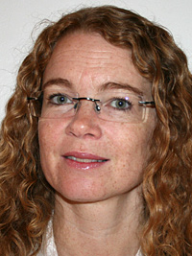
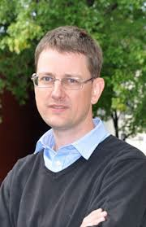
Centre for Disease Burden at the Norwegian Institute of Public Health (NIPH)
Mandate and funding from the Ministry of Health & NIPH & research funding
Highlighted in the 2015 Government’s public health white paper to the Parliament (Stortinget): Meld. St. 19 (2014-2015), «Mestring og muligheter»
Pilot centre 1 year from October 2015
Five researchers with varied backgrounds: demography, biostatistics, epidemiology, health economics, psychology, medicine and public health
Plus reseacher BoD-network at NIPH across domains and departments
Close collaboration with the Global Burden of Disease project at the Institute for Health Metrics and Evaluation (IHME), University of Washington in Seattle
Jonas Kinge
Mette Tollånes
Vegard Skirbekk
Ann Kristin Knudsen
Stein Emil Vollset
Notes:
Resultatene fra GBD prosjektet av stor interesse for Norge. Totaloversikt første gang i 2013

Slide 5
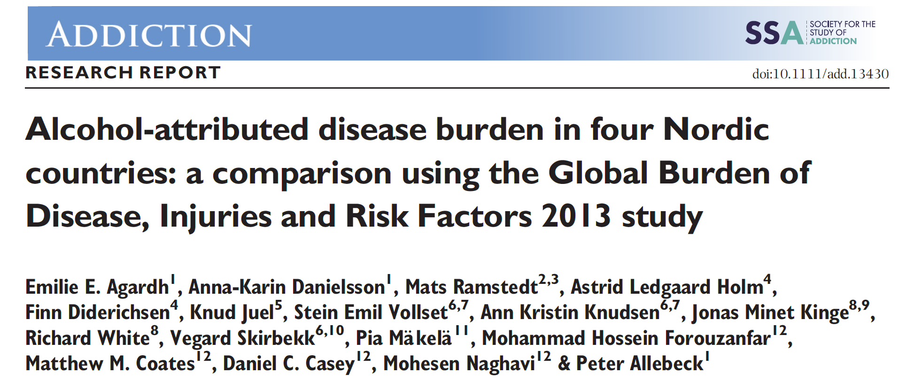
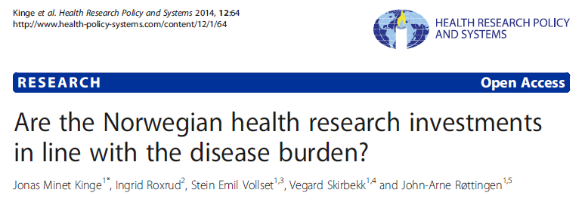
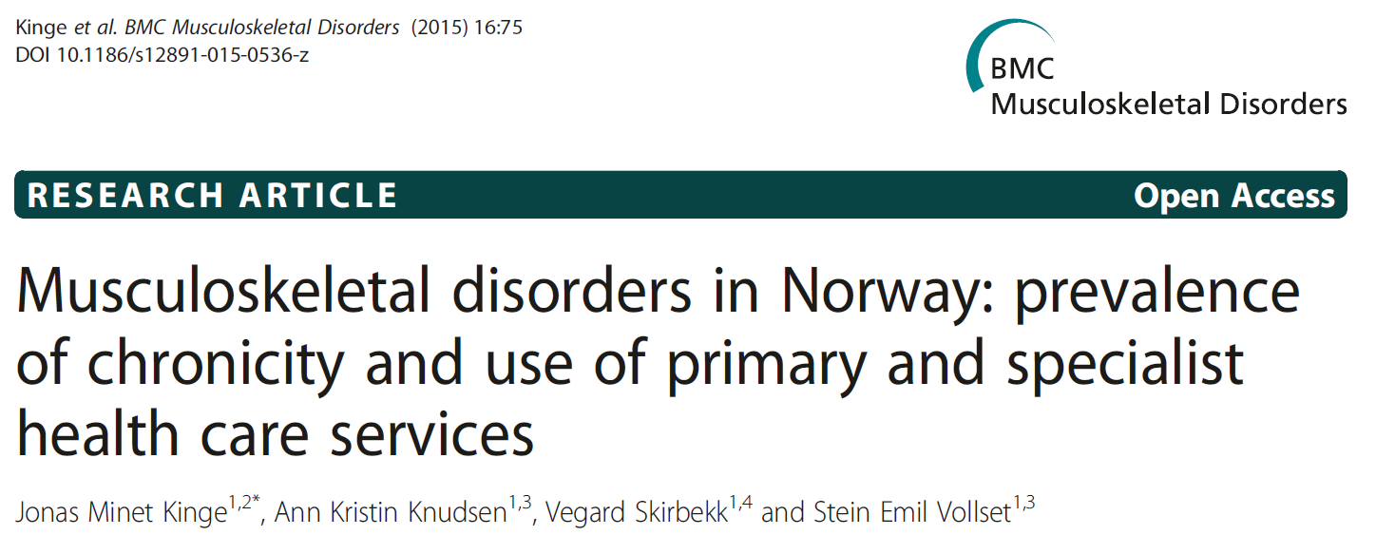
Selected Centre publications
J Epidemiol Community Health 2015

Slide 6
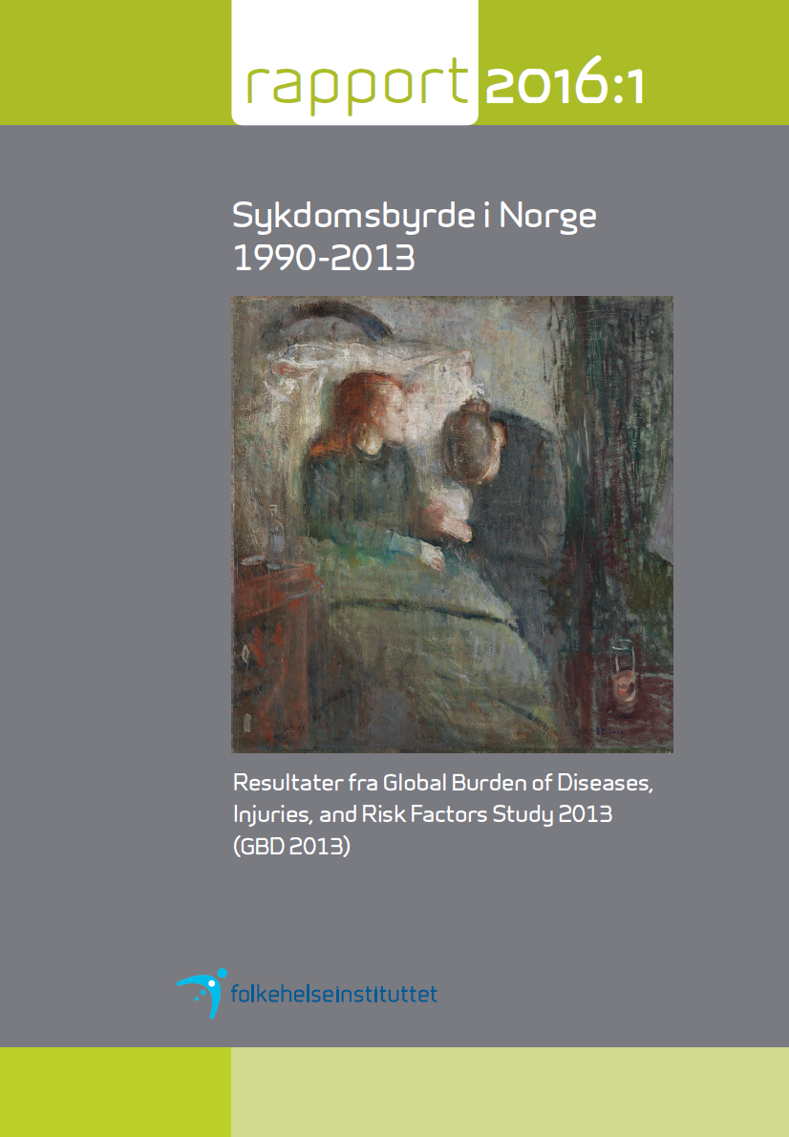
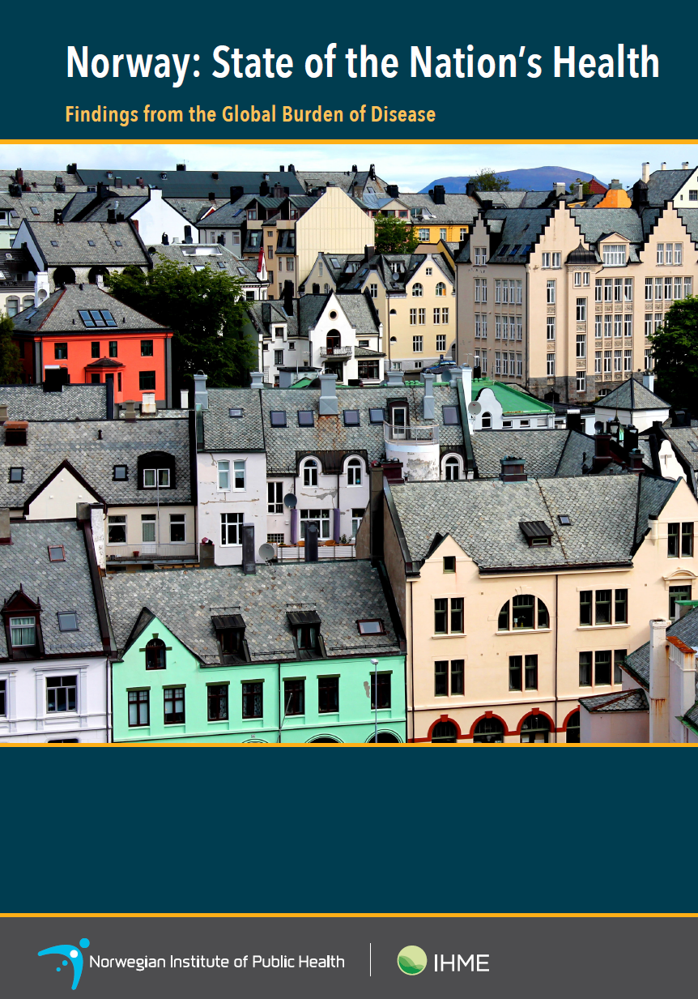

Slide 7
Hva is happening in Norway?
March 2016: Release NIPH-report 2016:1 (in Norwegian, 184 pages) Disease burden in Norway 1990-2013 – Results from the Global Burden of Diseases, Injuries, and Risk Factors Study 2013 (GBD 2013)
Contributions from 28 researchers at NIPH, discussion, assessment, presentation of detailed GBD2013 results
March 2016: IHME/NIPH publication (in English); Norway: State of the Nation’s Health (http://www.healthdata.org/policy-report/norway-state-nations-health)
Seeking permanent (4-year) Centre status with five researchers at NIPH
Planning/preparing sub-national analyses in collaboration with GBD/IHME
Looking into doing detailed health cost analysis by combining GBD2015 results with registry-based Norwegian cost estimates
Increasing use of GBD data in Norway: Minstry of Health, Directorate of Health, Research Council

Slide 8
Directorate of Health reports 2016
GBD 2013 results combined with relevant Norway cost data (with assitance from Centre for Disease Burden)
Societal costs from diseases and injuries 2013: Health care cost and production
loss by disease groups
2. Fruit and vegetables to school children – health economic assessment
3. Societal gains by adherance to dietary guidelines from Directorate of Health

Slide 9
The Norwegian BoD 2013 from NIPH report 20016:1 (GBD 2015-numbers third quarter2016)

Slide 10
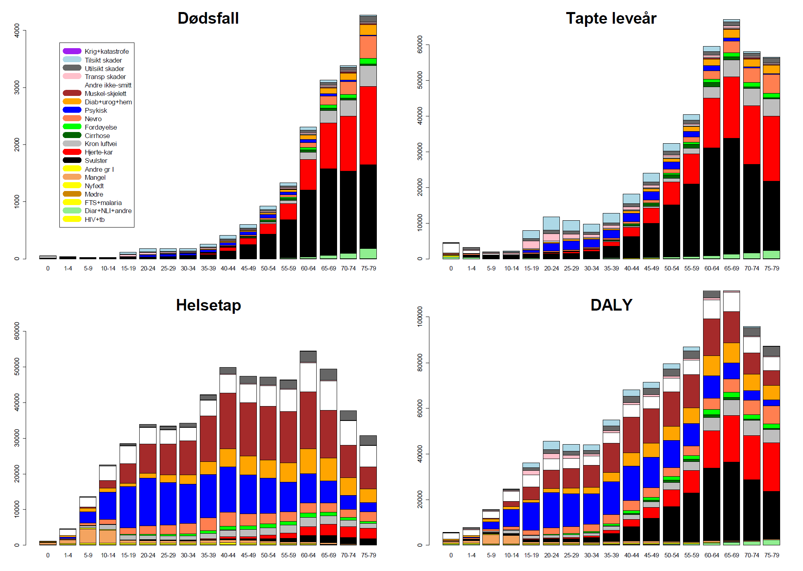
Hjertekar
Selvmord
Overdoser
Trafikkdød
Kreft
Muskel-skjelett
Psykiske lidelser
From NIPH-report 2016:1

Slide 11
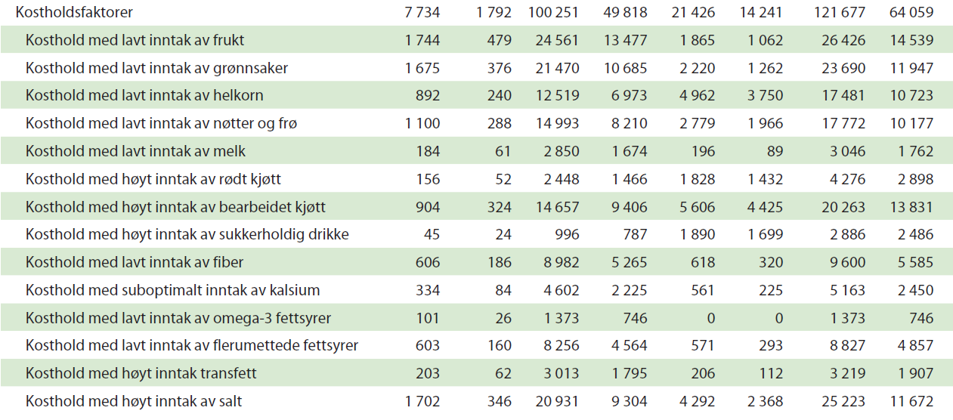
Kosthold: mer planter og mindre salt
From NIPH-report 2016:1

Slide 12
NIPH – future directions
Centre for Disease Burden (CBD) are GBD-collaborators assisting with Norway and other subject-specific knowledge in each GBD-cycle and contributing to capstone GBD-papers (Lancet series)
Sub-national BoD for Norway in GBD 2017 cycle
Norway BoD by socio-economic position (education, income) based on income and education registries
Registry-based analysis of disease burden
Research projects: e.g. Burden of obesity (Jonas Kinge) – Norwegian Research Council
Nordic countries study based on GBD 2015 results

Slide 13
Nordic BoD collaboration
Meeting Oslo 23 September 2015
Participants:
Chris Murray, IHME, University of Washington, Seattle,
Peter Allebeck, Karolinska, Stockholm,
Knud Juel, National Institute of Public Health, København,
Elisabete Weiderpass, Cancer Registry Norway,
Mika Gissler, National Institute for Health and Welfare (THL), Helsinki,
Ólöf Steingrímsdóttir, Ann Kristin Knudsen, Stein Emil Vollset, Vegard Skirbekk, Jonas Kinge, Richard White, Solveig Ellingsund,
Norwegian Institute of Public Health, Bergen, Oslo

