Slide 1
Burden of Disease: Methodological Workshop 15th and 16th September Royal Society of Edinburgh, Scotland
Burden of Disease and the Netherlands
Henk Hilderink

Slide 2
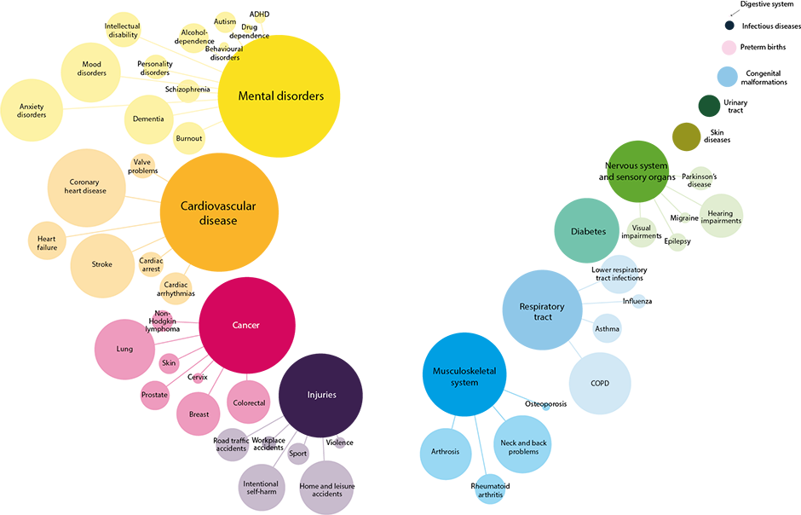
Highest disease burden due to mental disorders, cardiovascular diseases and cancer

Slide 3
Main players in the Netherlands
Data input
NIVEL (GP registration)
IKNL (Cancer registration)
LIS-EUR-VeiligheidNL (Injuries)
NSO CBS (CoD)
BoD Estimation: RIVM
Since the 1990s
As part of the Public Health Status and Foresight (PHSF) Reports
“Own” track e.g. Dutch Disability Study and Chronic Disease Model
Prevalence approach for YLD

Slide 4
Current Status
Diversity at RIVM
PHSF overall BoD
Environmental BoD (e.g. for PM, Radon, Noise, SHS,…)
Infectious disease-related BoD (e,g. food-born)
COST2HALE project
Harmonize (where possible) methodology
Inventory of (broad) interventions
Assessment of top 10 interventions

Slide 5
Harmonize
Make explicit which choices are made regarding:
Incidence of prevalence approach
Disease stages
Disability weights
Multimorbidity
Life table
Age weighting
Discounting
Attribution to risk factors
….

