Slide 1
Burden of Disease:
Methodological Workshop
15th and 16th September
Royal Society of Edinburgh, Scotland
Jürgen C Schmidt, Deputy Head, Public Health Data Science

Slide 2
Introducing the Public Health England Global Burden of Disease programme
Professor John Newton, Chief Knowledge Officer
      Responsible for delivering an effective knowledge and intelligence service that covers research, statistics and know-how, to inform the practice of public health and public health improvement.
Dr Julian Flowers, Head of Function, Public Health Data Science
      Data science is fully embedded in all aspects of data within PHE, there are partnerships in place to allow us to work rapidly and flexibly, data science skills and awareness are seen as core for analysts and team members respectively, and innovation and cross team working becomes the norm
Dr Jürgen C Schmidt, Deputy Head, Public Health Data Science
      The Analytical Projects workstream in particular assists in developing specific projects around queries coming from within Public Health England, or from outside partners, using modelling and analytical tools.

Slide 3
A bit of history
Global Burden of Disease 2010 UK paper in the Lancet (2013): a powerful tool for policy
Data cover UK, not England
Data from different sources, methodologies, boundaries
No complete models showing overall disease burden and trends
Various models on either specific disease patterns/ trends in terms of mortality outcomes or morbidity, but nothing combined.

Slide 4
The origins
August 2013: newly established PHE GBD team started providing England inputs
Challenge: “one source of the truth”, standards, quality assurance
Methodological and process issues:
      Sub-England data required for processing outside of the EU, not currently in the public domain
      Lack of consistent sub-England data on morbidity
      Limited set of sub-England data on covariates for the modelling process available
      Administrative boundaries: low level population numbers, 45 subgroups, LSOAs and the Census
      Methodological issues, e.g. coding
      Currency
      Unique source vs multi-agency controlled datasets

Slide 5
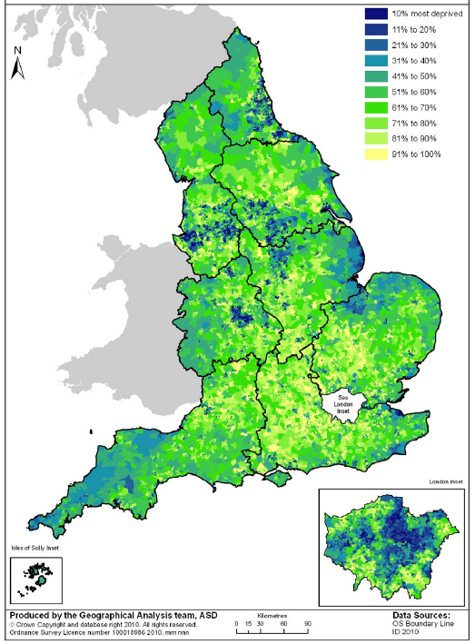
LSOA-based deprivation
Administrative regions,
45 subnational areas

Slide 6
GBD England Data Flow

Slide 7
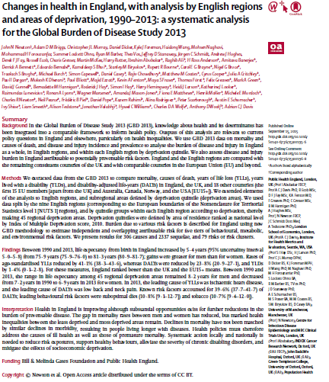
Results
England performs above average vs other high income countries on key health outcomes
Life expectancy from birth +5.4 years 1990-2013 from 75.9 years to 81.3 years
Big improvements in rates of premature mortality but not in morbidity: we’re living longer but spending more years in ill-health
Morbidity and especially multiple morbidity a major challenge
Persistent health inequalities – largely driven by deprivation; important within regions as well as between regions
40% of ill health in England is due to potentially preventable risk factors (unhealthy diet and tobacco)

Slide 8
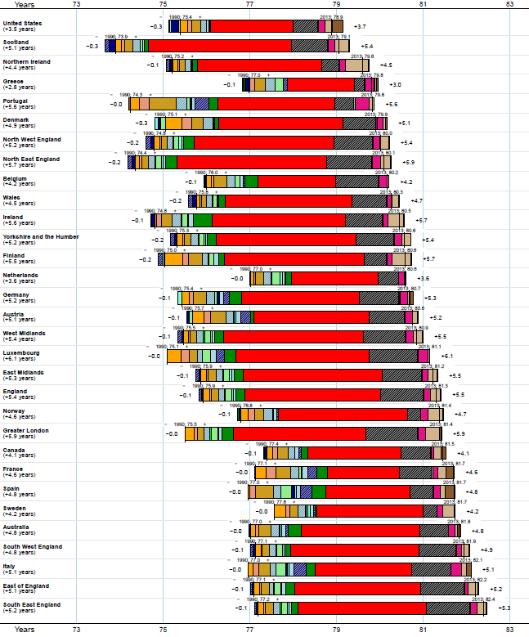
Change in life expectancy at birth for EU15+, British Nations, and English regions -
both sexes from 1990−2013 by broad cause group

Slide 9
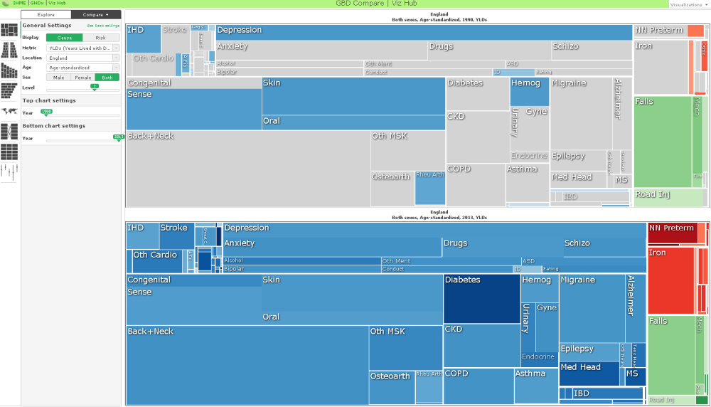
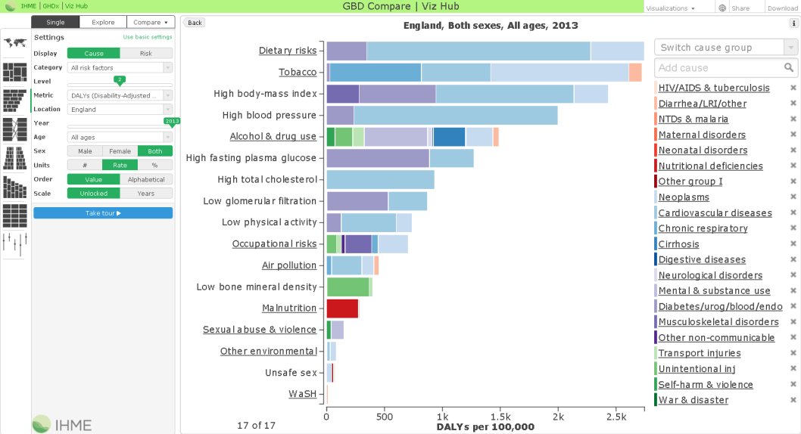
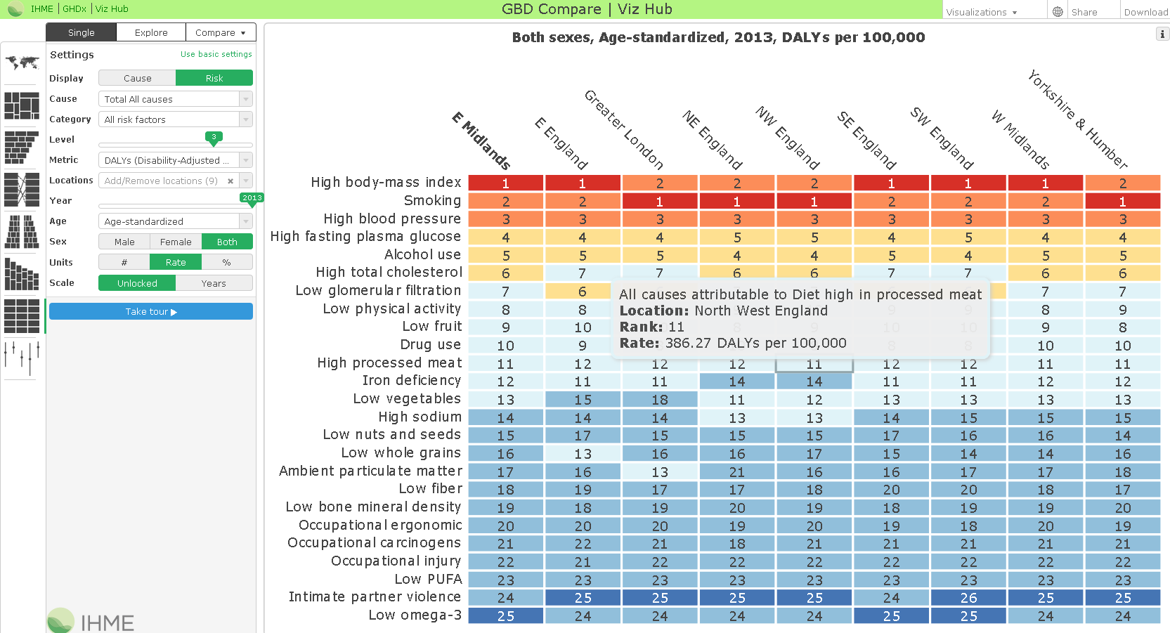
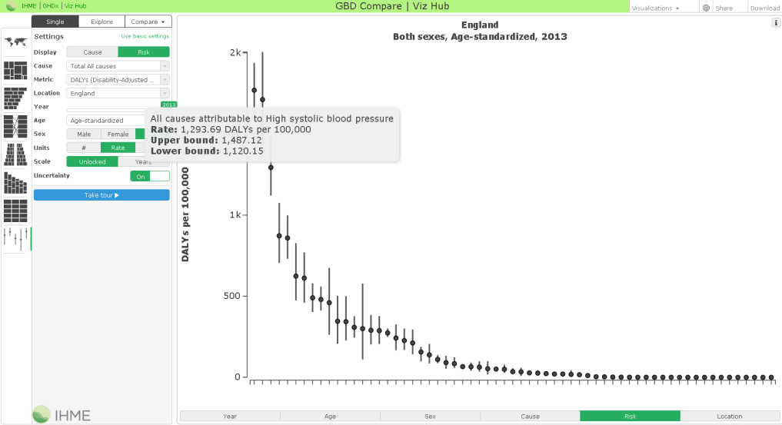
GBD England compare

Slide 10
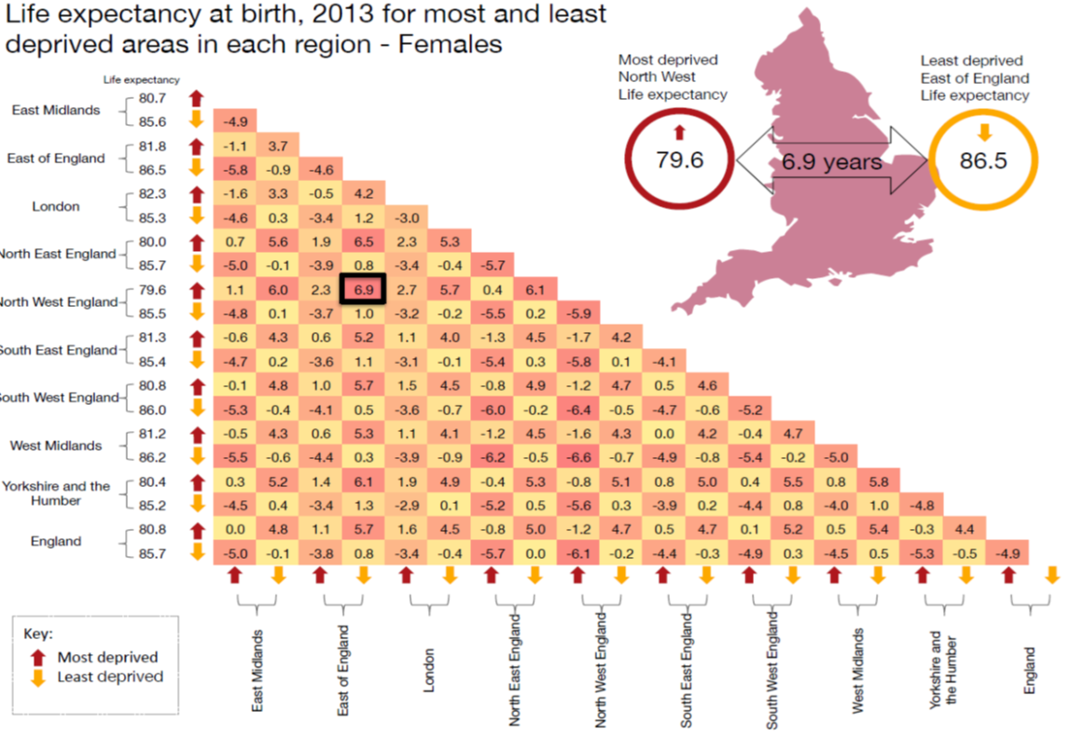
Infographics/1
Infographics/1

Slide 11
Infographics/2

Slide 12
next steps for England’s GBD
Enhanced data sources (e.g.: on distribution of causes of morbidity) – routine data and surveys
Break-down of data at local level – regions to local authorities
GBD data to model future projections and resource planning
Incorporate analysis of socio-economic determinants
Research questions around impact of deprivation, climate change, specific conditions or risk factors (mental health, neurological conditions, air pollution), Interaction of health and care systems
Encourage users to explore the wealth of data in GBD on the web site and the interactive tool

Slide 13
This workshop
Current and future collaboration
Areas of consensus
Methodological clarification
Topic 1. Key parameters: redistribution of ill-defined deaths, disability weights, severity distributions and more
Topic 2. Prevalence estimation (including uncertainty)
Topic 3. Comorbidity adjustment
Topic 4. Projections
Topic 5. Risk factor analysis
Topic 6. Health economics
Topic 7. Presentational approaches and Impact

