Slide 1
Belgian National Burden of Disease Study
Brecht Devleesschauwer
15/09/2016

Slide 2
Welcome
Managing Director
Office of Operations
Office of the Managing Director
Communicable and infectious diseases
Food, medicines & consumer safety
Public Health &Surveillance
Expertise, services & customer relations
Surveys, lifestyles & chronic disease
Epidemiology of infectious diseases
Healthcare-associated infections
Cancer centre
Health systems research

Slide 3
Welcome
Surveys, Lifestyle, Chronic Diseases
Policy support
Public Health Genomics
Survey Research
Public Health Indicators
Health Inequalities
SMPH methodology
National Health Status
Drugs and Illegal Substances

Slide 4
Why Belgian NBD study?
Ownership and sustainability
Local context
access to local data
contextual knowledge → interpretation
interaction with local stakeholders
more credibility to local stakeholders
Methodological flexibility
own assumptions versus e.g. global interpolations
own priorities, e.g., national and regional estimates
Process as such
impetus to appraise local data quality
capacity building: awareness, critical mass, scientific process

Slide 5
NBD Coordinator
Develop NBD support tools
Initiate, support and harmonize DALY initiatives
Interact with stakeholders

Slide 6
NBD support tools
“DALY” folder in “Common”
NBD Guidelines
harmonize initiatives → comparability
DALY workshop
in-house capacity building
2 day hands-on training
5-6 October 2016
DALY calculation tools
further development of DALY Calculator for R
command line + online interface

Slide 7
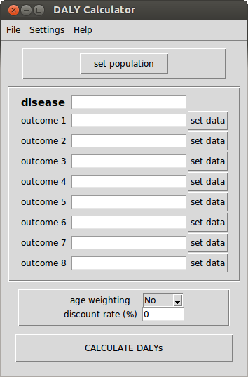
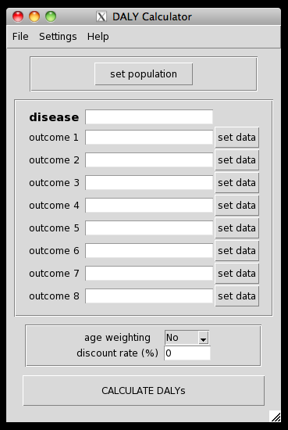
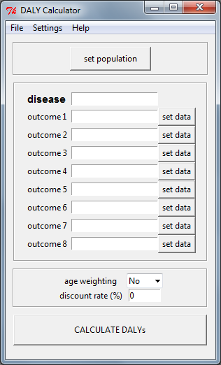
DALY Calculator
DALY package (version 1.4.0)
free and open-source graphical user interface for probabilistic DALY calculations in

Slide 8
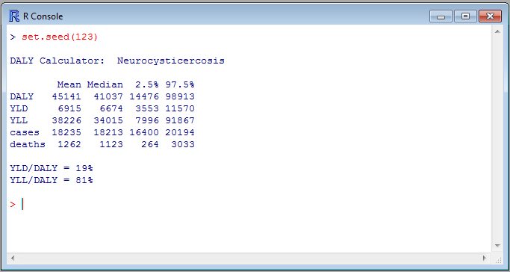
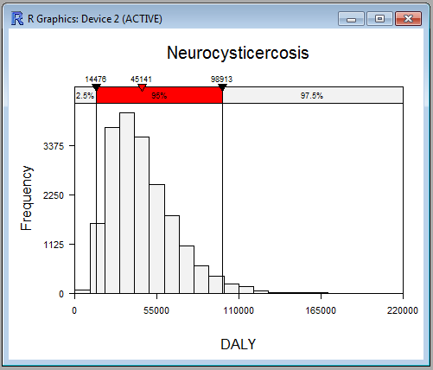
DALY Calculator
Probabilistic Sensitivity Analysis (Uncertainty Analysis)

Slide 9
NBD Initiatives
Initiate, support and harmonize DALY initiatives
Responsibilities
NBD Coordinator
methodological advice
general coordination
Unit
provide baseline epidemiological data
review disease models (health states, transition probabilities)
implement DALY calculations

Slide 10
NBD Initiatives
Initiate, support and harmonize DALY initiatives
Ongoing activities
SLCD: burden of chronic diseases
EID: burden of infectious diseases
HSR ??
HAI-AMR ??
CC ??
Notes:
HSR: CF, neuromuscular diseases, rare diseases, sentinel GP (diabetes, suicide, ..)
HAI-AMR: healthcare associated infections, antimocrobial resistance; cf ECDC
CC: cancer

Slide 11
Burden of infectious diseases
Initiative launched by EID unit
Based on ECDC BCoDE toolkit
disease models translated into SAS
incidence ~ EpiLabo data
automated DALY calculation framework
Future steps
review of BCoDE disease models
multipliers (underreporting correction)
expert opinion? international literature?
national gastroenteritis survey?

Slide 12
Interaction with stakeholders
Stakeholder meeting, 28 September 2016
Participants
Federal, Regional Health Ministries, Administrations
Statistics Belgium, Federal Planning Bureau, Superior Health Council, FPS Social Security
RIZIV-INAMI, Farmanet, KCE, IMA-AIM
BCR, Intego, VITO
Belgian Universities

Slide 13
Interaction with stakeholders
Stakeholder meeting, 28 September 2016
Expected outcomes
foster awareness, uptake and support
enhance willingness to share data
create supervisory committee

Slide 14
Interaction with stakeholders
Stakeholder meeting, 28 September 2016
Preliminary agenda
WIV-ISP Symposium: Towards a Belgian National Burden of Disease Study
14:00–14:15 | Welcome ­– Prof Dr Herman Van Oyen (WIV-ISP)
14:15–14:45 | Disability-Adjusted Life Years: historical and technical background – Prof Dr Niko Speybroeck (Université catholique de Louvain)
14:45–15:15 | Dutch national burden of disease study: policy implications – Dr Henk Hilderink (RIVM)
15:15–16:00 | Towards a Belgian national burden of disease study – Dr Brecht Devleesschauwer (WIV-ISP)
16:00–16:15 | Conclusions and closure ­– Prof Dr Herman Van Oyen (WIV-ISP)

