Slide 1
Overview of WHO work on GBD and summary measures
Colin Mathers
Coordinator, Mortality and Health Analysis Unit
World Health Organization, Geneva
Burden of disease methodological workshop
Royal Society of Edinburgh, 15-16 September 2016

Slide 2
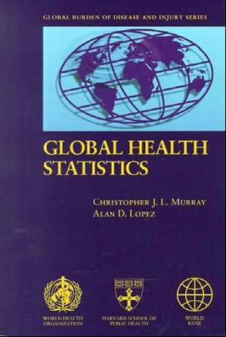
Abbreviated GBD history (1)
1991-96 Global Burden of Disease 1990 Study
  World Bank 1993; Murray & Lopez 1996
1999-04 WHO updates for years 2000-2002
  Mortality and COD – country level
  DISMOD II software tool (public)
  YLD – 17 regions
  Comparative Risk Assessment - 26 RFs
  WHO-CHOICE: generalized CEA
  Healthy LE (HALE) – 192 Member States

Slide 3
Abbreviated GBD history (2)
2004-06 Disease Control Priorities Project
  Lopez, Mathers et al 2006
2005-09 WHO updates
  Projections to 2030
  GBD: 2004 update (pub. 2008)
  Global health risks (pub. 2009)
  Stand-alone NBD software tool
2007-12 GBD 2010 study (IHME - BMGF)
  WHO collaboration (core group)
2013+ GBD 2013+ studies (IHME - BMGF)
WHO Global Health Estimates

Slide 4
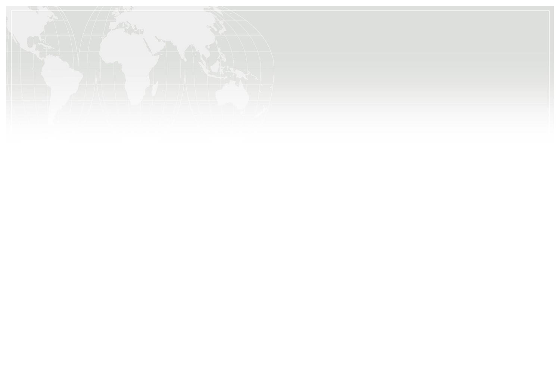
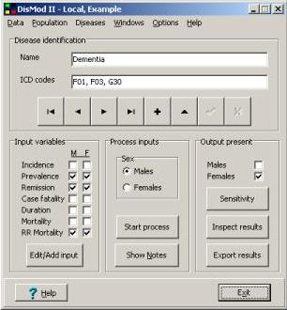
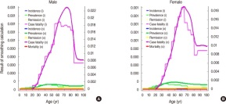
DISMOD II – PC-based software tool
http://www.epigear.com/index_files/dismod_ii.html

Slide 5
National Burden of Disease (NBD) Toolkit
QUICK START – Summarizes WHO disease estimates for the year 2004 by age, sex and cause
BASIC ANALYSIS – Displays WHO disease estimates for the year 2004 by age, sex and cause, allowing for manipulation and generation of disease specific or risk factor summaries
INTERMEDIATE ANALYSIS – Allows insertion of mortality country data with automatic YLD modifications enabling comparison with WHO estimates for the year 2004 by age, sex and cause
COMPREHENSIVE ANALYSIS – Provides features for insertion of country data with cause-specific YLD modifications allowing comparison with WHO estimates for the year 2004 by age, sex and cause through revisions of mortality, incidence and prevalence of disease and injury
All are linked directly to summary slides and tables

Slide 6
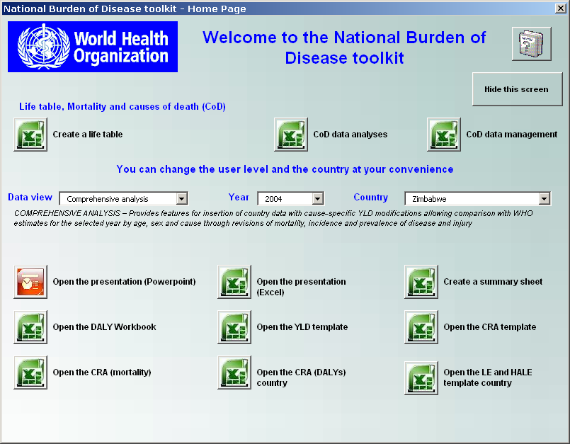

Slide 7
Global projections for selected causes,
2004 to 2030
Cancers
Ischaemic HD
Stroke
Acute respiratory
infections
Road traffic
accidents
Perinatal
HIV/AIDS
TB
Malaria
Updated from Mathers and Loncar, PLoS Medicine, 2006

Slide 8
WHO Global health estimates
www.who.int/gho
www.who.int/evidence/bod
Life tables and all-cause mortality
Feb 2014 update for 1990-2012 (WPP2012, UN-IGME, VR data)
Mar 2016 update for 1990-2015 (WPP2015, UN-IGME, VR data)
Comprehensive estimates of causes of death
  May 2014 Update for 2000-2012 (WHO, UN, GBD2010, VR data)
  End Jun 16 Provisional regional-level update COD
  Nov 2016 Update for 2000-2015 (WHO, UN, GBD2013, VR data)
WHO estimates of YLD and DALYs
  June 2014 2000-2012 (GBD2010, WHO)
  End Jun 16 Provisional YLD 2000-2015 (GBD2013, WHO)
  Nov 2016 Update for 2000-2015 (WHO, UN, GBD2013, VR data)

Slide 9
WHO Global Health Estimates (www.who.int/evidence/bod)
Country/regional/global estimates for deaths by detailed cause list for years 2000 to 2015 – to be released in November 2016
UN interagency envelopes (child mortality, all cause mortality)
WHO estimates for specific causes (child causes, HIV, TB, malaria, maternal, cancers, road injury, suicide, homicide etc) – increasing focus on SDG mortality indicators
WHO estimates for other causes for countries with useable death registration data
Use of IHME analyses for other causes for non-VR countries – as well as WHO analyses for selected causes
IHME analyses for YLD – with some revisions

Slide 10
Clearance of new health statistics
Official WHO health statistics are cleared by IER. We evaluate:
High-quality database of evidence
Methods are appropriate (i.e. estimates are comparable)
Statistics are consistent with other health estimates
Expert review and compliance with transparency criteria
Databases of primary data (literature or country reports), clearly identified as such, do not require IER clearance.
Notes:
This point can be broken down into (1) data (2) biases and (3) estimates for all populations of interest

Slide 11
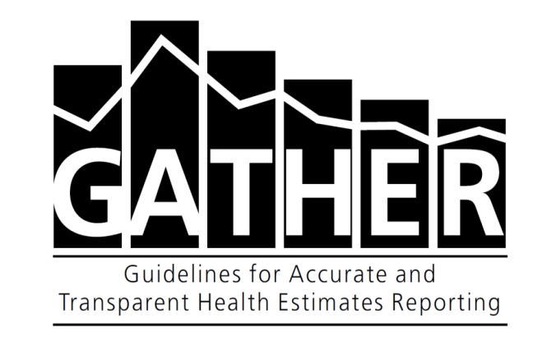
Guidelines for Accurate and Transparent Health Estimates Reporting (GATHER)
Reporting guidelines for new estimates of health status and some health determinants (including substance use) published in Lancet and PLOS Medicine in June, 2016
Developed by a working group convened by WHO, including IHME and other partners, with extensive outreach and comment periods
Aim is to provide sufficient information for users to understand limitations & potentially reproduce analyses
Some reporting items will be challenging for producers of estimates:
  Existing datasets may not be documented in alignment with GATHER
  Open-access of input data, and access to computer code are both required; these imply additional reporting burden when publishing estimates
  Quantification of uncertainty is required: this is an active area of research

Slide 12
Interagency collaborations
on global health estimates
Child mortality: Interagency Group on Child Mortality Estimates (IGME) – UNICEF (lead), WHO, UN Pop Division, World Bank, UNFPA
Maternal mortality: WHO, with same UN agencies
Immunization, nutrition: WHO and UNICEF
Water and Sanitation: Joint Monitoring Programme (JMP) (WHO and UNICEF)
HIV/AIDS: UNAIDS with co-sponsors, also WHO, UNPD
TB, malaria, several NCD risk factors, injuries: WHO main lead
Cancers: IARC with HQ

Slide 13
WHO Expert involvement models
No expert group but individual expert engagement, internal work (NCD, injuries, hepatitis, etc)
Expert group, consultants do the work (UN-IGME, MMR)
Expert group, external institution does the work (UNAIDS Ref group)
Expert group, external institute(s) in lead (CHERG then MCEE)
Interaction with IHME: other model?
WHO/UN has full access to inputs and methods and is involved in analytic decisions

Slide 14
Country consultation on estimates
Put into place in 2001 in WHA resolution following the World Health Report 2000
Estimates, with methods and input data, are sent (web) for consultation to country focal points: 3-4 weeks minimum (6 weeks preferred)
Consultation, NOT clearance
Usually leads to 30-50 countries responding: new data, questions, arguments etc. This year considerably more interest from countries
Some major challenges: MDG, but also when the data presented become too granular by age, sex and cause (e.g. child homicide)
Continuous discussion on difference between WHO best estimate and country reported / best estimate
Estimates are only changed if reliable new data provided
WHO does not change a number because of political pressure

Slide 15
SDG 3: Ensure healthy lives and promote well-being for all at all ages
Sustainable Development Goal 3 and its targets
Target 3.8: Achieve universal health coverage, including financial risk protection,
access to quality essential health-care services, medicines and vaccines for all
3.1: Reduce maternal mortality
3.2: End preventable newborn and child deaths
3.3: End the epidemics of AIDS, TB, malaria and NTD
and combat hepatitis, waterborne and other communicable diseases
3.7: Ensure universal access to sexual and reproductive health-care services
3.4: Reduce mortality from NCD and promote mental health
3.5: Strengthen prevention and treatment of substance abuse
3.6: Halve global deaths and injuries from road traffic accidents
3.9: Reduce deaths and illnesses from hazardous chemicals and air, water and soil pollution and contamination
3.a: Strengthen implementation of framework convention on tobacco control
3.b: Provide access to medicines and vaccines for all, support R&D of vaccines and medicines for all
3.c: Increase health financing and health workforce in developing countries
3.d: Strengthen capacity for early warning, risk reduction and management of health risks
MDG unfinished and expanded agenda
New SDG 3 targets
SDG3 means of Implementation targets
Health targets in other goals: water and sanitation, disasters, air pollution, violence and homicide, conflict.
Interactions with economic, other social and environmental SDGs and SDG 17 on means of implementation

Slide 16


Reporting on the health SDGs
– still largely uncharted territory
IHME
Countries
WHO
Other agencies
Notes:
Ken's method does not capture the HIV / AIDS epidemic as most recent data point is after the HIV / AIDS epidemic (peak). For estimates 2007.5 and 2008.5, estimates will differ significantly (by more than 5%) for 16 of the 17 countries (Cameroon sees no difference) when Ken's method is compared to WHO method for each of the Spline and Loess Regressions. As Ken's method doesn’t capture full information (e.g. South Africa) and assumes HIV-free q5 constant after most recent data point, and as estimates differ between WHO method and Ken's, then we suggest WHO method.

Slide 17
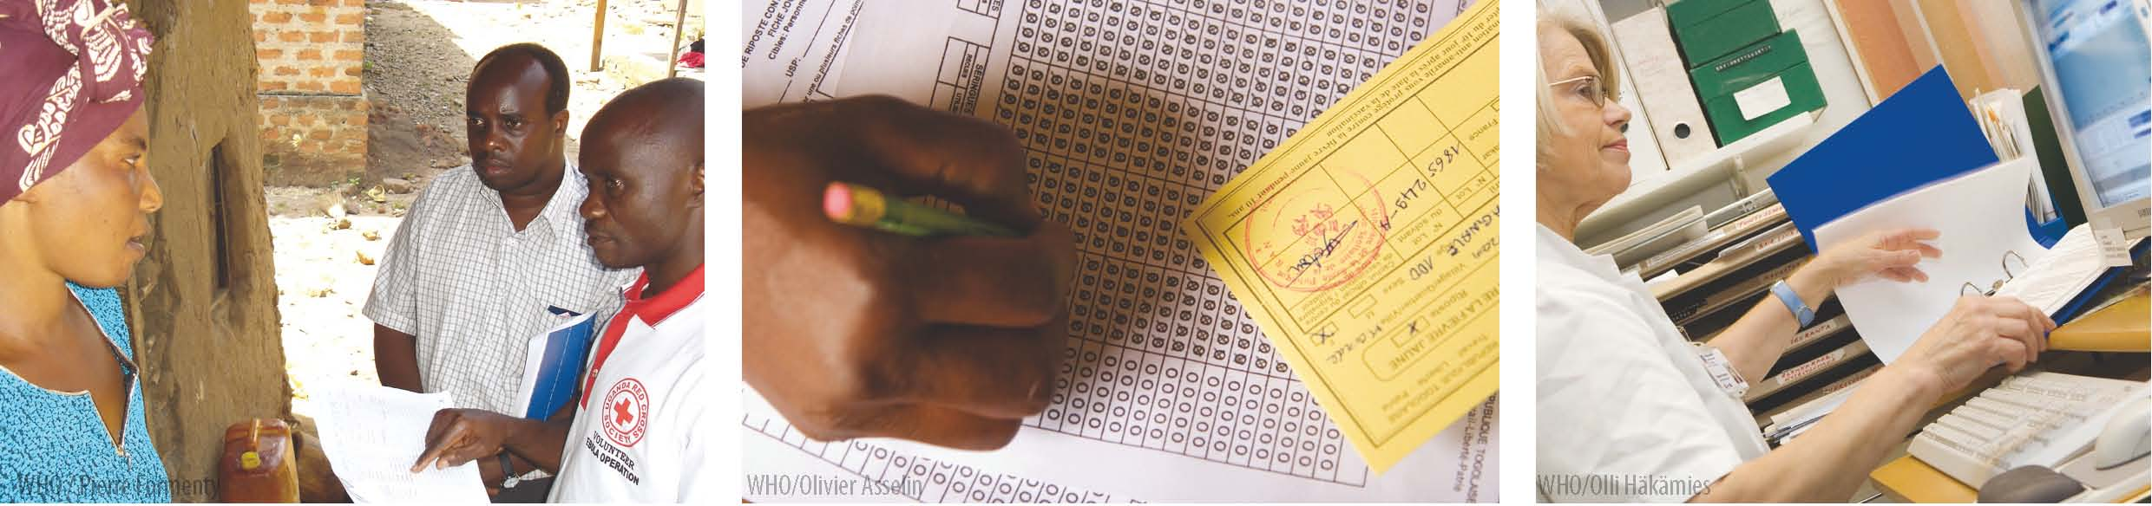
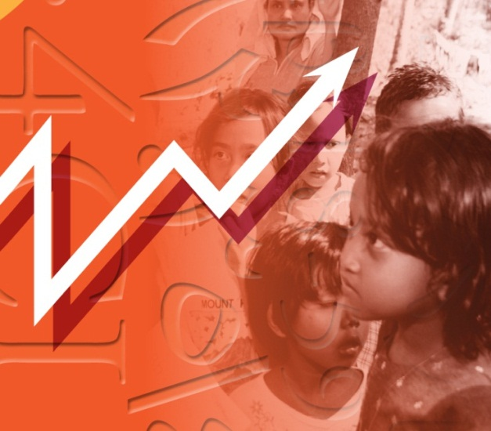
Global Health Observatory
Monitoring the global health situation and trends
www.who.int/gho/

