Slide 1
GATHER reporting guidelines
Harry Campbell
University of Edinburgh
Harry.Campbell@ed.ac.uk

Slide 2
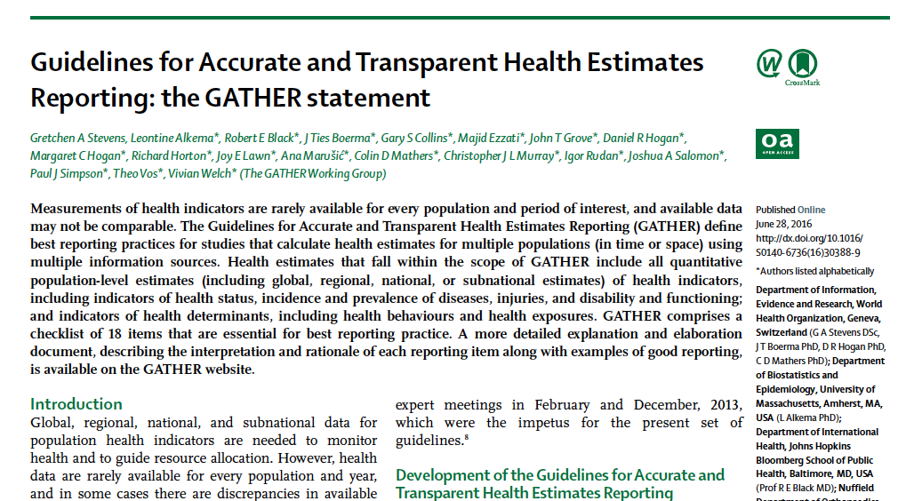

Slide 3
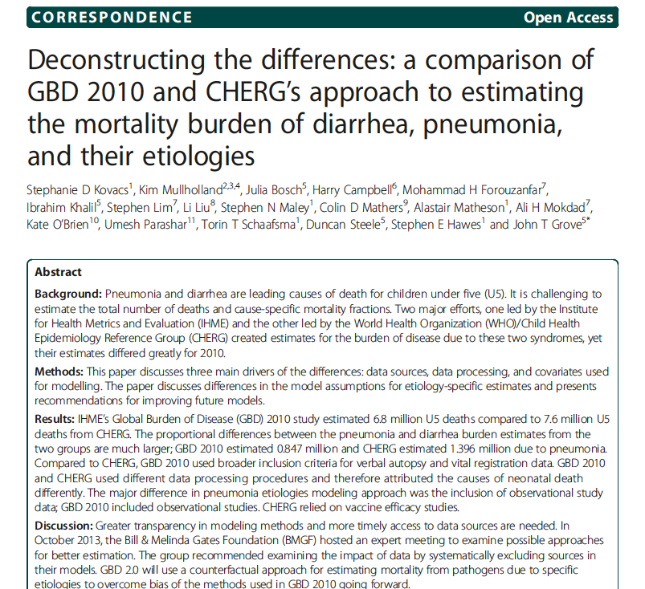
Guidelines for Accurate and Transparent Health Estimates Reporting: the GATHER statement

Slide 4
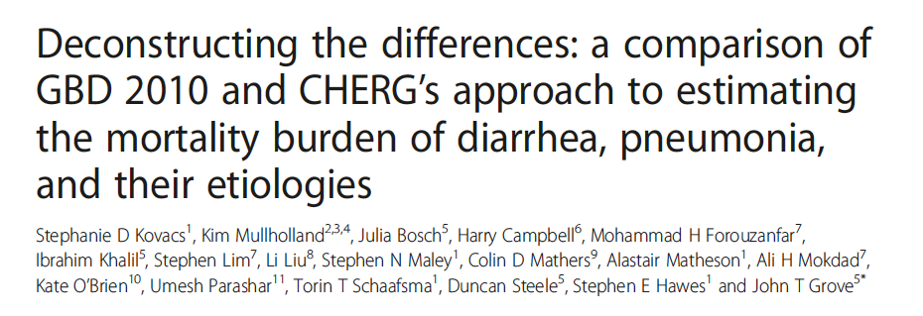
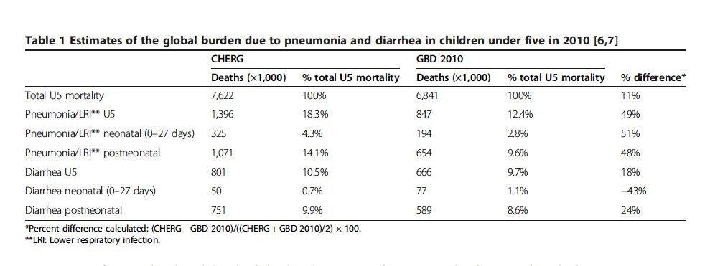

Slide 5
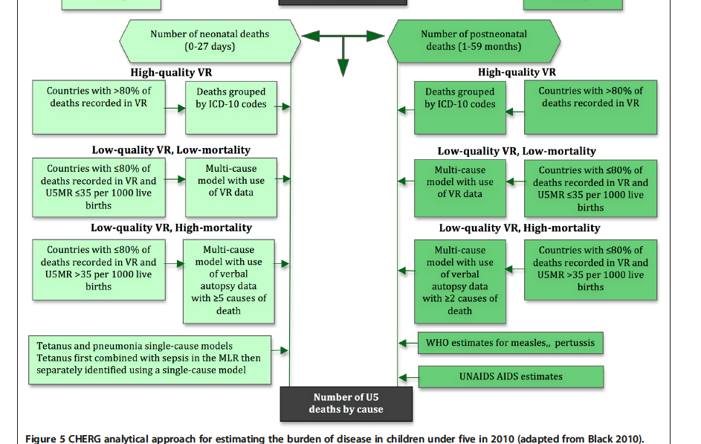

Slide 6
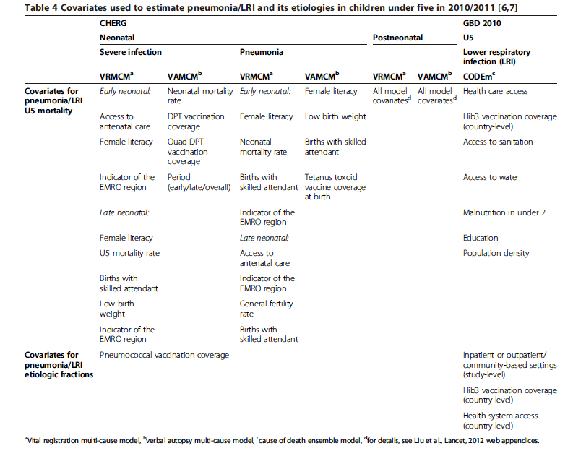

Slide 7
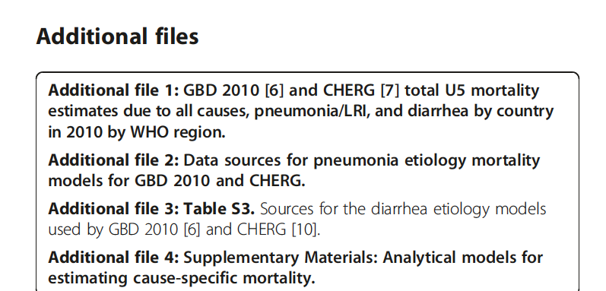

Slide 9
Guidelines for Accurate and Transparent Health Estimates Reporting: the GATHER statement
Published 28 June 2016
Target audience – decision makers; researchers
Defines best reporting practices for studies gathering data from multiple populations (in time or space) using multiple information systems
Applies to all quantitative population-level estimates of heath indicators and indicators of health determinants
  for studies that synthesise information from multiple sources

Slide 10
Guidelines for Accurate and Transparent Health Estimates Reporting: the GATHER statement
GATHER Working Group to define and promote good practice in reporting of global health estimates
Generated list of possible reporting items
118 responses to survey on this list
Consensus meeting to develop guidelines
Further consultation with LMIC (130 country focal points for WHO mortality estimates)

Slide 11
Guidelines for Accurate and Transparent Health Estimates Reporting: the GATHER statement
Objectives and Funding
Define the populations, health indicators and time periods in the estimate
State the sources of funding

Slide 12
Guidelines for Accurate and Transparent Health Estimates Reporting: the GATHER statement
Data Inputs (that are used in the estimate)
3. Describe how data identified and accessed
4. Specify inclusion and exclusion criteria (and all ad-hoc exclusions)
5. Details of data sources and main characteristics
  Contact points, populations, data collection methods, years of data collection, age and sex range, diagnostic criteria, measurement method, sample size
6. Identify categories of data with biases

Slide 13
Guidelines for Accurate and Transparent Health Estimates Reporting: the GATHER statement
Data Inputs (that are not generated in the study)
7. Describe and give sources of other data
For all data
8. Provide all data/ meta-data in an extractable file format (or give details of group holding the rights to the data)

Slide 14
Guidelines for Accurate and Transparent Health Estimates Reporting: the GATHER statement
Data analysis
9. Provide conceptual overview of the analysis
10. Provide detailed description of all steps in data analysis
  Cleaning, pre-processing, adjustments, weightings, models
Describe how models evaluated and final model selected
Provide evaluation of model performance, including any sensitivity analysis
Describe sources of uncertainty and methods for calculating uncertainty intervals
Describe how source code for analyses can be accessed

Slide 15
Guidelines for Accurate and Transparent Health Estimates Reporting: the GATHER statement
Results and Discussion
15. Provide published results in an extractable file format
16. Report uncertainty intervals
17. Interpret results in the light of previous estimates and explain reasons for changes
18. Discuss limitations of the estimate, including data limitations and model assumptions

Slide 16
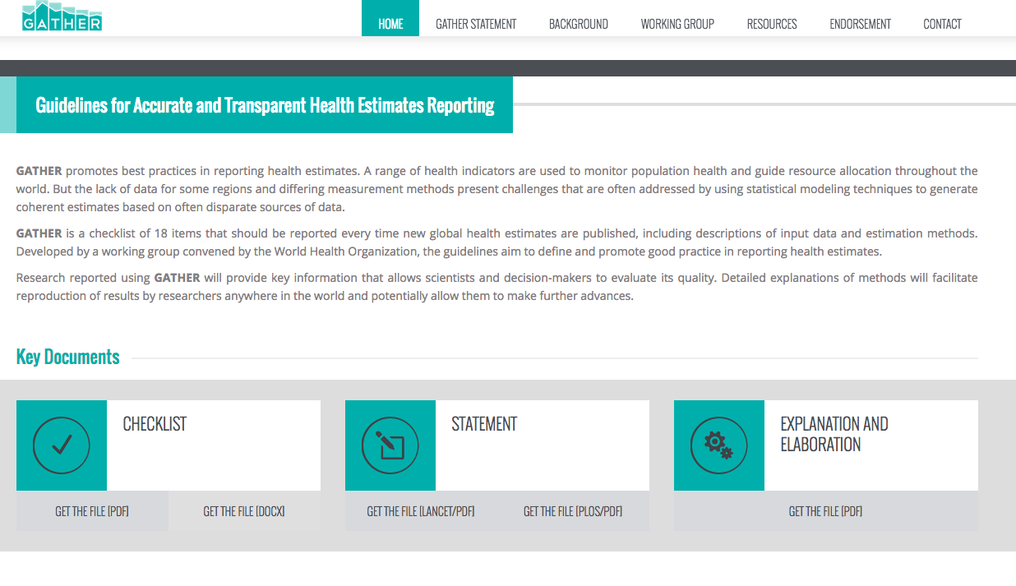
www.gather-statement.org

Slide 17
Guidelines for Accurate and Transparent Health Estimates Reporting: the GATHER statement
GATHER website [www.gather-statement.org]
Electronic version of 18 item checklist
  Minimum essential reporting items
More detailed explanation of requirements for reporting
Examples of good reporting
Authors expected to make use of online appendices to provide full details and data

Slide 18
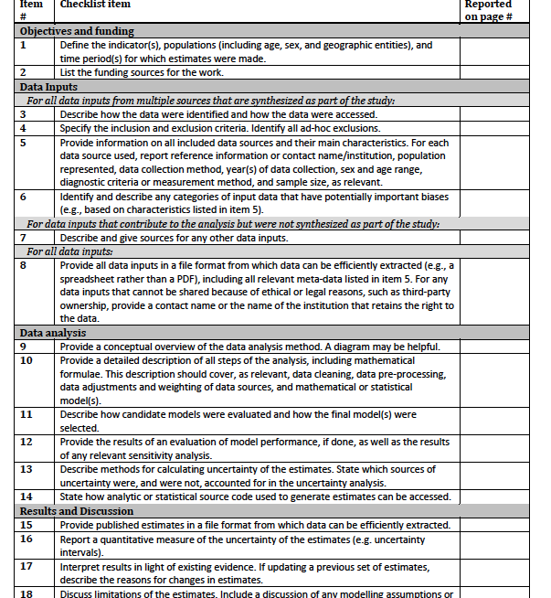

Slide 19
Guidelines for Accurate and Transparent Health Estimates Reporting: the GATHER statement
GATHER future implications
Data and code (at least key elements) to be made available online
No requirement at present to give user support
Hope that future funding of GBD studies will incorporate funding to cover this as part of study dissemination
Anticipated that leading journals will require adherence to GATHER principles as prerequisite publication

