Slide 1
Comparing the Burden of Disease across the Nordic countries
Vegard Skirbekk
Norwegian Institute of Public Health, Columbia University

Slide 2
Structure
Motivation
Risks
Diseases
Death
Discussion

Slide 3
Motivation
Jointly analysing the burden of disease across Nordic countries meaningful?
Similarities in terms of social structures, health service coverage/quality, population genetics, geography can increase validity of comparisons
Data quality generally among world’s best
Variation in policy and health related behavioural variation may be investigated

Slide 4
Why study the Nordic nations?
Global health research disproportionally influenced by findings from the Nordic countries – important to understand their relative health situation
Nordic countries are economically and socially closely integrated; and are often thought to have similar health –yet, substantial social differences, culture, variation in health policies, health service provision, health service uptake – which may imply unequal outcomes.

Slide 5
Nordic life expectancy falling behind
Notes:
Life expectancy is higher for men (the position for Norwegian men is 13 and for women 13; Swedish men 4 and women 8; Icelandic men 2 and women 8; Danish men 22 and women 29).
Yet, Finnish men perform relatively poorly, with mortality being place 27 for males and 11 for women for the year 2015.
Mortality among the Nordic nations relatively higher among certain age groups
Mortality above age 65 in Sweden substantial, partly following high levels of cardiovascular disease mortality

Slide 6
Longevity differences generally lower – rank-ordering matters less over time
Although the Nordic countries are no longer leading in life expectancy, it is important to understand that a given rank-ordering matters less for actual life expectancy than before.
E.g., from 1950 to 2010, the difference in female life expectancy between less and more developed nations (United Nations definition) fell from 25.1 years in 1950 to 11.6 years by 2010, in a period where global life expectancy rose by more than 23 years to 71 years.
While 3.8 years separated top 10 countries in terms of both sex life expectancy in 1950-55, the variation fell to less than half - only 1.8 years - in 2010-2015; while the differences between rank order 1 and 100 also fell to less than half – from 21.9 to 10.1 years.

Slide 7
Risk factors

Slide 8
Possible causes of lost lead?
Activity levels, smoking, diet, drinking?
Health policies?
Frail cohorts surviving?
Denmark: Liberal smoking and alcohol regulation; relatively modest taxation?
Norway: Drug use high, self-harm important?
Nordic mortality relatively high at young adult ages and at older ages (more important)

Slide 9
GBD estimates - risk factors

Slide 10
Risk factors in Nordic nations

Slide 11
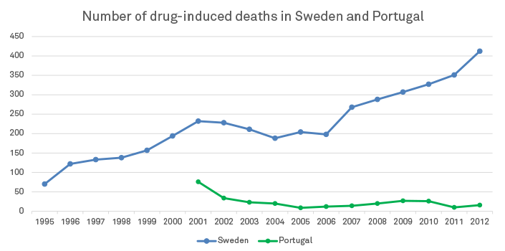
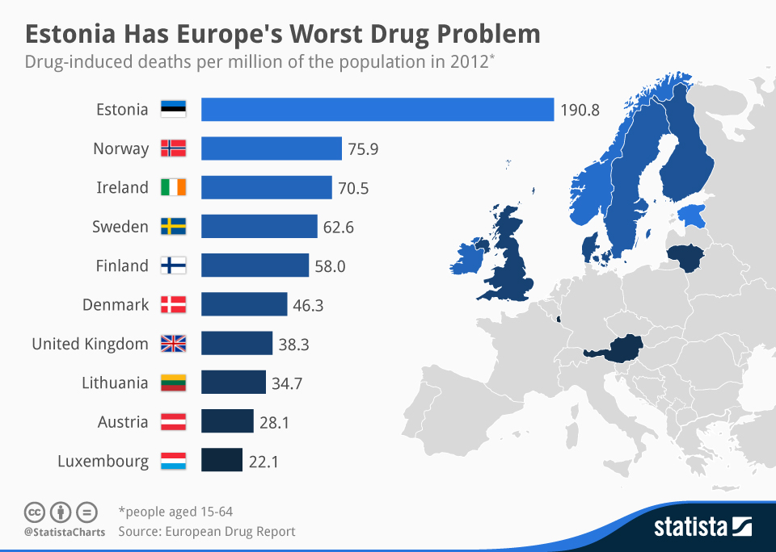
Drug use becoming Nordic problem?

Slide 12
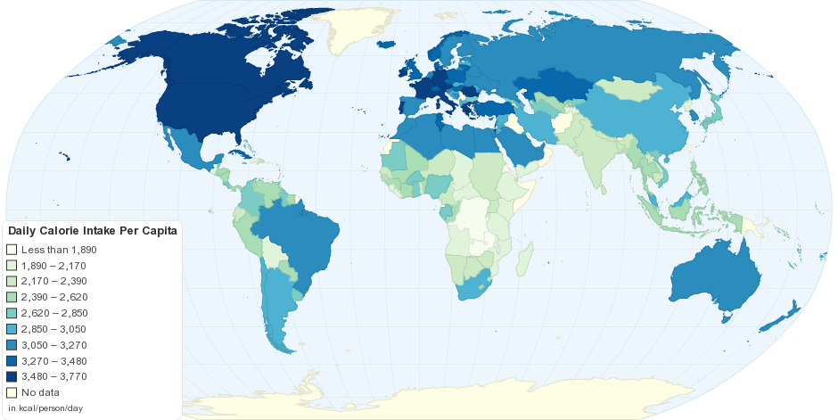
Kcal per capita, source: FAO 2010

Slide 14
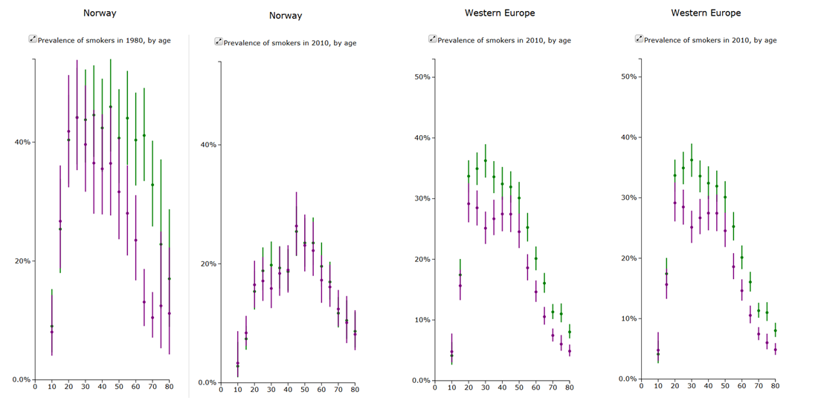
Smoking by age & sex, Norway vs Western Europe 2013

Slide 15
Diseases

Slide 16
GBD estimates – DALYs

Slide 17
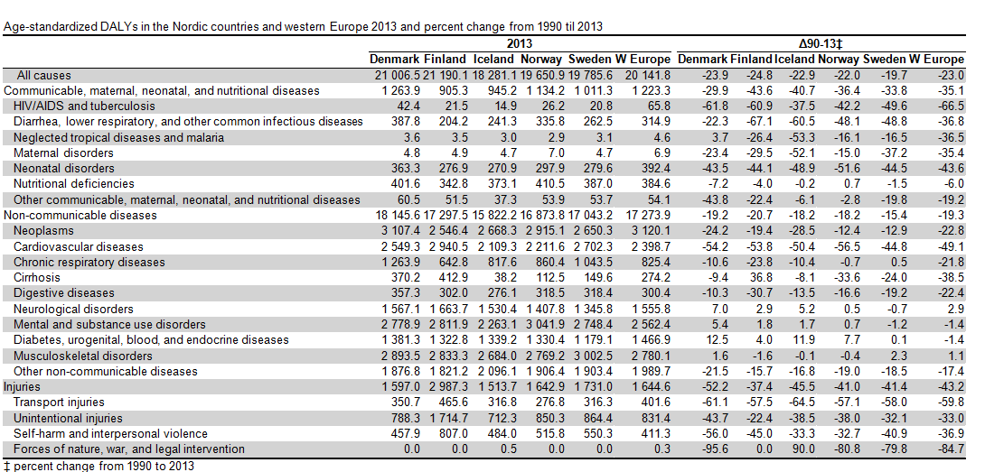

Slide 18
Cause of death

Slide 19
Cause of death, men

Slide 20
Cause of death, men

Slide 21
Cause of death, Women

Slide 22
Cause of death, Women

Slide 23
Conclusion
Several important topics could benefit from being jointly analyzed:
i) Nordic longevity has been improving slower than other Western European nations, even in a period when the region became one of the richest and best educated in the world
ii) health levels have fallen behind others in spite of a generous, universal and high quality health and social security system [1, 2],
iii) there is comparatively high mortality among young adult men and older individuals of both sexes in the Nordic region,
iv) there has been a lack of a synthesis of most available disease and mortality data, which through the global burden of disease project is now possible,
v) there are highly divergent health policies and health risk behaviors across the Nordic countries that should be analyzed,
vi) Nordic health registries and health information is among the best in the world, and information from Nordic health registries is of great importance to understand health also in many other regions of the world [3].
The Nordic nations need to learn from each other as much as from other countries in order to maximize health

