Slide 1
Burden of Disease: Methodological Workshop 15th and 16th September Royal Society of Edinburgh, Scotland
Burden of Disease and the Netherlands
Henk Hilderink

Slide 2
Public Health Status and Foresight study
Overview of public health and health care in the Netherlands
Every four years, 6th edition published in 2014
Input for National Public Health Policy Statement (MoH)
Notes:
PHSF = one of the topprojects of the RIVM (booklet with these topprojects, and on the website: www.rivm.nl/topprojects
Overview:
integration of available information on health, prevention, health care
Trend scenario:
‘business as usual’.
Extrapolate current societal developments, assuming no new policy measures
Four perspectives
Explore the future by reflecting on four perspectives on public health
Future scenarios to give room different views on health in the future
Confronting the different scenarios: options and opportunities

Slide 3
From present to future
Scenarios
Desirable
futures
B
Present
C
forecast
Likely
future
Possible
futures
A
D
Scenarios
Present
Future

Slide 4
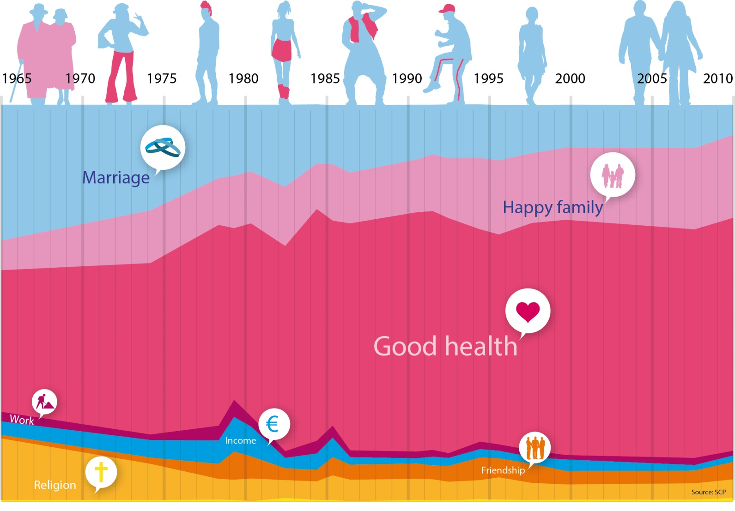
Health: most important in life
Notes:
For most people, health is most important in life.
But what people mean by health differs between people
People have different perspectives on health, and what about health they value most
We built four future scenarios on four different perspectives on health
In this workshop we share our experience with working with scenarios
And discuss the usefulness of the scenarios for policy making at national and European level.

Slide 5
Scenario approach
Cognitive uncertainties (“what are we facing”)
Limited knowledge, i.e. economic growth, technological progress, climate change
Normative uncertainties (“what we want”)
Deviating ideas what people want or what people value most
Approach:
One trend scenario or Business-as-usual, current trends continue-no new policies
Four perspectives on (future) health

Slide 6
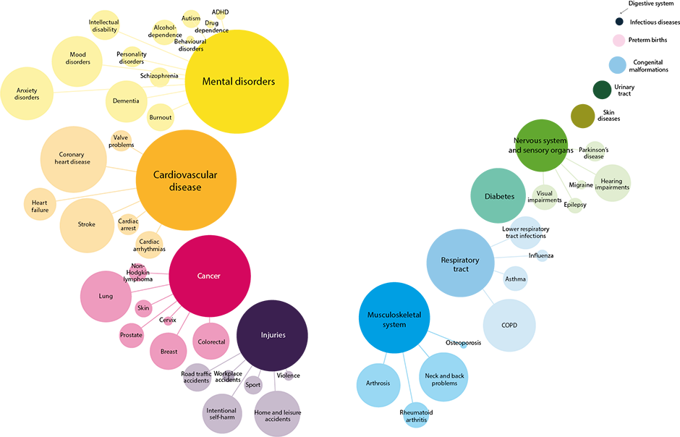
Highest disease burden due to mental disorders, cardiovascular diseases and cancer

Slide 7
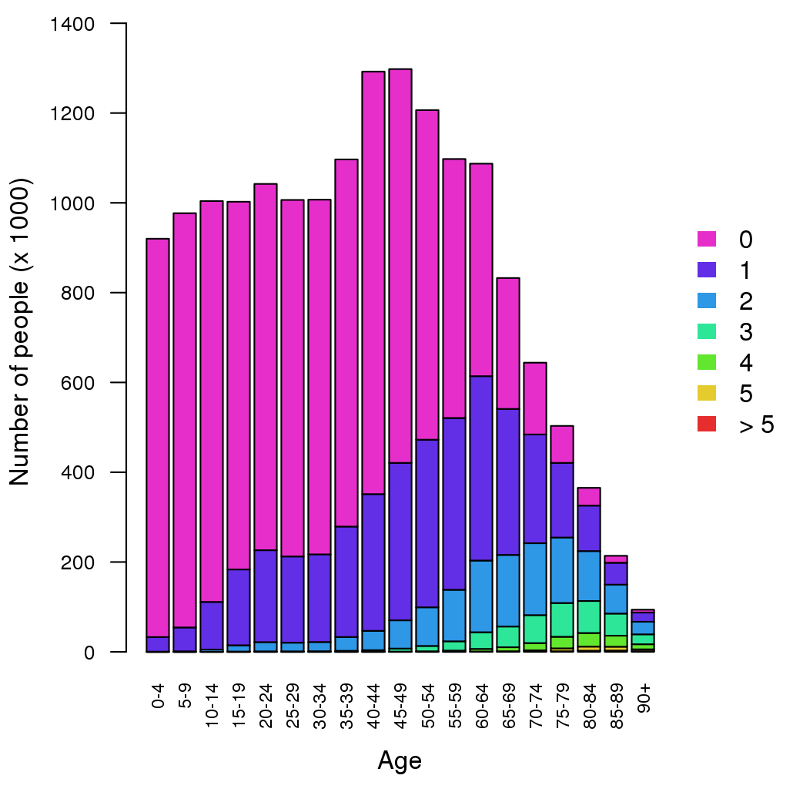
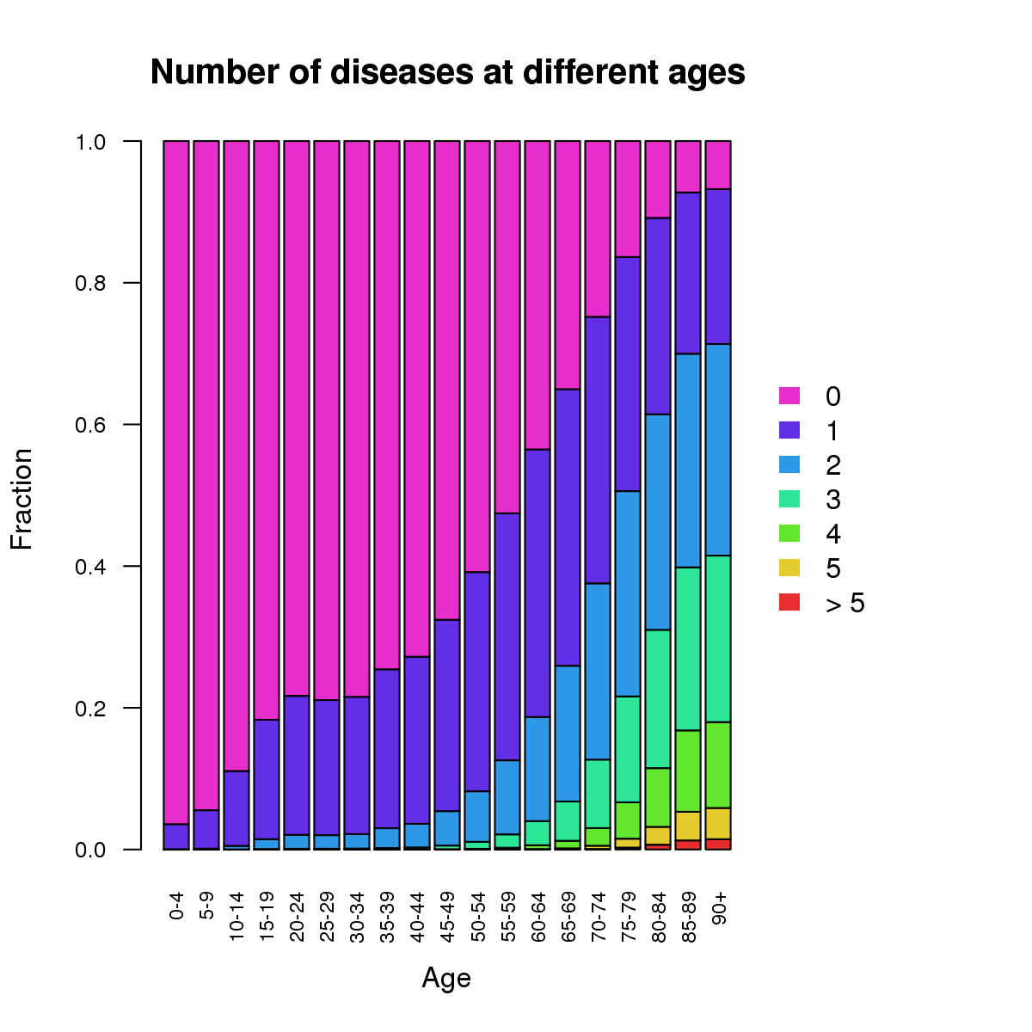
Multimorbidity should be accounted for…

Slide 8
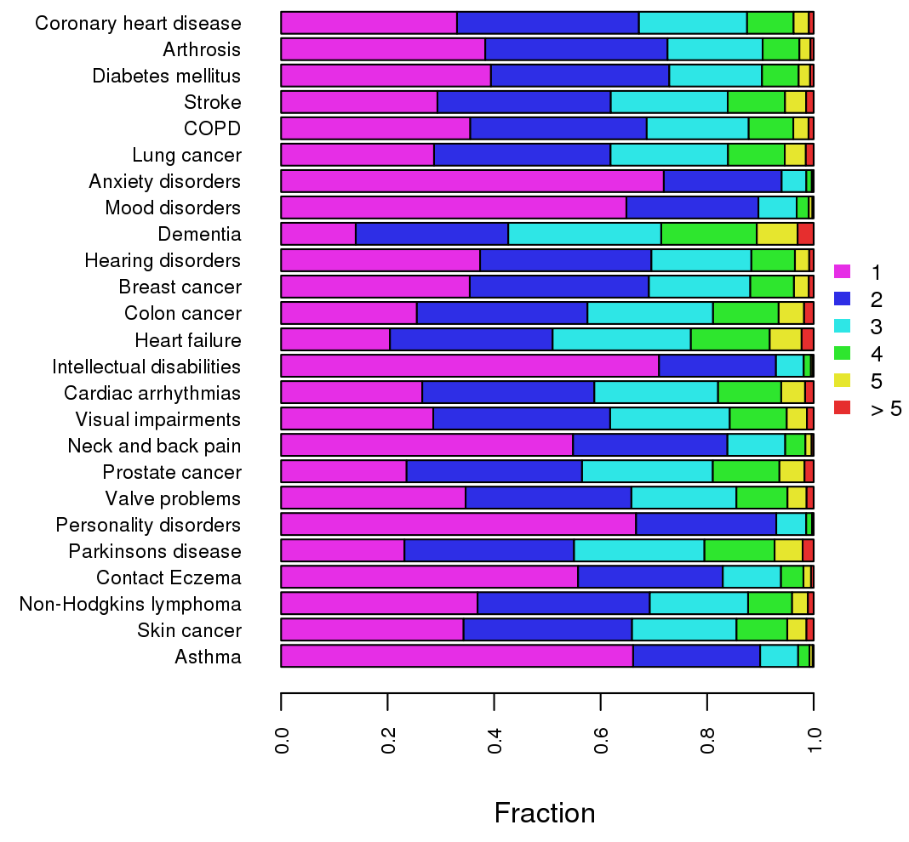
Distribution of number of diseases, by disease
Method C: Sex-age-specific

Slide 9
Life style and social/physical environmental
Smoking responsible for 13% of the disease burden
Followed by overweight, inactivity and food consumption
Trends: smoking declines, other risks stable
Workplace-related 5%
Physical environment 5%

Slide 10
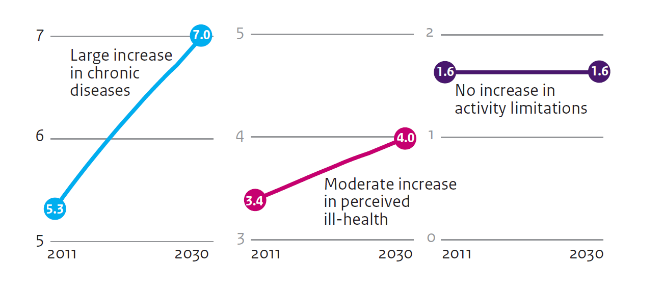
Continued increase in chronic diseases
No effect on health and participation
Notes:
Large increase of people with a chronic disease (5 million, 32% to 7 million, 40% of the Dutch population)
Ageing of the population
Early detection
Increased survival
Changing norms
Moderate increase in ill health
Only ageing
Stable age specific rates of perceived ill health
No increase in activity limitations
Despite ageing of the population
Declining rates in specific age groups
Effects of the increase in the number of chronically ill do not translate in reduced health.
And also not in reduced abilities to participate. Activity limitations and perceived health are important for participation. A chronic disease only if combined with activity limitations or less self-rated health.

Slide 11
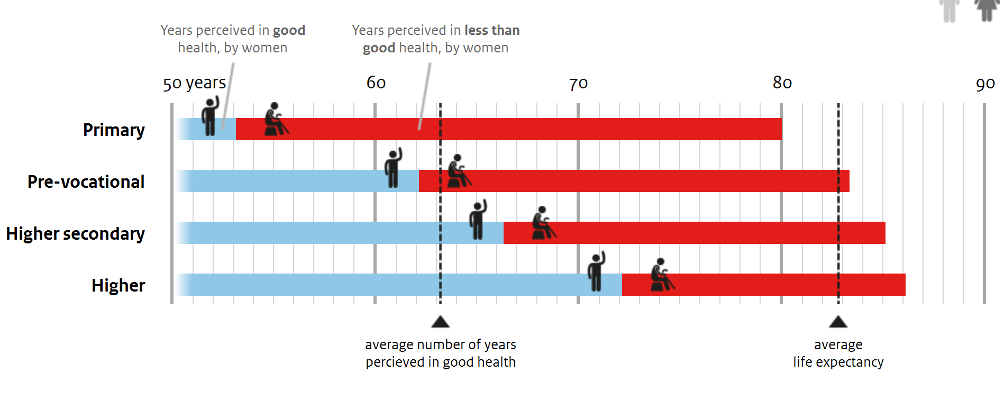
Socio-economic differences big
19 years
6 years

Slide 12
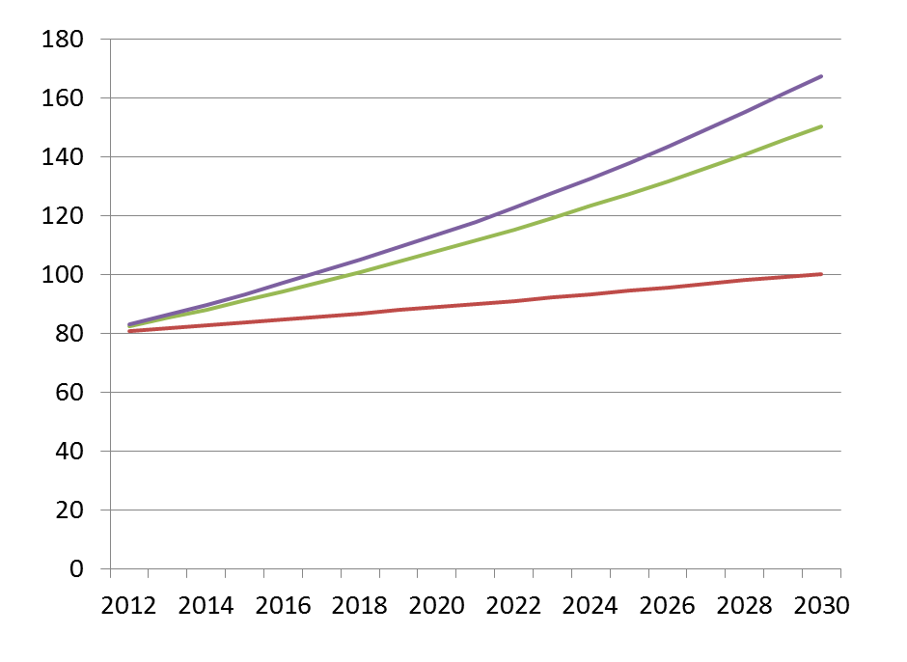
Health care expenditures on the rise …
19-21%
of GDP
… but
highly
uncertain
at what
pace
15%
of GDP

Slide 13
Use of Bod in projections and scenarios
Methodological challenges
Simulation models to project the future?
Changes in diseases (early diagnosis, prevalence registration)
Multimorbidity
Primary cause of death at ages 85+
Life table choices
Overall challenges
Communication
Answer to which question?
Changing perception of disease / health

