Slide 1
To what extent can the burden of disease in Scotland be explained by modifiable risk factors?
A comparative risk assessment approach using health record linkage
Thursday 15th September 2016
Elaine Tod, NHS Health Scotland

Slide 2
Objectives
Comparative risk assessment approach
Background to Global Burden of Disease (GBD) risk factor work
Current GBD methodology
The National Burden of Disease, Injuries & Risk Factors Study for Scotland
Stroke pilot study
  Methodology
  Results from the stroke pilot
  Strengths & limitations
Planned work

Slide 3

The Comparative risk assessment (CRA)
“the systematic evaluation of the changes in population health which result from modifying the population distribution of exposure to a risk factor or a group of risk factors.”
Source: Ezzati, M. Annex 4.1: Comparative Risk Assessment in the Global Burden of Disease Study and the Environmental Health Risks
Image source: http://piperreport.com/blog/2012/11/04/price-transparency-guidelines-for-healthcarepurchasers/
The CRA an be a useful tool for decision-makers when setting priorities, particularly when the question we are asking is “how much good can we do with the resources we have?” or “what proportion of a specific health outcome is explained by a key risk factor or group of risk factors

Slide 4

Background to Global Burden of Disease risk factor work
World Bank commissioned first GBD study in 1992 reporting results for 10 risk factors globally and for 8 broad regions.
Several methodological advances since then for the
risk factor work
Main advances
  Ability to analyse risk factors
  as continuous covariates rather
  than simply dichotomous
  Calculation of PAFs at country level
  Evolving ways of defining
  minimum risk

Slide 5
IHME methodology
Key metric: Population Attributable Fraction
“the proportional reduction in population disease or mortality that would occur if exposure to a risk factor were reduced to an alternative ideal exposure scenario (e.g. no tobacco use)”
World Health Organization
www.who.int/healthinfo/global_burden_disease/metrics_paf/en/
Methods evolved with each iteration
Data on exposure prevalence
  Synthesised using a Bayesian meta-regression method, DisMod-MR or spatial-temporal Gaussian process regression
Relative risks
  Based on meta-regressions of published cohort studies and intervention studies
Evidence of appropriate counterfactual risk level or distribution
  Based on systematic reviews of the literature
Data became available at Scotland level for the first time in the 2015 GBD update

Slide 6
The National Burden of Disease, Injuries & Risk Factors study in Scotland

Slide 7
Overarching aim
To explore the possibility of using Scottish survey data on exposure prevalence linked to routine administrative data on hospitalisations and mortality as a means of carrying out the comparative risk assessment element of the national burden of disease study

Slide 8
Stroke pilot study aim
To what extent can the burden of stroke in Scotland be explained by modifiable risk factors?

Slide 9
Stroke pilot study methodology

Slide 10
Study design & population
The study utilised pooled cohort data created through follow up for health outcomes (hospital admissions and death records) of 8 waves of the Scottish Health Survey (SHeS).
The Scottish Health Survey is intended to provide a comprehensive picture of the health of the population living in private households.
Between 85.6% and 92.8% of SHeS respondents agreed to their survey data being linked to routine hospital admission data for all eight waves between 1995 and 2012.
In total 49,451 adults who consented to linkage were technically able to be followed up using their Community Health Index (CHI) identifier.
Adult age ranges from 16-64 years in 1995, 16-74 years in 1998 and 16 years+ from 2003 onwards.

Slide 11
Total population years at risk contributed by each SHeS survey wave between 1995 and 2012

Slide 12
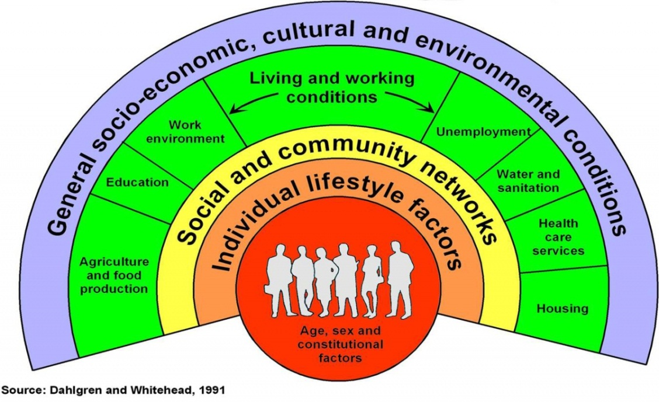
Exposure data
Interested in the contribution of modifiable risk factors in explaining stroke incidence in Scotland
A literature review to identify important risk factors for stroke and consulted a panel of stroke experts.
Risk factors were organised hierarchically according to the layers of the Dahlgren & Whitehead model.

Slide 13
Identifying risk factors for stroke

Slide 14
Selecting risk factors for this study

Slide 15
Stroke outcome data
Three data sources were considered for linkage to the SHeS
  The Scottish Stroke Care Audit
  The Scottish Morbidity Record (SMR01)
  NRS Death records

Slide 16
Stroke outcome data
Stroke is defined by the World Health Organization as:
“rapidly developing clinical signs of focal (at times global) disturbance of cerebral function lasting more than 24 hours or leading to death with no apparent cause other than that of vascular origin”
Source:http://www.who.int/healthinfo/statistics/bod_cerebrovasculardiseasestroke.pdf
Stroke incidence was defined as either a first hospitalised admission for stroke in the primary diagnostic position on hospital discharge or a fatal event from stroke
10 year look back period
Self-reporting of a previous stroke

Slide 17
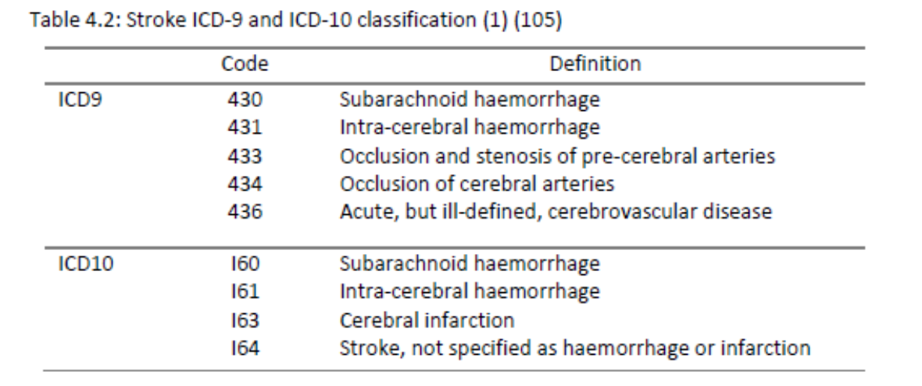
ICD coding was aligned with the national definition used in Scotland to report stroke mortality (includes ICD10 ‘I64’ and ICD9 ‘436)
Stroke outcome data

Slide 18
Method: Missing data
Types of missing data:
Potentially valid but missing (e.g. refused, don’t know)
Not valid and missing (e.g. question not applicable)
Question not included in survey wave
Less than half of the 49,451 survey respondents included in the baseline cohort had valid observations for all risk factor variables (n = 23,161).
With a decline in survey response levels and consent to linkage, it was important to explore any potential bias in the data that may impact on the generalisability of the data to Scotland.
Multiple Imputation via chained equations (MICE)
Sensitivity analysis: MICE versus complete-case analysis

Slide 19

Population Attributable Fraction
“the proportional reduction in population disease or mortality that would occur if exposure to a risk factor were reduced to an alternative ideal exposure scenario
(e.g. no tobacco use)”
World Health Organization
www.who.int/healthinfo/global_burden_disease/metrics_paf/en/
Concept introduced by Levin in 1953 in a study looking at the link between lung cancer and smoking.
Many variations on the formula to address limitations of Levin’s formula.
PAF
RR(x) – relative risk at each exposure level
P(x) – proportion of population at each exposure level
P’(x) – counterfactual proportion of population at each exposure level
M – maximum exposure level.

Slide 20
Population Attributable Fraction
The PAF requires two elements in its calculation:
  The prevalence of a risk factor in a defined population
  An estimate of the relative risk of the outcome in relation to the level of the exposure

Slide 21
(1) Estimating prevalence of each risk factor across the pooled SHeS cohort

Slide 22
(1) Estimating prevalence of each risk factor across the pooled SHeS cohort

Slide 23
(2) Estimating relative risk
Cohort study, used Cox-proportional hazards regression to examine the relationship between the time to stroke event and exposure to selected modifiable risk factors
Complicated by censoring and competing risks
We modelled the cause-specific hazard
Systematic approach to adjustment for confounding

Slide 24
Directed Acyclic Graphs

Slide 25
Johannes Textor, Juliane Hardt, Sven Knüppel.
DAGitty: A Graphical Tool for Analyzing Causal Diagrams.
Epidemiology, 5(22):745, 2011.
Accessed via: http://www.dagitty.net/

Slide 26
Theoretical Minimum Risk Level

Slide 27
Population Attributable Fractions and Disability Adjusted Life Years
Another key metric of burden of disease studies is the DALY
We calculated the number of DALY’s attributable to each risk factor as the product of the DALY for stroke and the PAF for the respective risk factor

Slide 28
Stroke study results

Slide 29
How did our stroke results compare with GBD 2013?
Risk factor | Population Attributable Fraction estimates
 | SBoD 1995-2012 | GBD 2013
High BMI | 19.2% (5.2 to 31.3) | 28.6 (24.0 to 33.6)
High SBP | 31.3% (21.1 to 40.1) | 52.5% (45.1 to 59.9)
High total cholesterol |  | 5.5% (2.6 to 11.0)
Smoking | 25.6% (17.9 to 32.6) | 16.4% (11.6 to 21.5)
Physical inactivity |  | 11.3% (7.7 to 15.1)
Low fruit/vegetable consumption |  | 25.8% (20.3 to 31.7)/ 27.4% (17.0 to 37.8)
Alcohol consumption |  | 7.4% (4.1 to 10.6)
Area deprivation (SIMD) | 34.9% (26.4 to 42.4%)
Area deprivation (Carstairs) | 23.5% (14.4 to 31.7)
Education | 38.8% (26.0 to 49.4)
Social class | 30.3 (19.4 to 39.8)

Slide 31
Strengths
Uses comprehensive routine datasets (SMR01 & NRS data) to create a large prospective study making causal inferences easier
The SHeS provides robust information on a range of behaviours and physiological risk factors associated with health outcomes as well as including socio-economic measures
Linked to administrative data on hospital admissions and deaths, providing a powerful resource for assessing the strength of causal relationships with stroke
The study has a transparent and replicable methodology
Use of Directed Acyclic Graphs (DAGs) to illustrate the consistent approach taken to confounder adjustment in all analyses and the transparency of causal assumptions
The study includes 95% confidence intervals around PAF and DALY estimates as a measure of the precision of estimates
Accounted for competing risks (important as ignoring competing risks can over-estimate the hazard ratios)

Slide 32
Weaknesses
Potential for responder and recording bias (problems in measuring income, employment, self-assessed alcohol consumption, physical activity and diet). Self-reporting bias is likely to underestimate the hazard of stroke in terms of alcohol consumption.
Pooling exposure data from 1995 to 2012 will mask any changes in the risk profile of the population over time.
Limitations in the utility of using area deprivation measures for identifying risk at the individual level (ecological fallacy)
The DAG approach forces you to be clear about the direction of causality e.g. alcohol consumption and deprivation.
The small number of stroke events recorded in the SHeS-SMR/NRS linked dataset may have meant that some analyses were insufficiently powered to detect real differences for some of the risk factors.
Unable to explore differing risk profiles for stroke subtypes

Slide 33
Scope of remaining work
Hospitalisations attributable to overweight and obesity.*
Calculating Population attributable fractions for a selected list of exposure-disease pairings as the data will reasonably allow.
Publish PAFs for key risk factors:
Socio-economic inequality
Obesity*
Alcohol
Smoking
Calculate attributable DALYs for all diseases combined
Progression of causal mediation analysis element of study

Slide 34
Towards a robust, replicable methodology
Validating the process for generating PAFs (single, joint, particularly when allowing flexibility to model different scenarios other than the TMRL.)
Practical tools (STATA? Excel?). How can we make these tools accessible and user-friendly?
Considering pathways in PAF analysis
What experiences have you had in calculating PAFs in your own work?
Collaboration on CRA methods

Slide 35
Thank you
Contact:
Elaine Tod
Public Health Information Manager
Public Health Observatory
NHS Health Scotland
Email: elaine.tod@nhs.net
Tel: 0141 414 2751

