Slide 1
WHO DALY calculations
Colin Mathers
Coordinator, Mortality and Health Analysis Unit
World Health Organization, Geneva
Burden of disease methodological workshop
Royal Society of Edinburgh, 15-16 September 2016

Slide 2
Standard loss function for YLL

Slide 3
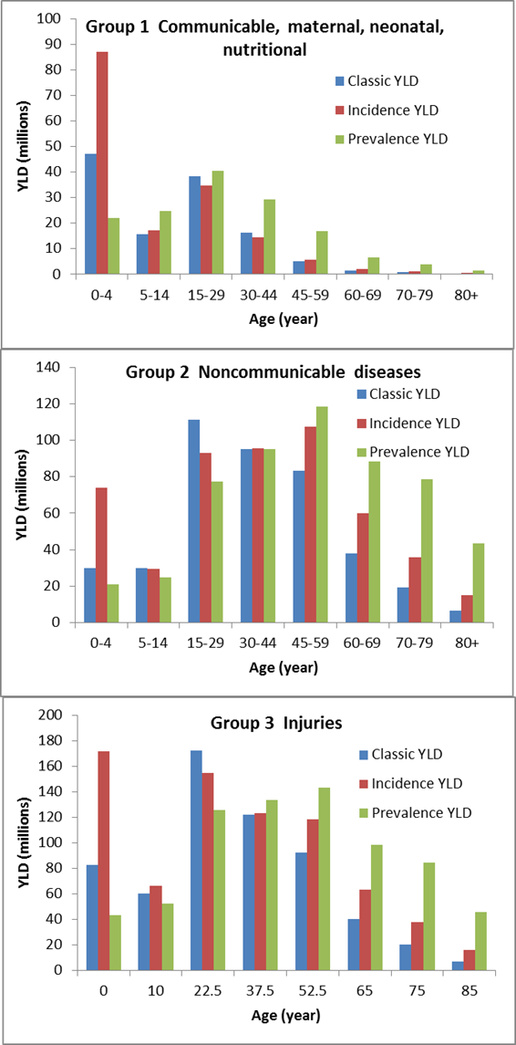


Slide 4
GBD2010 disability weights

Slide 5
GBD2010 disability weights
0.126 IQ<35

Slide 6
Problems with GBD 2010 disability weights
Amputation of both arms with treatment (0.044) less severe than amputation of one arm with treatment (0.13)
Urinary incontinence (0.142) more severe than “treated” paraplegia (0.047), which usually involves incontinence also
Complete hearing loss (0.033) of similar severity to mild anxiety disorder (0.030) or mild neck pain (0.040)
Mild intellectual disability, IQ 50-69 (0.031) of similar severity to viral warts (0.030)
Severe intellectual disability , IQ 20-34 (0.126) lower in severity than urinary incontinence (0.142)
Heroin dependence (0.64) more severe than cancer terminal phase (0.51)

Slide 7
WHO Revisions to Disability Weights
Dutch disability weights study (Stouthard et al 1997,200) gave EQ5D+ descriptions for health state sequelae
Expanded set of EQ5D+ descriptions for GBD2010 health states
Regression prediction model fitted to GBD2010 DW and EQ5D+ health states
Used to estimate revised DW for outlier DW for infertility, intellectual disability, hearing loss, vision loss, amputation, disfigurement
Masked DW used for drug and alcohol dependence states
GBD 2013 also revised many of these weights using revised lay descriptions in European surveys

