Slide 1
Musculoskeletal disorders in Norway
Jonas Minet Kinge
September 2016

Slide 2
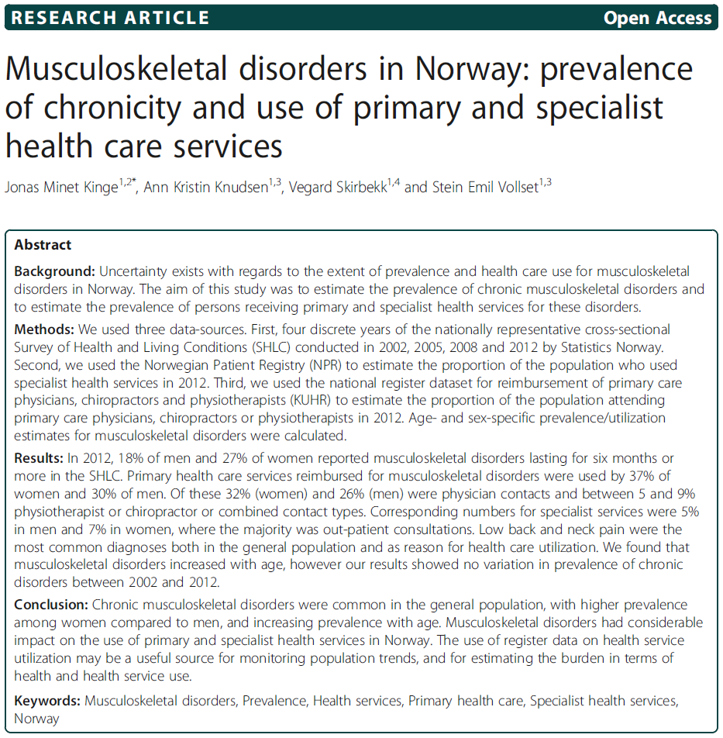

Slide 3
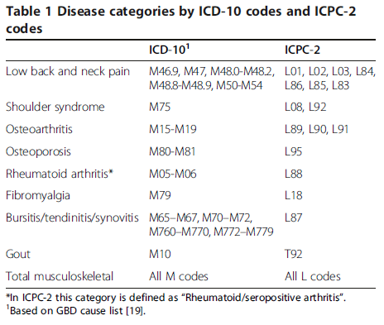
Disease categoreis

Slide 4
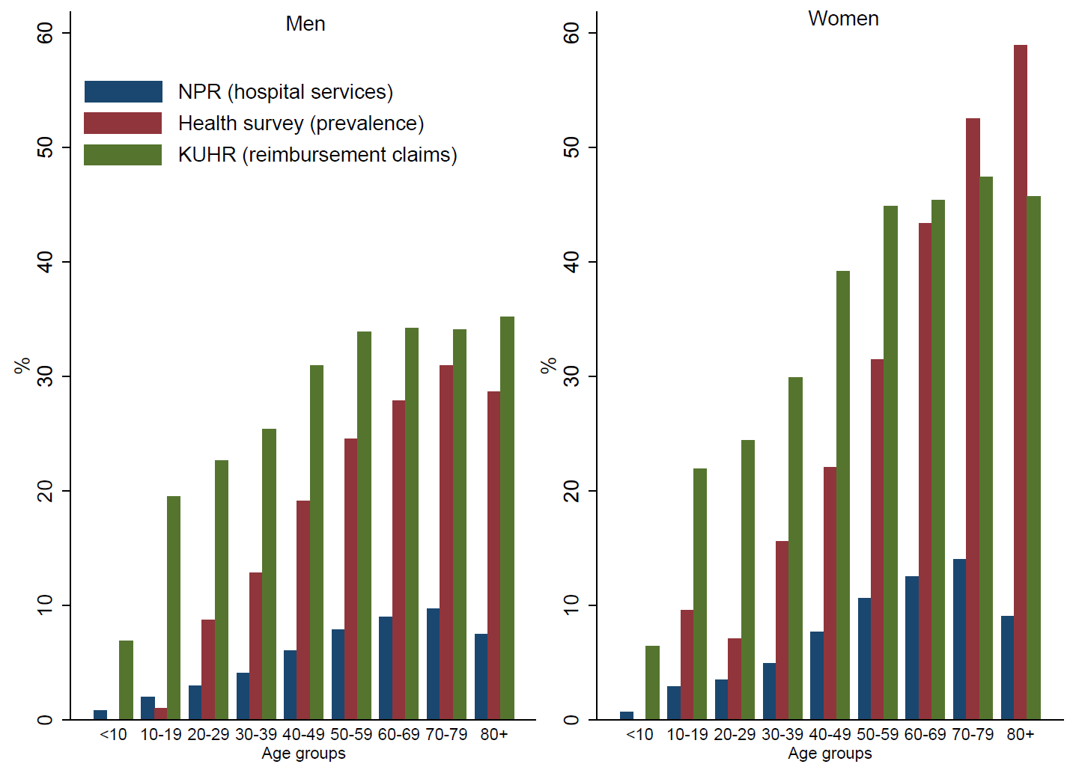

Slide 5
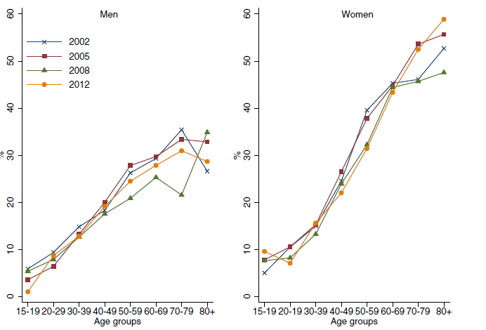

Slide 6
Public expenditures and burden of disease by medical conditions
Jonas Minet Kinge
September 2016

Slide 7
DALYs by ICD10 chapters in Norway 2013
GBD 2013 www.healthdata.org

Slide 8
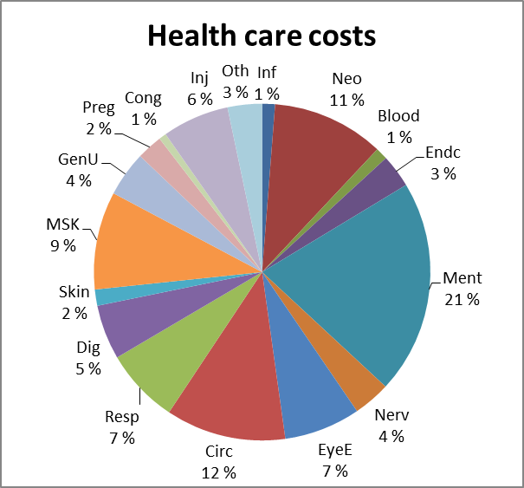
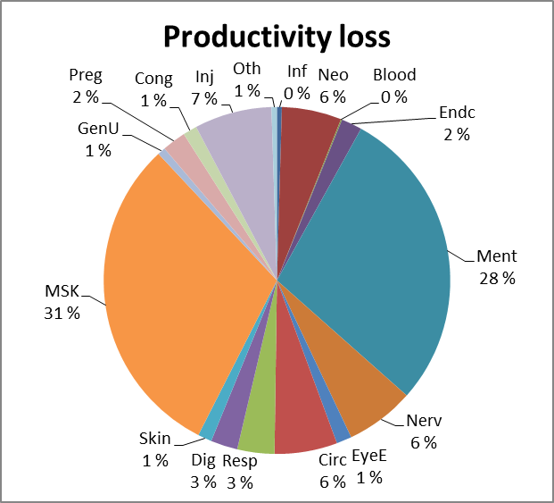
Health expenditures and productivity loss
Norwegian Directorate of Health, 2013

Slide 9
GBD 2013 www.healthdata.org

