Slide 1
Multimorbidity and Bod
A comparison of approaches
Henk Hilderink

Slide 2
Burden of Disease corrected for multimorbidity
In VTV2014 no correction for multimorbidity (implicit assumption of additive)
Partial analysis (prevalence of diseases and multimorbidity separately)
Objective: Improvement of BoD estimates
  Prevalence of Multimorbidity
  Severity of Multimorbidity

Slide 3
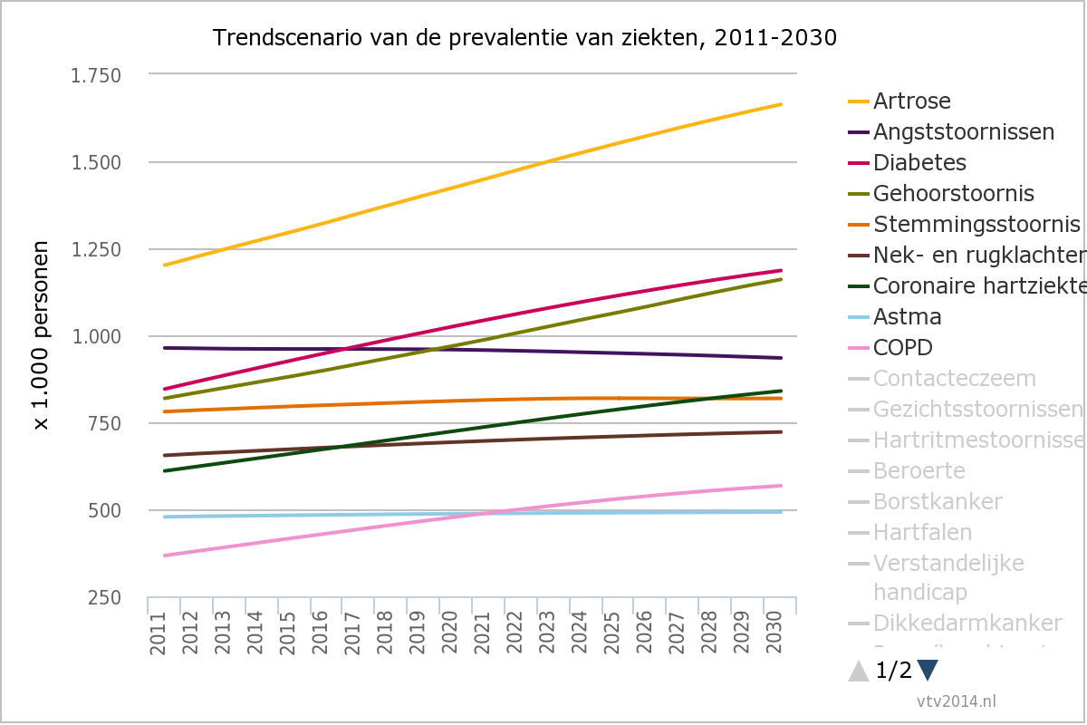
(Source: eengezondernederland.nl)

Slide 4
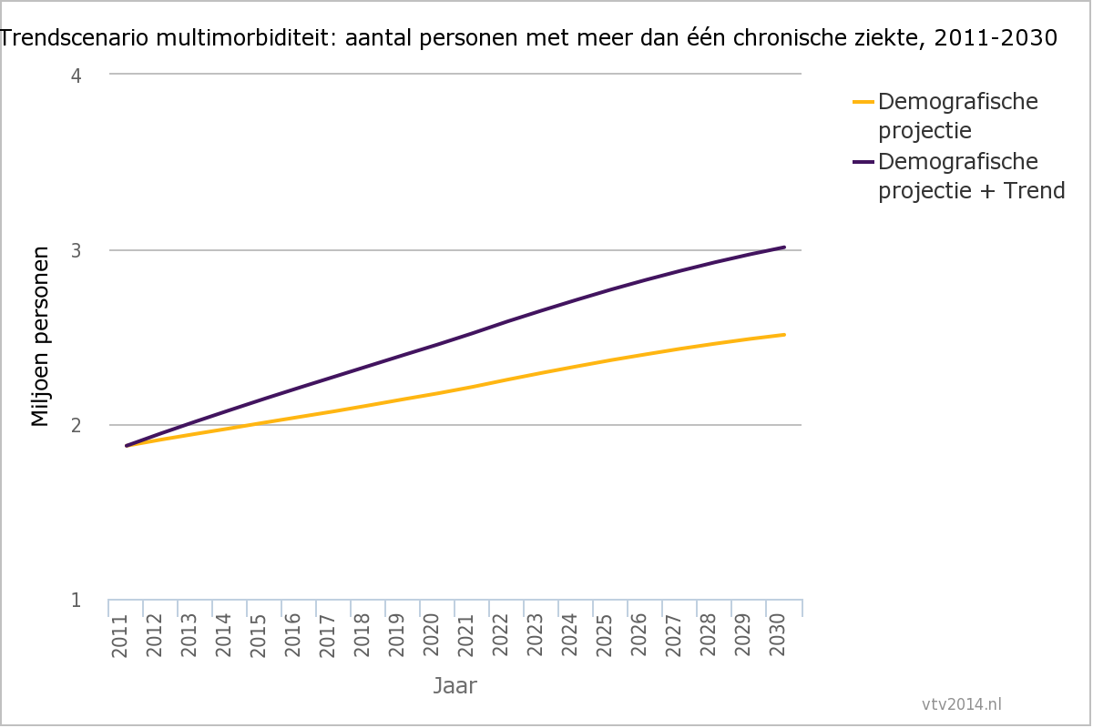
(Source: eengezondernederland.nl)

Slide 5
Approaches of prevalence and combined disability weights

Slide 6
Input data
 | Prevalence | DW | YLD | DALY
Arthrosis | 7.12% | 0.103 | 122,423 | 123,509
Anxiety disorders | 5.77% | 0.187 | 180,220 | 180,272
Diabetes mellitus | 5.00% | 0.198 | 165,150 | 194,312
Hearing disorders | 4.86% | 0.109 | 88,344 | 88,344
Mood disorders | 2.31% | 0.425 | 164,025 | 164,592
Neck and back pain | 3.91% | 0.236 | 153,930 | 154,499
Coronary heart disease | 3.62% | 0.288 | 174,090 | 282,834
Asthma | 2.86% | 0.080 | 38,192 | 39,244
COPD | 2.17% | 0.314 | 113,600 | 177,809
Contact Eczema | 1.94% | 0.070 | 22,720 | 22,720
Visual impairments | 1.81% | 0.137 | 41,348 | 41,375
Cardiac arrhythmias | 1.17% | 0.154 | 30,142 | 48,305
Stroke | 1.11% | 0.609 | 113,147 | 191,320
Breast cancer | 0.60% | 0.265 | 26,459 | 88,019
Heart failure | 0.85% | 0.154 | 21,809 | 67,660
Intellectual disabilities | 0.77% | 0.430 | 55,599 | 56,929
Personality disorders | 0.60% | 0.273 | 27,438 | 27,438
Colon cancer | 0.36% | 0.294 | 17,667 | 87,177
Prostate cancer | 0.40% | 0.231 | 15,271 | 39,403
Dementia | 0.48% | 0.678 | 54,744 | 112,130
Valve problems | 0.46% | 0.118 | 9,091 | 28,346
Skin cancer | 0.24% | 0.070 | 2,768 | 19,446
Lung cancer | 0.12% | 0.285 | 5,845 | 169,120
Parkinson's disease | 0.19% | 0.497 | 15,401 | 25,657
Non-Hodgkin's lymphoma | 0.13% | 0.233 | 4,910 | 20,749
Sex-age specific prevalence data
Disability weights
25 diseases (out of 56 from VTV selection)
Diverse variation of diseases

Slide 7
Prevalence of multimorbidity: two diseases
Disease
A
Disease
B
A∩B
Prevalence A = 10%
Prevalence B = 5%
Prevalence A’ = 9.5%
Prevalence A∩B = 0.5%
Prevalence B’ = 4.5%
Prevalence A’ = 8.5%
Prevalence A∩B = 1.5%
Prevalence B’ = 3.5%

Slide 8
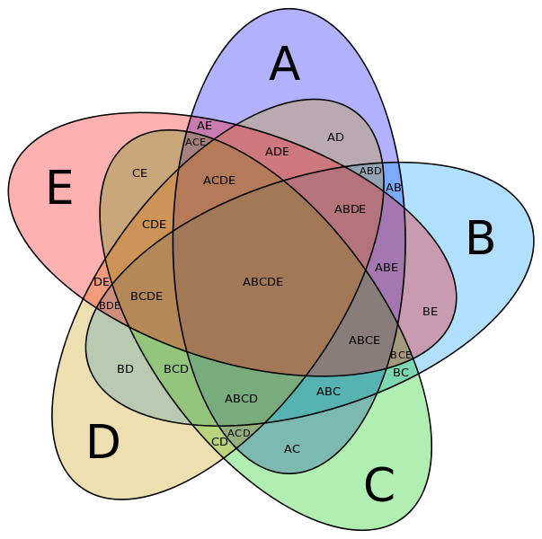
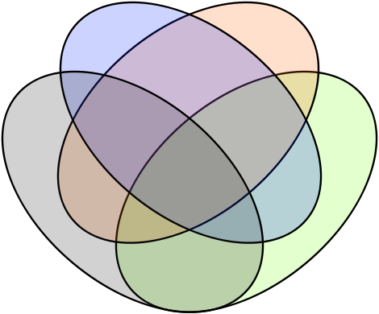
A
B
C
BC
AB
AC
ABC
B
A
AB
B
A
AB
BCD
AC
ABD
ABC
D
C
ABCD
AD
BC
ACD
DC

Slide 9
Method for Prevalence calculation
General:
  Combinations up to 5 diseases considered
  More than 5 maximum probability of 1.5 in a million
  With 25 diseases 68.405 unique combinations
Four different methods:
  Method A: total population, independent
  Method B: total population, dependent
  Method C: sex-age-specific independent
  Method D: sex-age-specific dependent
Dependent (Method B and D):
  making use of odds ratios (van Oostrom) for combinations of only 2 diseases
  ORs are not age-specific (assuming similar OR of 1.3)

Slide 10
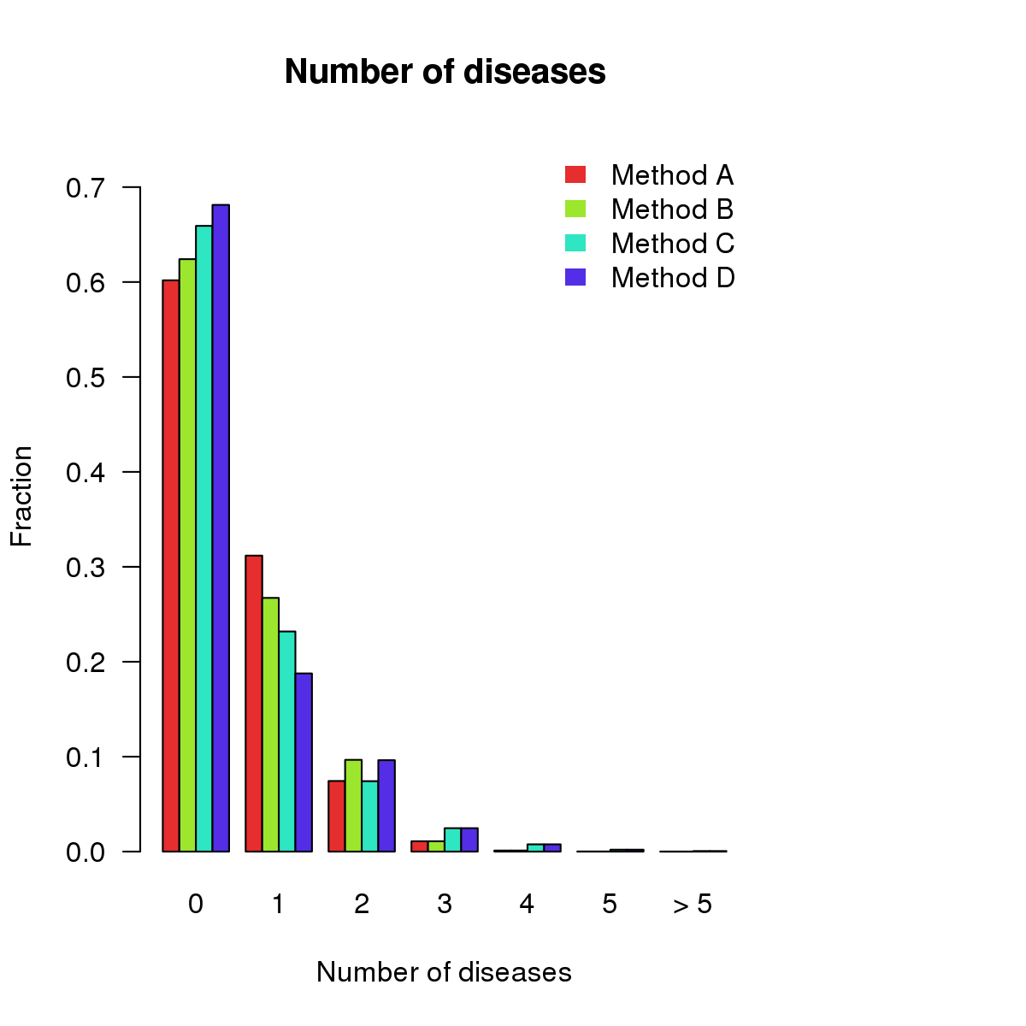
Distribution of number of diseases
Method A: total population, independent
Method B: total population, dependent
Method C: sex-age-specific independent
Method D: sex-age-specific dependent

Slide 11
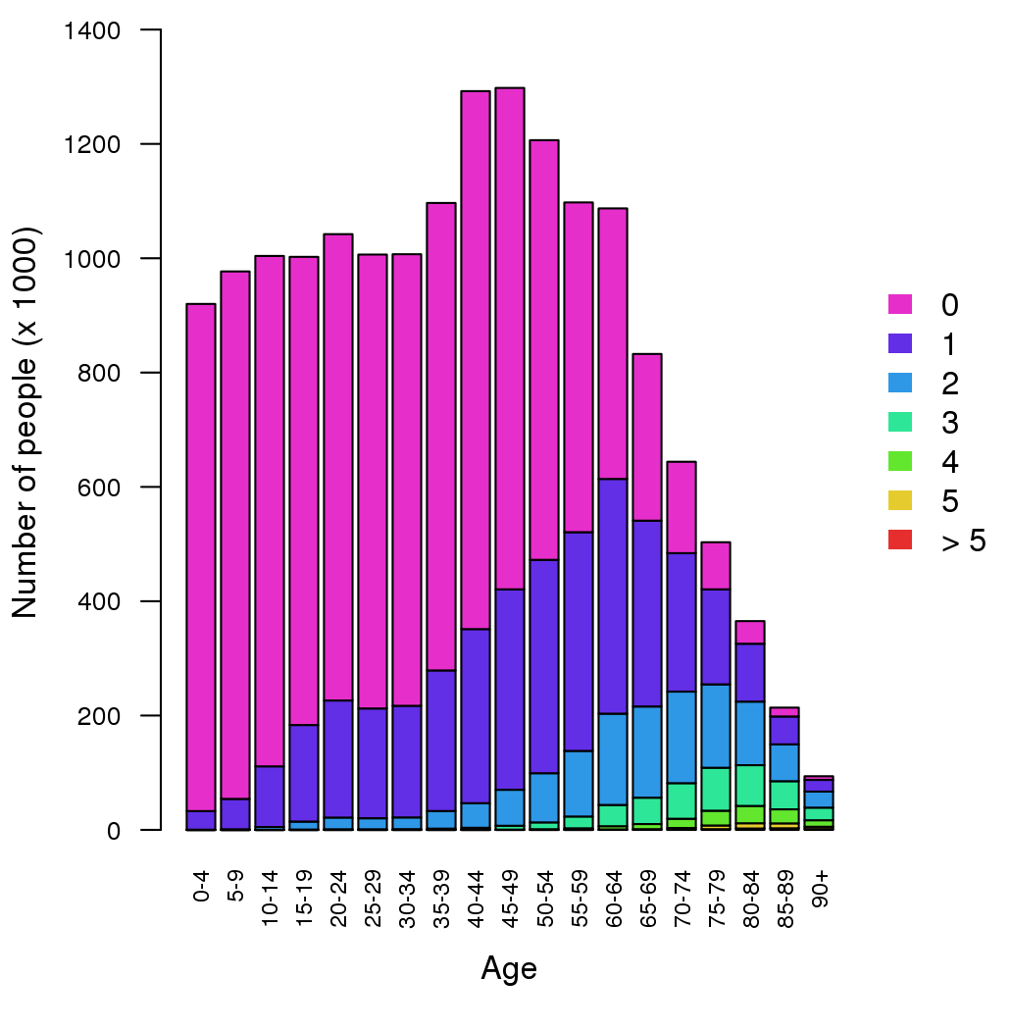
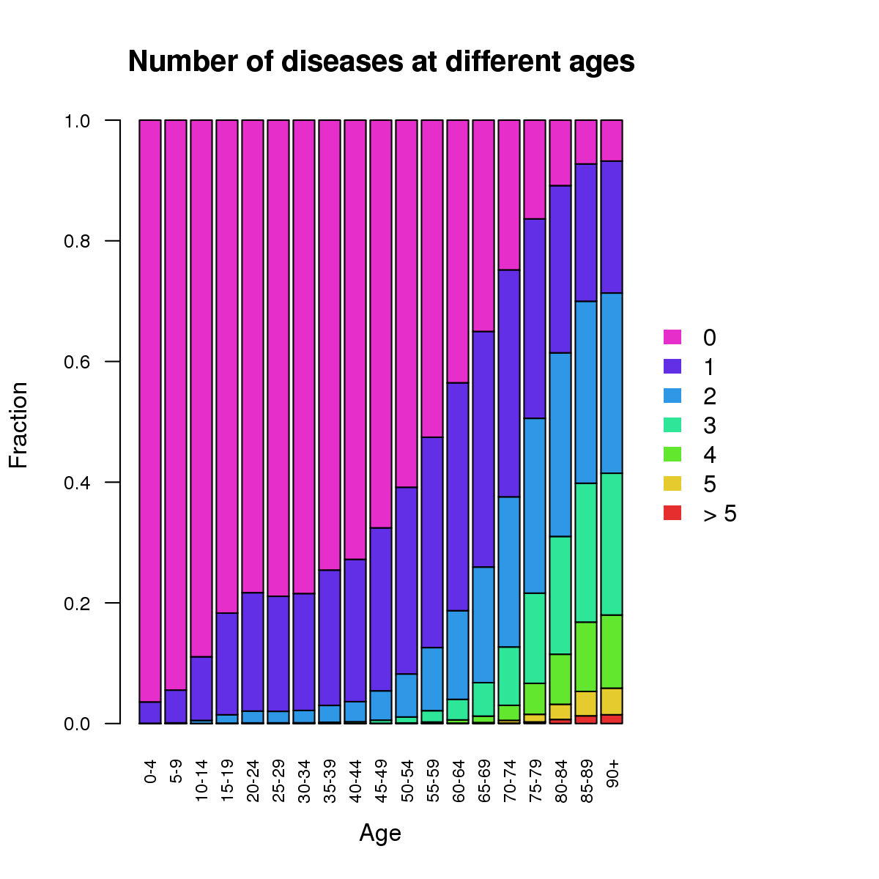
Sex-age-specific distribution of number of diseases (method C)

Slide 12
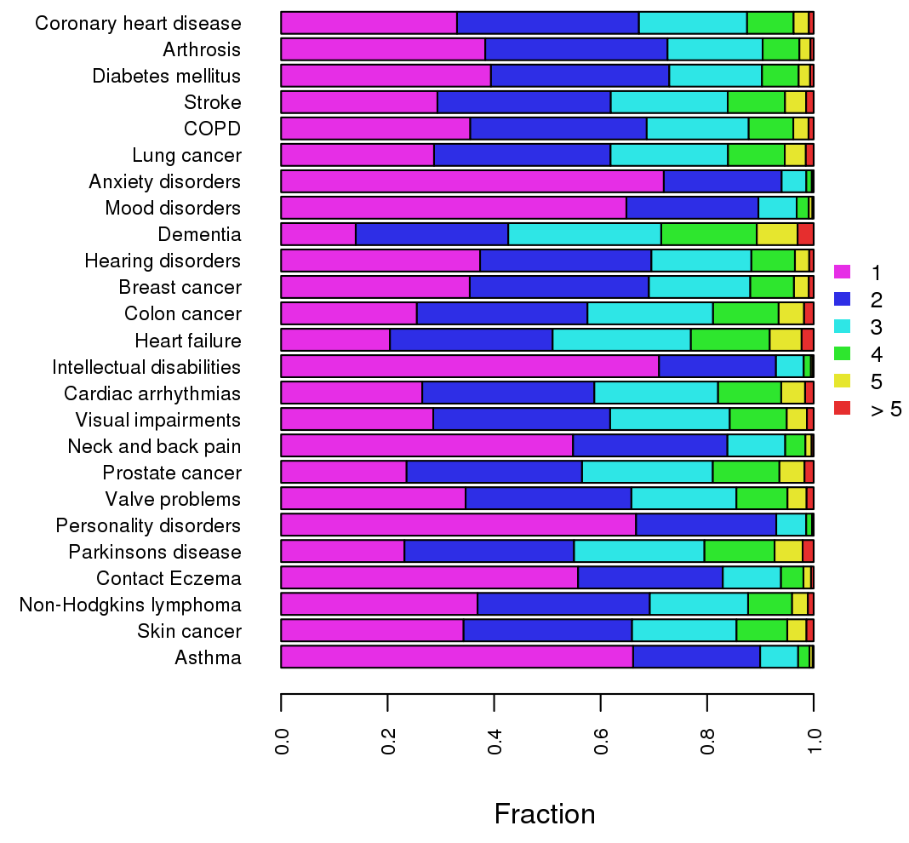
Distribution of number of diseases, by disease
Method C: Sex-age-specific

Slide 13

2. Methods for combined disability weights
Method 1: Additive ${DW}_{ij}={DW}_{i}+{DW}_{j}$
Method 2: Multiplicative ${DW}_{ij}=1−\left(1−{DW}_{i}\right)∗\left(1−{DW}_{j}\right)$
Method 3: Maximum ${DW}_{ij}=\max\left({DW}_{i}, {DW}_{j}\right)$

Slide 14
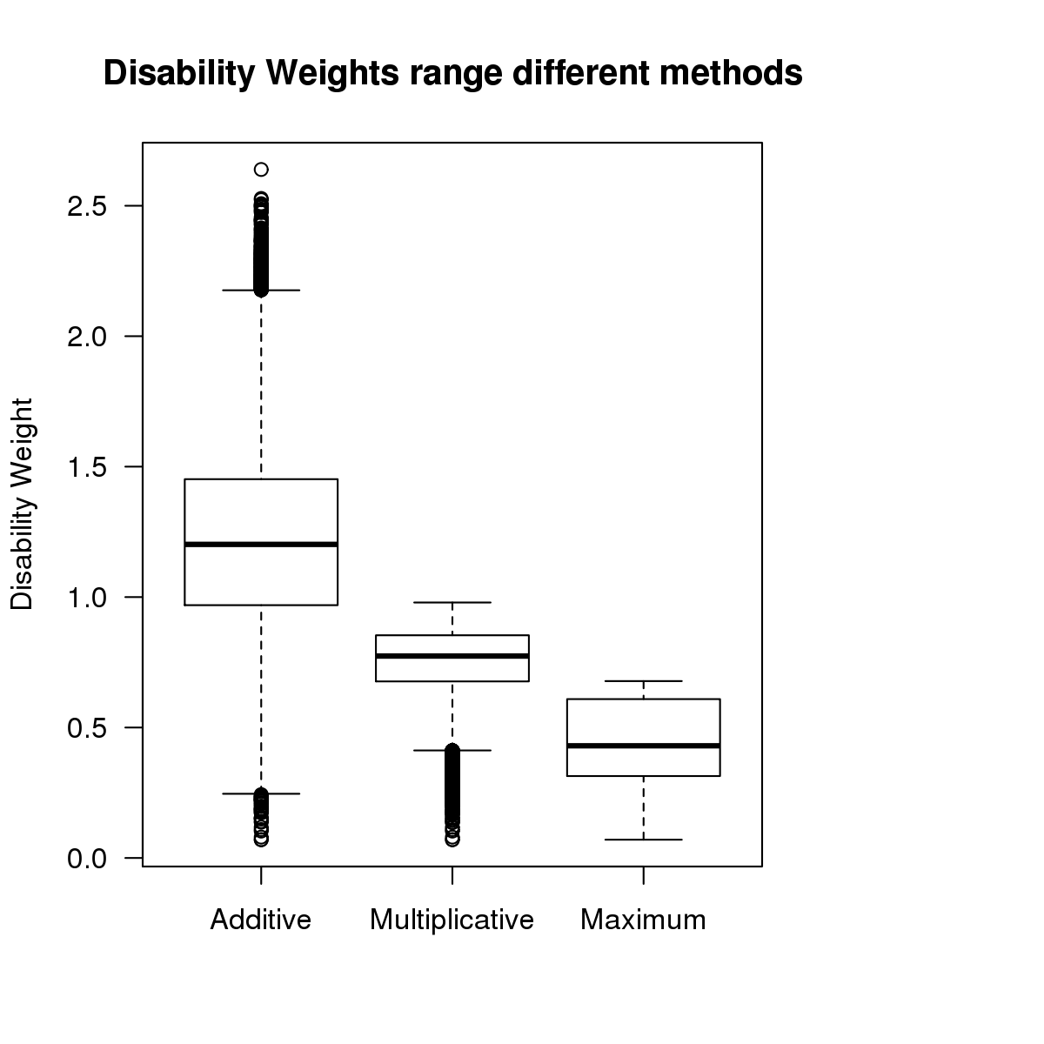
Results for Combined Disability Weights
Notes:
snorredoos, of doosdiagram
Deze vijf-getallensamenvatting bestaat uit het minimum, het eerste kwartiel, de mediaan (of tweede kwartiel), het derde kwartiel en het maximum van de waargenomen data. Een boxplot is daarmee een weliswaar sterk vereenvoudigde, maar zeer bruikbare, voorstelling van de verdeling van de data. De boxplot is in 1977 geïntroduceerd door de wiskundige John Tukey.

Slide 15
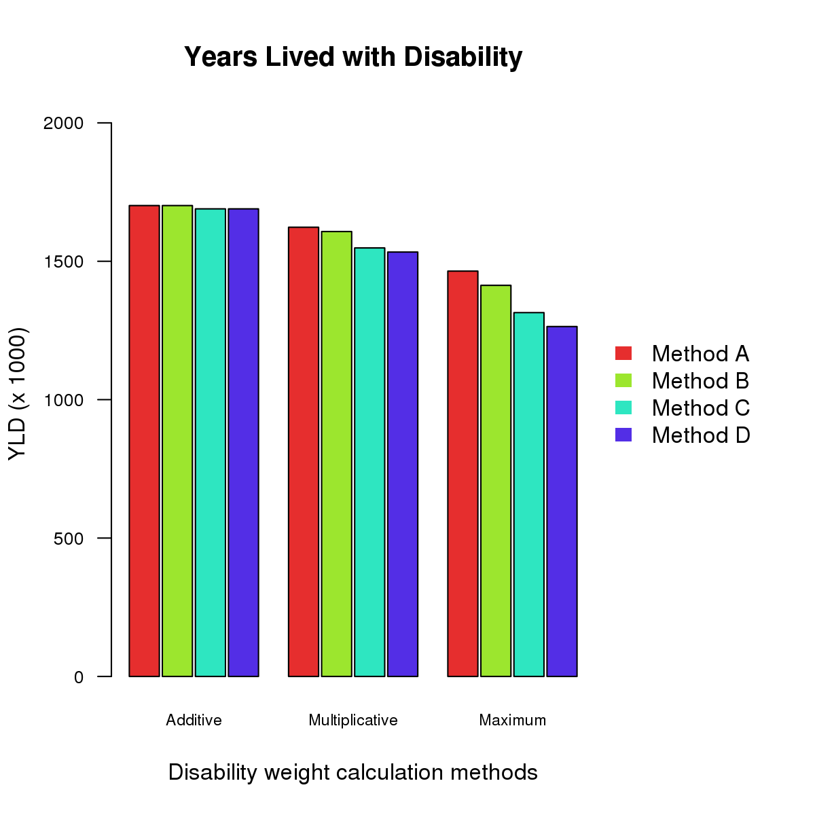
Results for YLD
-26%
Method A: total population, independent
Method B: total population, dependent
Method C: sex-age-specific independent
Method D: sex-age-specific dependent

Slide 16
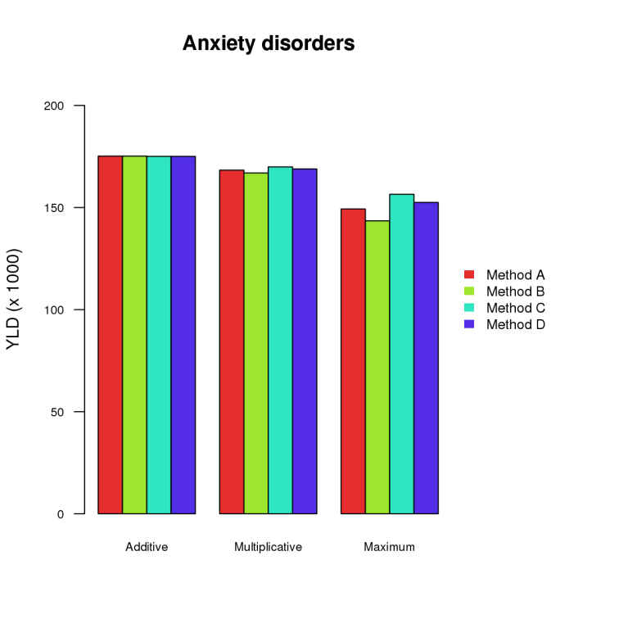
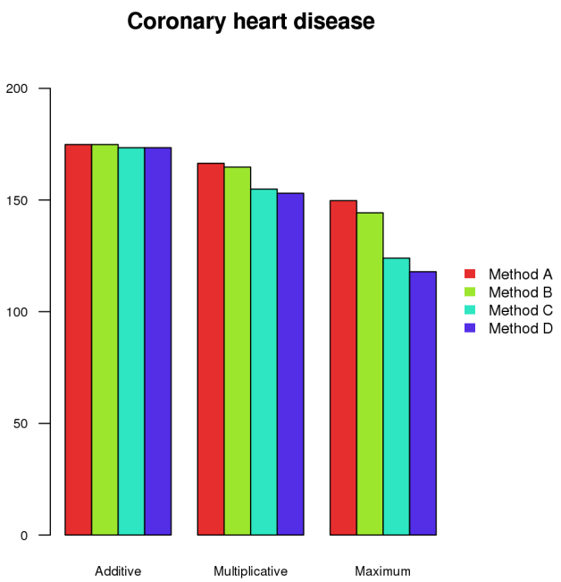
YLD for specific diseases

Slide 17
Conclusions
Burden of Disease substantially lower when accounting for multimorbidity
This might affect intervention analysis (e.g. CEAs) when done partially (intended effect of interventions might be lower)
Depends on methodology for prevalence and combined disability (but is a step forward compared to VTV2014)
Better understanding of multimorbid conditions on disability (e.g. by looking at specific combinations of diseases
Improving methodology for prevalence of multimorbidity e.g. clustering of more than two diseases

