Slide 1

Burden of Diseases Technical Workshop Edinburgh September 2016
Scottish National Burden of Disease, Injuries
and Risk Factors study:
Comorbidity correction
Ian Grant
Scottish Burden of Disease Study Project Team
ScotPHO colloboration, Information and Services Division
June 2016

Slide 2
Comorbidity in GBD
GBD’s focus on correcting the estimates of cause-specific YLDs and total YLD for the biasing influence of comorbidity, rather than on analysing patterns of comorbidity per se.
Models comorbidity in a large micro-simulated population and uses this to adjust disability weights in the final estimates
- wherever possible, inputs to the micro-simulation for each country, age, sex, year group will be at the level of health sequelae
- places no upper limit on the number of comorbid conditions
- micro-simulation process repeated (for each country-age-sex- year) 1000 times
Notes:
1st bullet The bias correction was achieved through microsimulation-based adjustments to the disability weights
2nd bullet last sub- bullet - so as to generate uncertainty in the prevalences and disability weights into comorbidity estimates

Slide 3
Comorbidity in GBD
Model comorbidity assuming independent multiplicative model (i.e. probability of experiencing a combination of sequelae is simply the product of the probabilities of experiencing each of the constituent sequelae).
Independent vs. Dependent comorbidity (i.e. diseases may ‘cluster’ because of common risk factors, or because one disease is itself a risk factor for other diseases.
  GBD tested independence assumption using US Medical Expenditure Panel Survey data which suggest that error in the magnitude of YLDs from using the independence assumption is minimal (Murray et al 2012)
  In New Zealand, reductions in overall YLD for dependent comorbidity beyond that required for adjustment due to independent comorbidity were small, although they did increase slightly with age (New Zealand Ministry of Health 2012)
Notes:
1st bullet i.e. diseases (or health states) are independently distributed
2nd bullet – New Zealand used large population health surveys from New Zealand and from Canada to estimate dependent comorbidity for major chronic diseases. At most, in older people, failure to adjust for dependent (as opposed to independent) comorbidity will lead to underestimation of the YLD comorbidity adjustment by no more than 8%, according to our study

Slide 4
SBoD comorbidity process
Broadly following the GBD’s methodological framework when adjusting our baseline (or default) estimates of YLDs for comorbidity bias
i.e. Applying the multiplicative independence model :
to Scottish estimates of individual disease and injury prevalences, to estimate prevalences for comorbidity,
to the GBD disability weights / health losses for individual diseases and injuries, to estimate weights for comorbidity.
Notes:
Broadly following the GBD’s methodological framework when adjusting our baseline (or default) estimates of YLDs for comorbidity bias. Apply the multiplicative independence model ie Assuming no correlation between diseases

Slide 5
SBoD comorbidity simulation algorithm
Work with a synthetic population of size n, with the same age group and sex, and assume to be alive at the same calendar year.
2. For each individual i in a synthetic population set:
  (a) Assign him/her a number of co-morbidities C_{i} based on the probability distribution of the number of comorbidities
  (b) Repeat until the person has been assigned C_{i} different co-morbidities
    (i) Choose a disease sequela d based on a probability distribution RD
    (ii) Decide if the person has the disease d based on the probability of having such disease (point prevalence for the population subgroup)
    (iii) If the person has the disease:
      - Remove disease sequela from the list and update probability distribution RD
      Update number of comorbidities assigned to the person

Slide 6
SBOD Simulation algorithm (cont)
  (c) Once the person has been assigned C_{i} co-morbidities, work out the total co-morbidity adjusted disability weight for the simulant
  (d) And the disability weight attributable to each sequela for the simulant
4. Once all individuals have been done work out the YLD Rate for disease sequela k

Slide 7
SBoD Comorbidity process
Not a full population simulation i.e. simulated population is 200 000
run the simulation ~1000 times.
requires more than 1 year of computer power, that is 20 age groups x 1000 simulations x 40 min per simulation = 800 000 min = 555 days
Or is it enough simulating 2000 people, 1000 times?
Take into account probability distribution of the number of co- morbidities by age – with a limit on number of comorbidities (by age group)

Slide 8
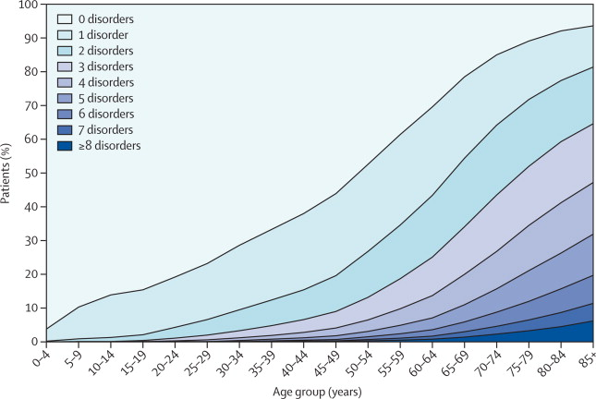
Number of chronic disorders by age group
Source: Barnet et al, 2012 Epidemiology of multimorbidity and implications for health care, research, and medical education: a cross-sectional study
Notes:
The impact of age in the number of co morbidities is substantial

Slide 9
SBOD: impact of comorbidity correction
Disease | YLD | comorbidity adjusted YLD | % change
Neck and low back pain | 44,373 | 48,184 | 8
Other musculoskeletal disorders | 37,734 | 41,104 | 8
Oral disorders | 29,641 | 31,556 | 6
Inflammatory bowel disease | 29,090 | 32,476 | 10
Sense organ diseases | 20,831 | 22,447 | 7
Migraine | 19,632 | 22,315 | 12
Depression | 19,090 | 21,123 | 10
Diabetes mellitus | 18,096 | 19,639 | 8
Ischemic heart disease | 16,880 | 18,309 | 8
Anxiety disorders | 16,041 | 17,536 | 9
Notes:
Results so far from simulation run only on 1000 individuals

Slide 10
SBOD supplementary analyses of comorbidity prevalences
Consider whether and how best to exploit the potential of the Scottish evidence:
  Estimating the prevalence of comorbidities, to the depth of two or three co-present conditions.
  Assessing the degree to which the comorbidity prevalences observed in AHS and IHS conform to or depart from the multiplicative independence model.
  Making a broad assessment of the degree to which the overall adjustment of YLDs for comorbidity bias might be affected
Notes:
Using EHRS to calculate prevalence, we now a have a huge dataset which allows us to calculate YLD considering the actual co-morbidities suffered by the hospitalised population.
Quick win : Could use, for instance, diseases correlation matrix in the long term conditions report. Or we could create our own correlation matrix, based on all (hospitalised) patient records

Slide 11
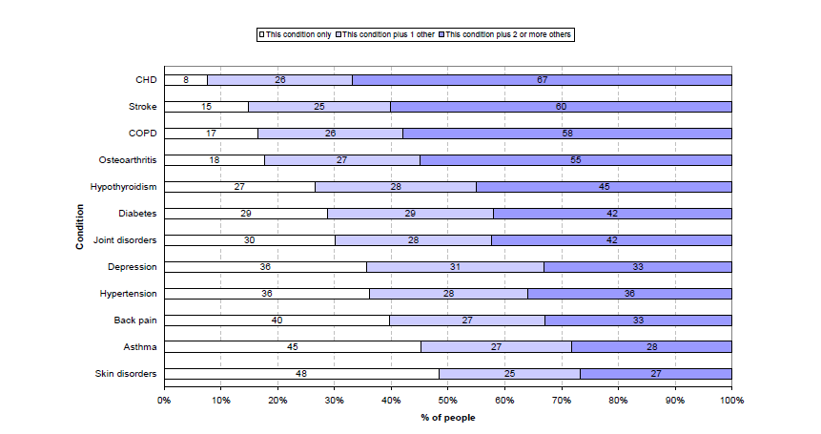
Number of co-existing conditions
Source: Measuring Long-Term Conditions in Scotland, Information Services Division, Edinburgh 2008 https://www.isdscotland.org/Health-Topics/Hospital-Care/Diagnoses/2008_08_14_LTC_full_report.pdf
Notes:
Analyses based on primary care data
Interpretation: Of all people listed as having CHD, 8% have only CHD, 26% have CHD plus one other condition and 67% have CHD plus 2 or more other conditions (based on consultations within the same year).

Slide 12
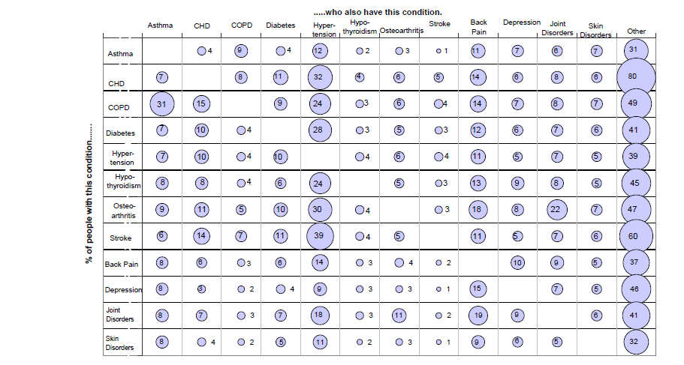
Common combinations of conditions
Source: Measuring Long-Term Conditions in Scotland, Information Services Division, Edinburgh 2008 https://www.isdscotland.org/Health-Topics/Hospital-Care/Diagnoses/2008_08_14_LTC_full_report.pdf
Notes:
Analyses based on primary care data
Interpretation: 4% of people with Asthma also have diabetes. 39% of people who have suffered a stroke also have hypertension

Slide 13
Discussion
Comorbidity adjustment by means of a simulation presents multiple challenges, for instance:
which co-morbidities and how many of them are assigned to a person;
how the disability weights are combined.
GBD methodology presents a solution to these questions, but is that the best methodology possible?
How can data rich countries use their information to improve the comorbidity adjustment?
Comorbidity

