Slide 1
Why life expectancy trends have changed; health inequalities are increasing; and what would be an appropriate response
Dr Gerry McCartney
Consultant in Public Health and Head of the Public Health Observatory
NHS Health Scotland
October 2019

Slide 2
My objectives for the next 25 minutes:
To demonstrate that life expectancy trends changed from 2012
…that this is due to changes for almost all age groups and causes of death
…that this is leading to a rapid rise in unjust and avoidable health inequalities
…that the causes are most likely to be economic, working through a variety of pathways
To convince you that you all have a vital role in reversing these trends

Slide 3
Why does this matter?
Life expectancy is a very good marker of overall societal progress

Slide 4
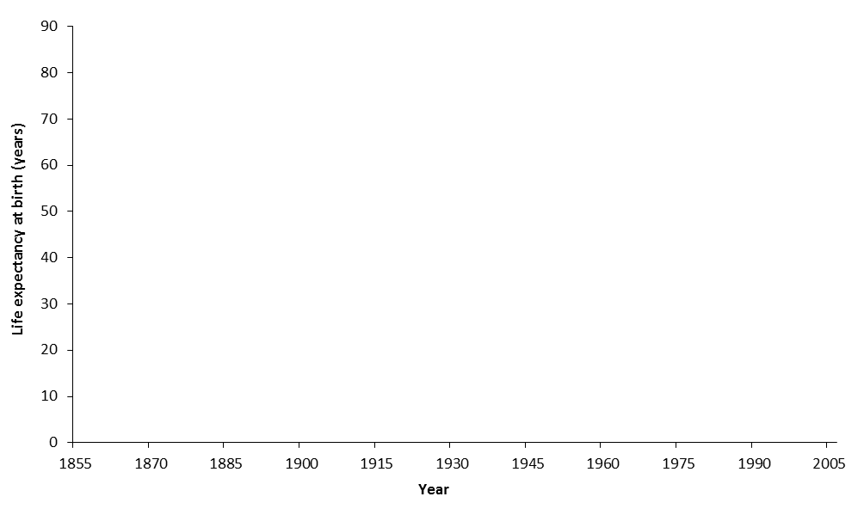
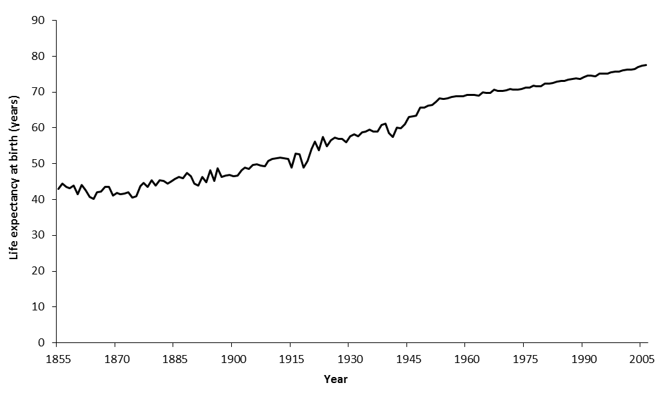
Infectious disease outbreaks, food supplies, wars
WWI and Spanish flu
Continuous improvement
WWII
Life expectancy in Scotland, 1855-2005

Slide 5
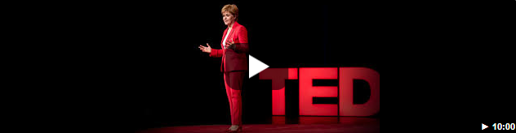
Why does this matter?
Life expectancy is a very good marker of overall societal progress
Underneath these numbers are personal and community tragedies
The First Minister is now explicit that population well-being is a top priority for the Scottish Government
We can change these trends

Slide 6
Life expectancy trends changed from 2012

Slide 7
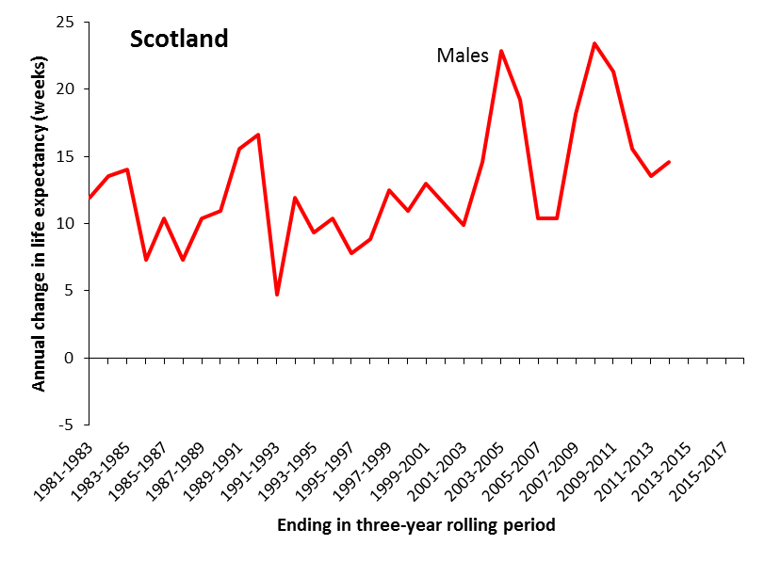
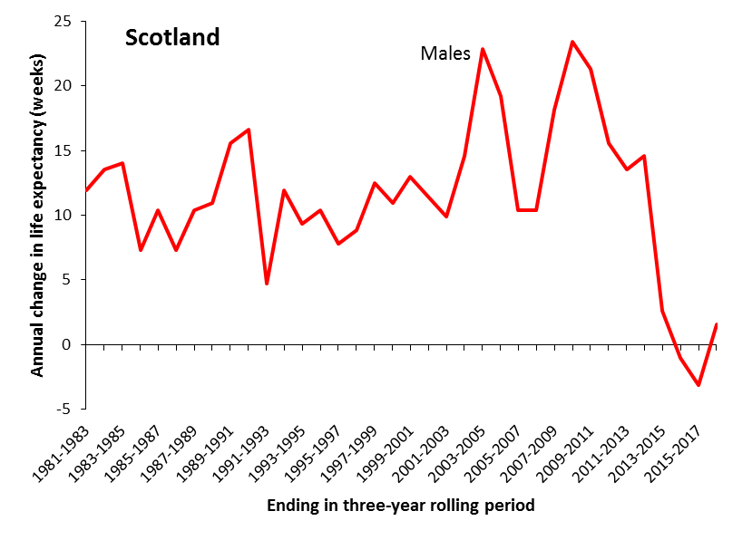
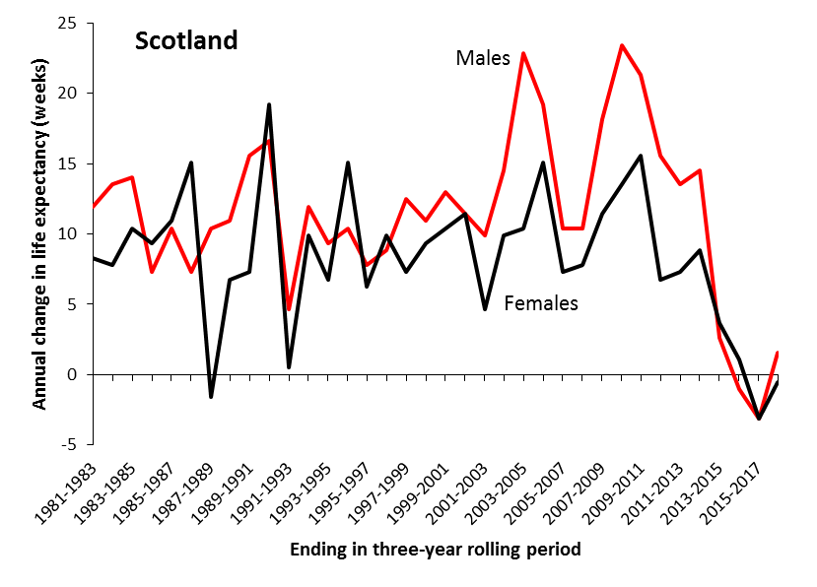

Slide 8
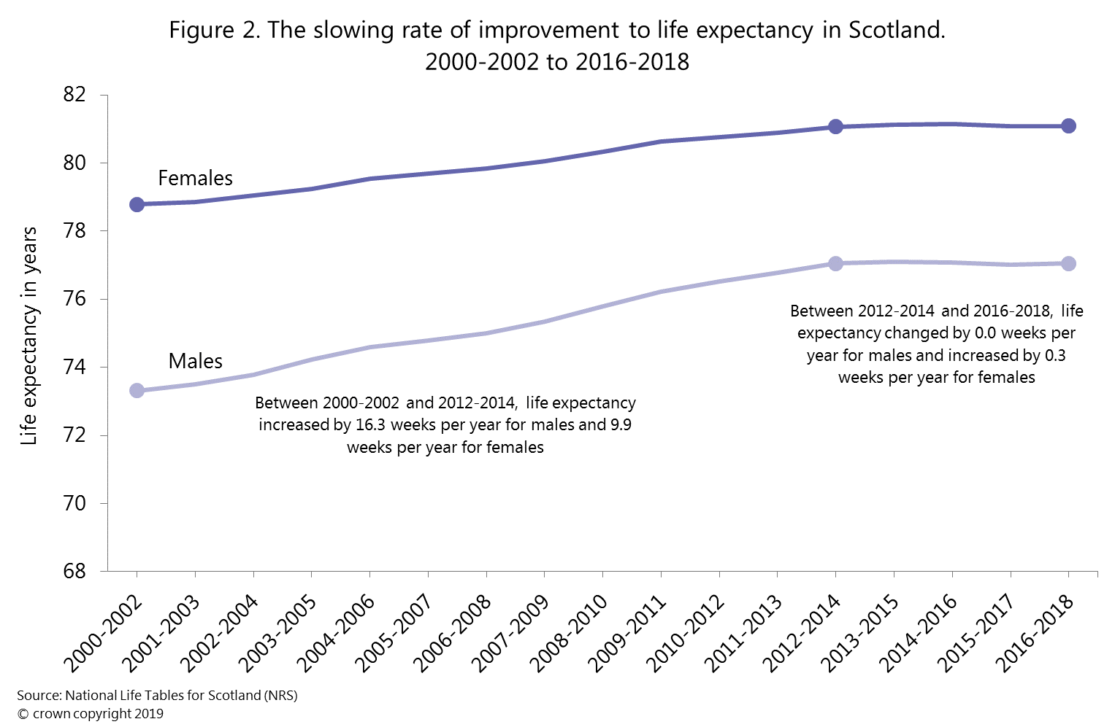

Slide 9
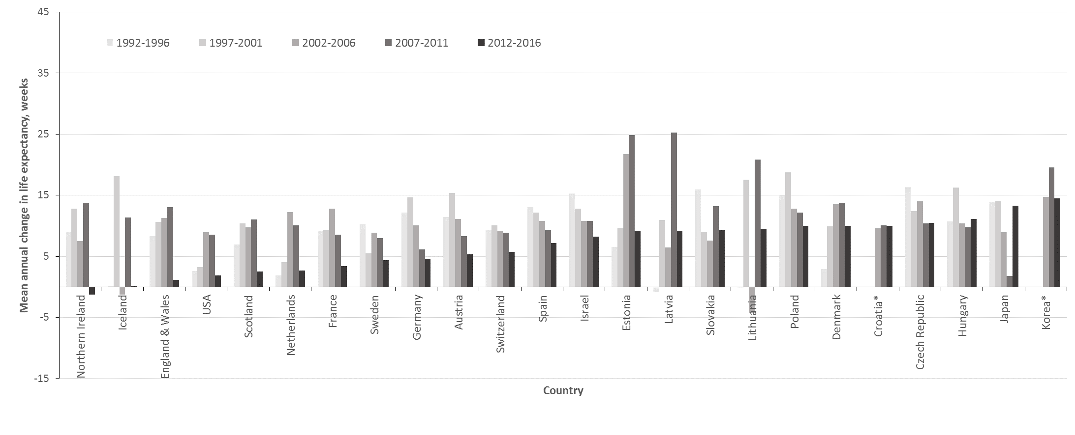
Mean annual change in female life expectancy

Slide 10
Almost all age groups and causes of death

Slide 11
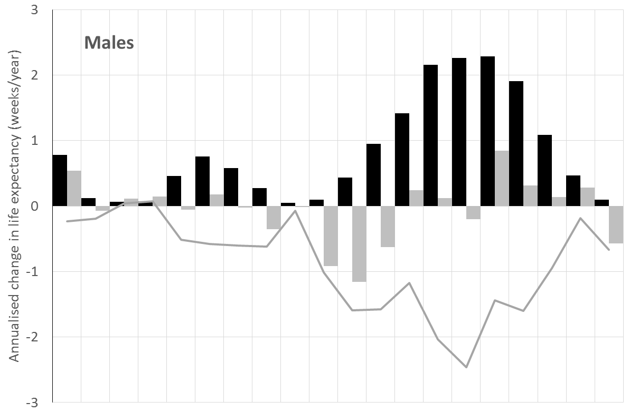
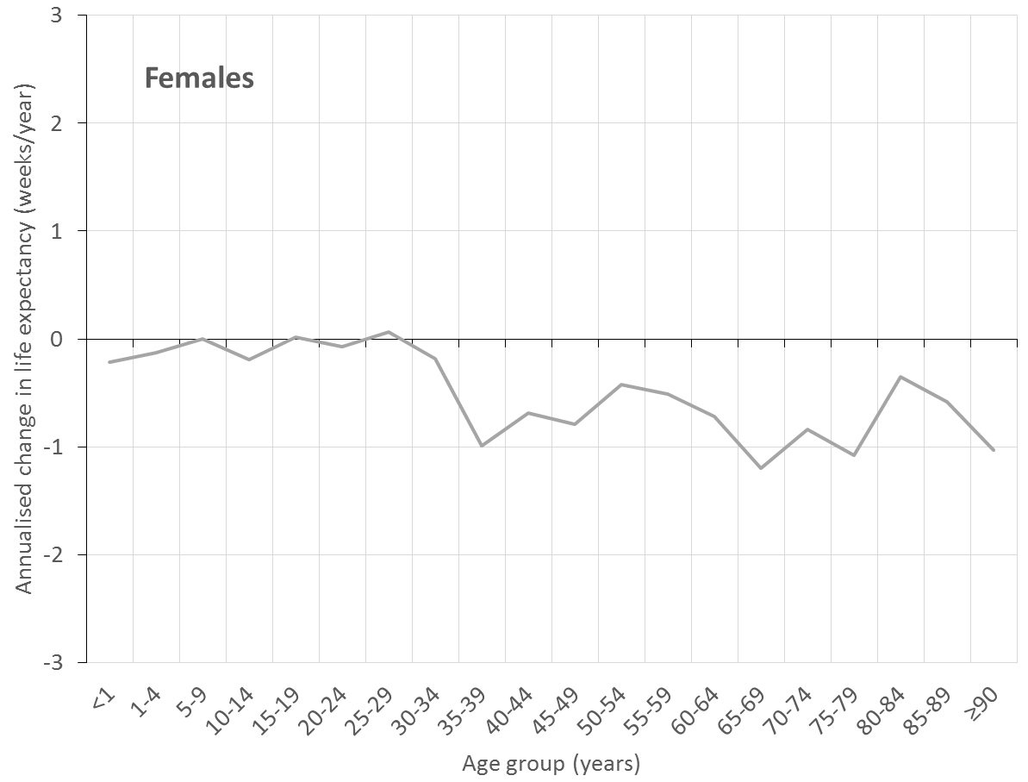
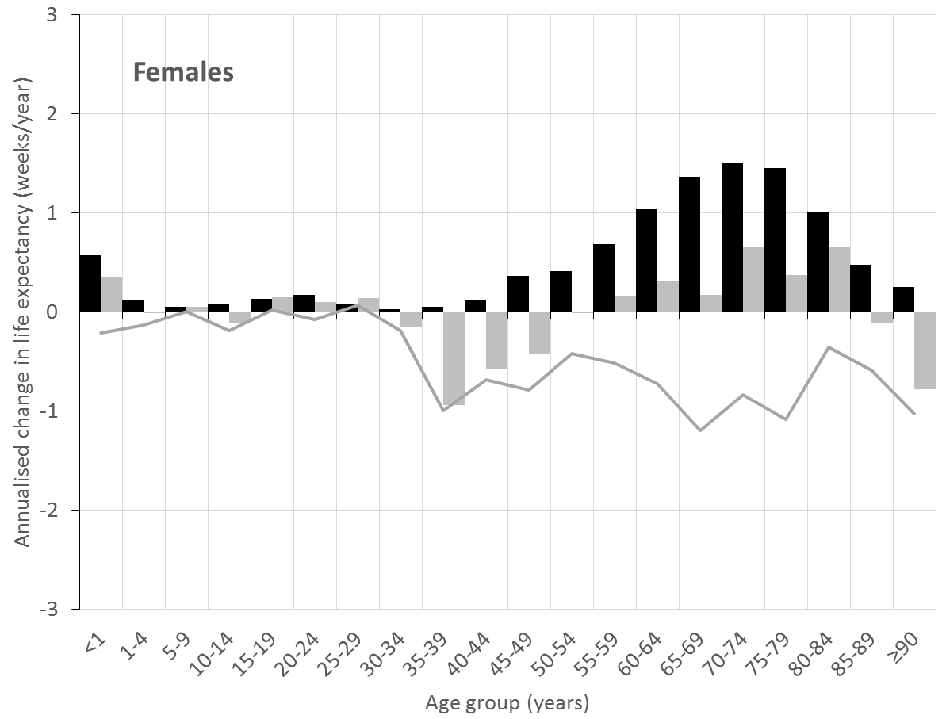
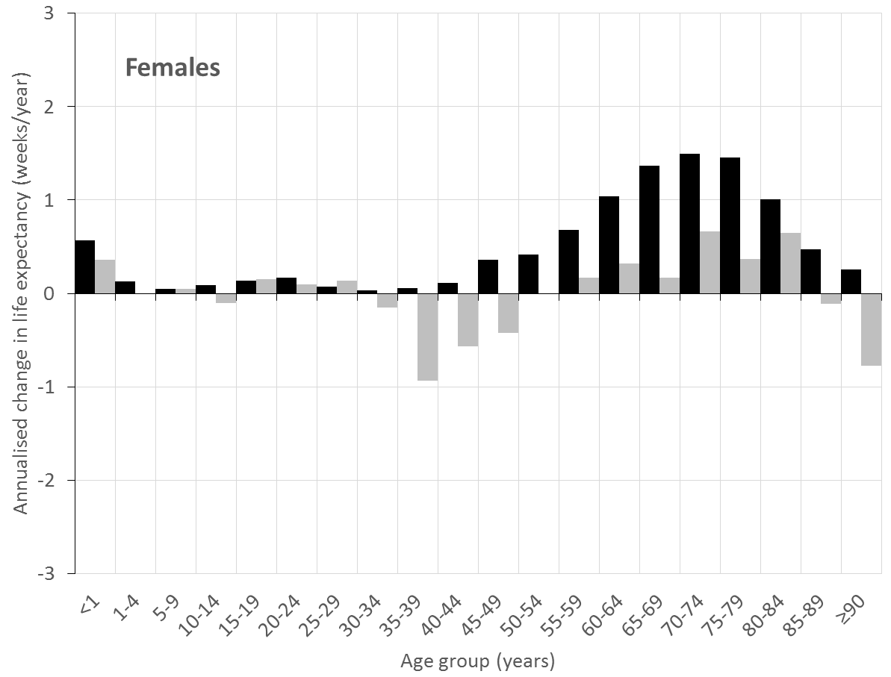
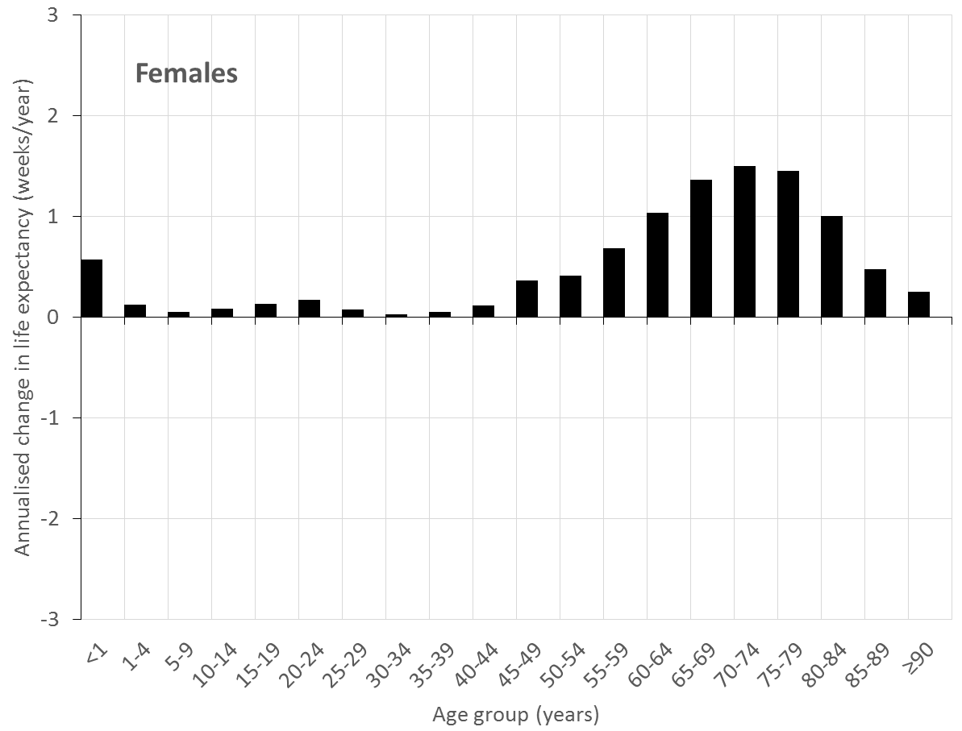
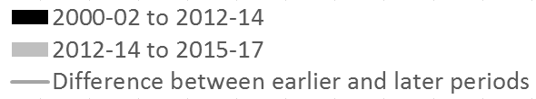
All age groups improving
Worsening in trend has happened at (almost) all ages

Slide 12
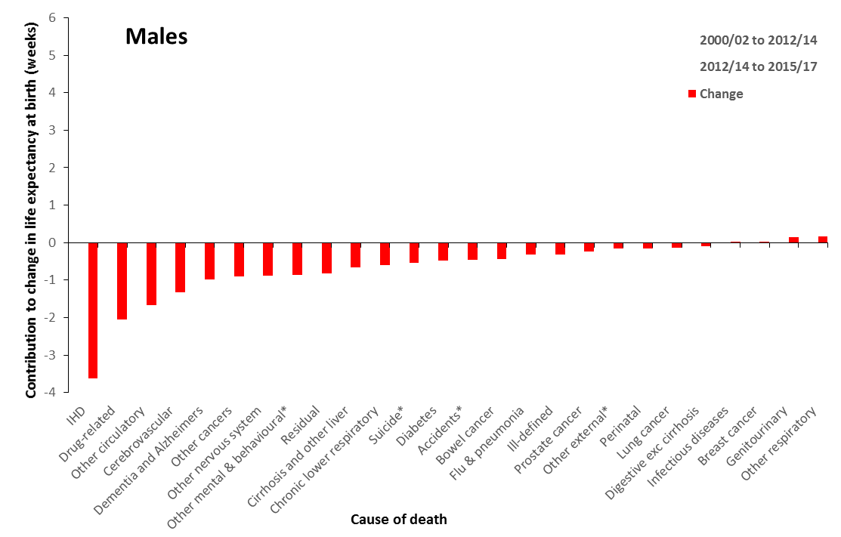
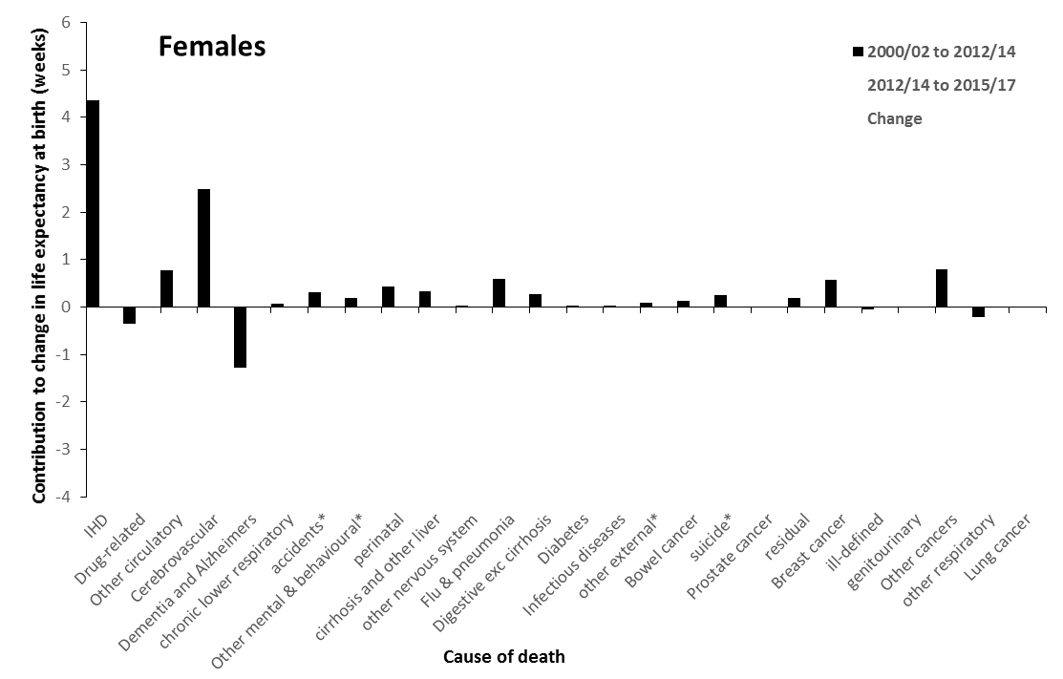
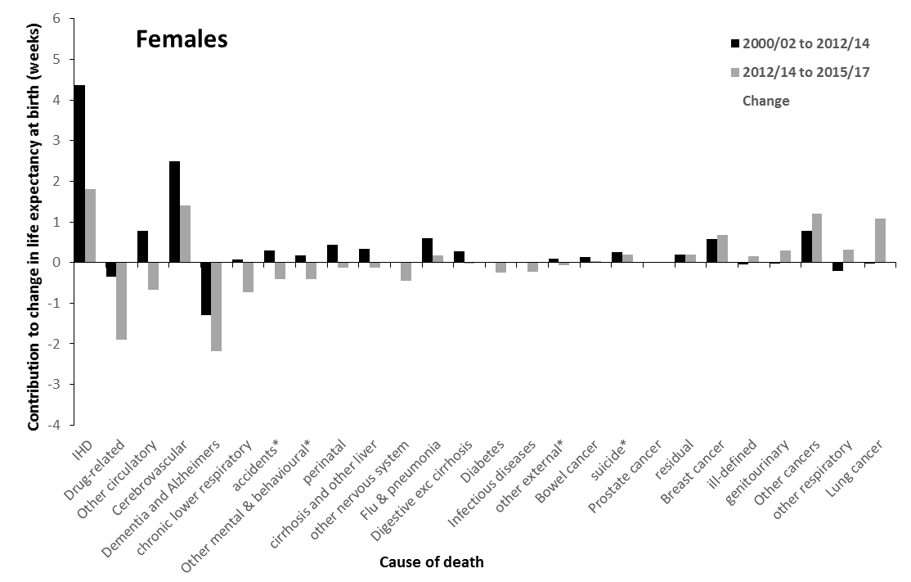
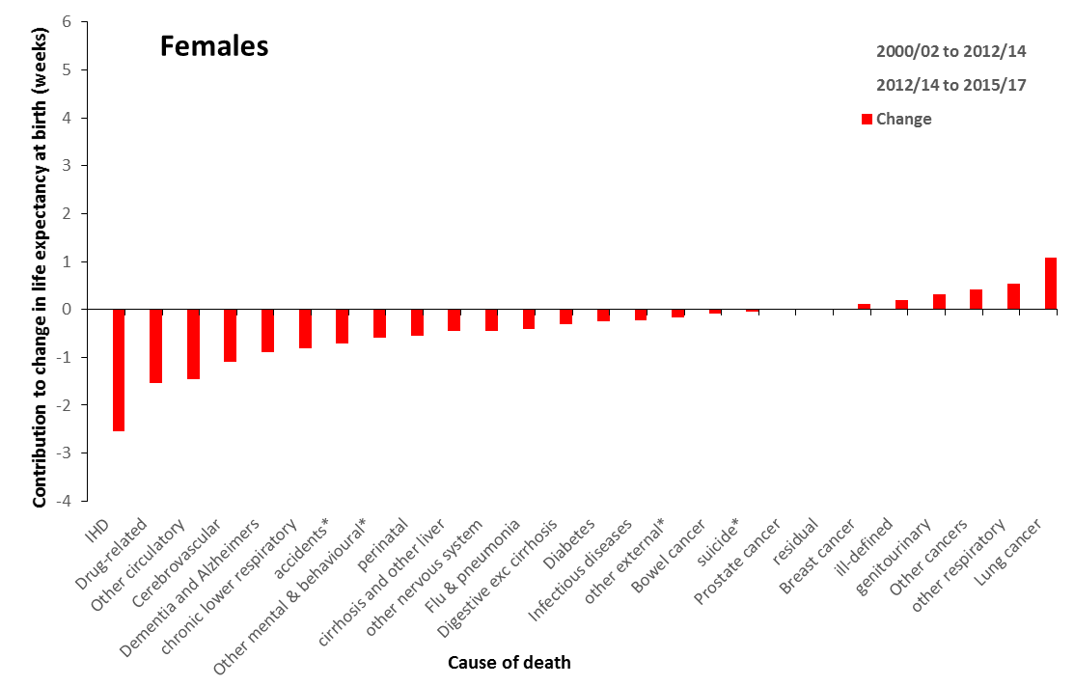
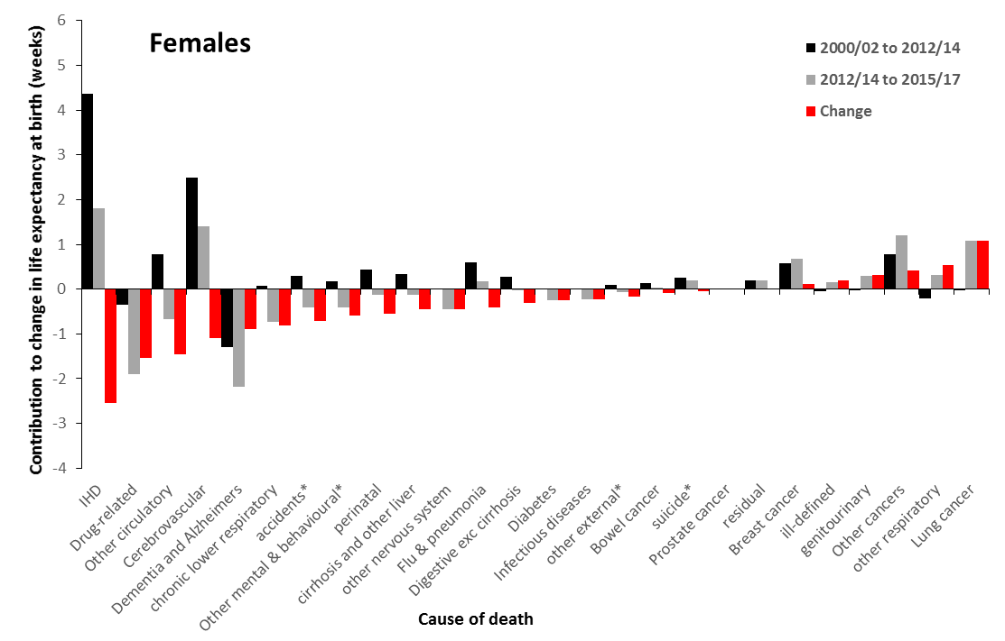

Slide 13
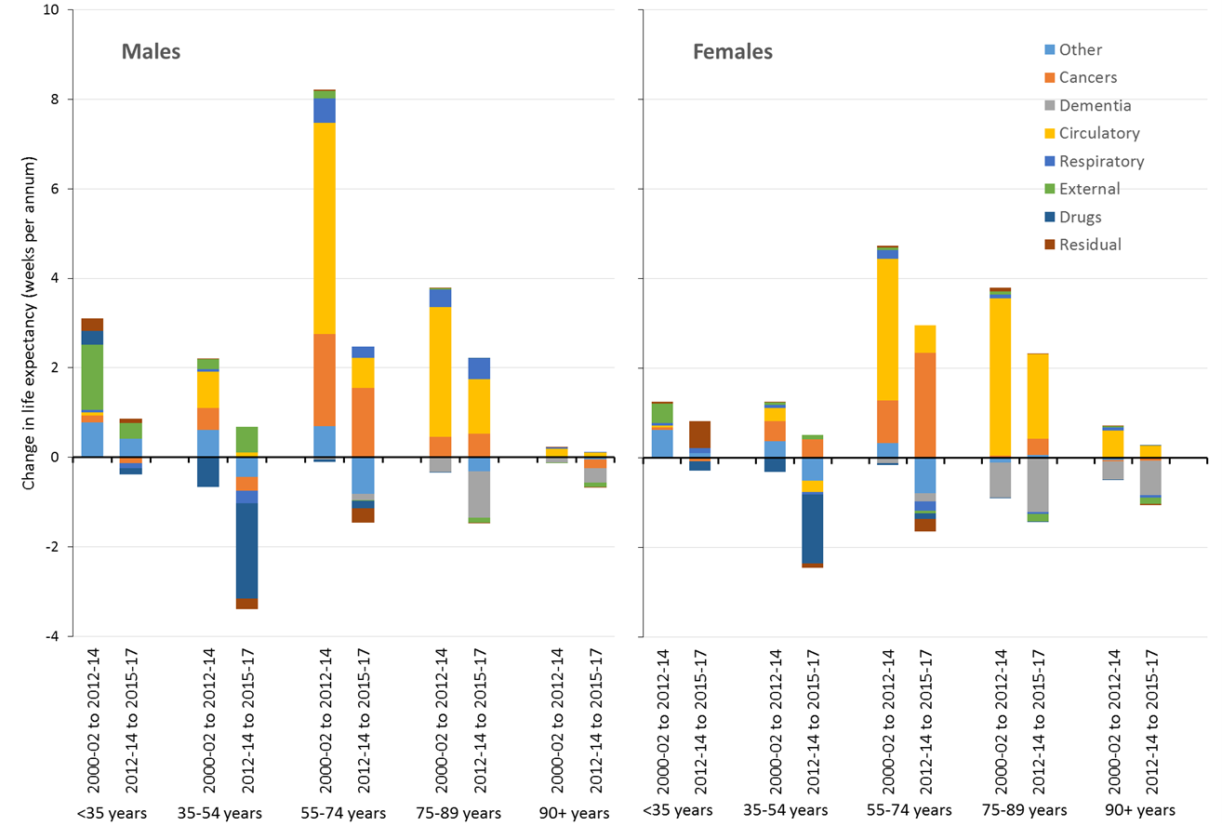

Slide 14
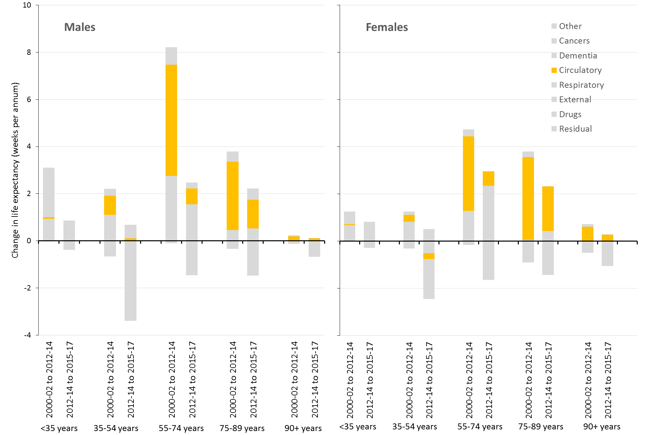

Slide 15
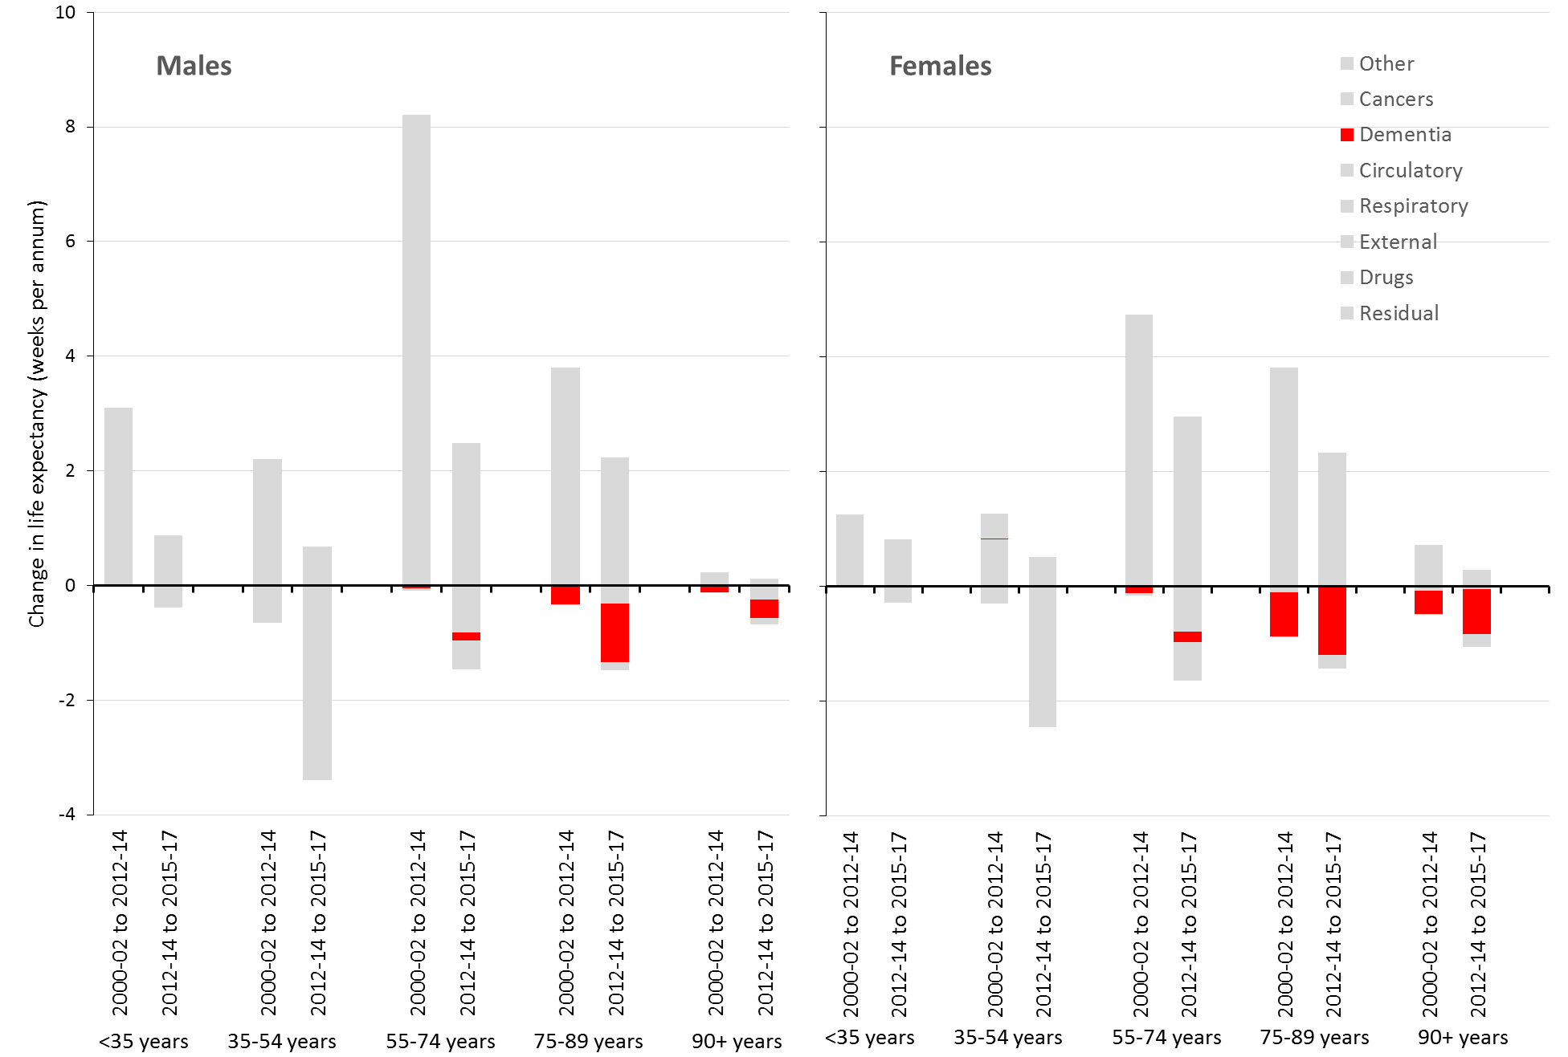

Slide 16
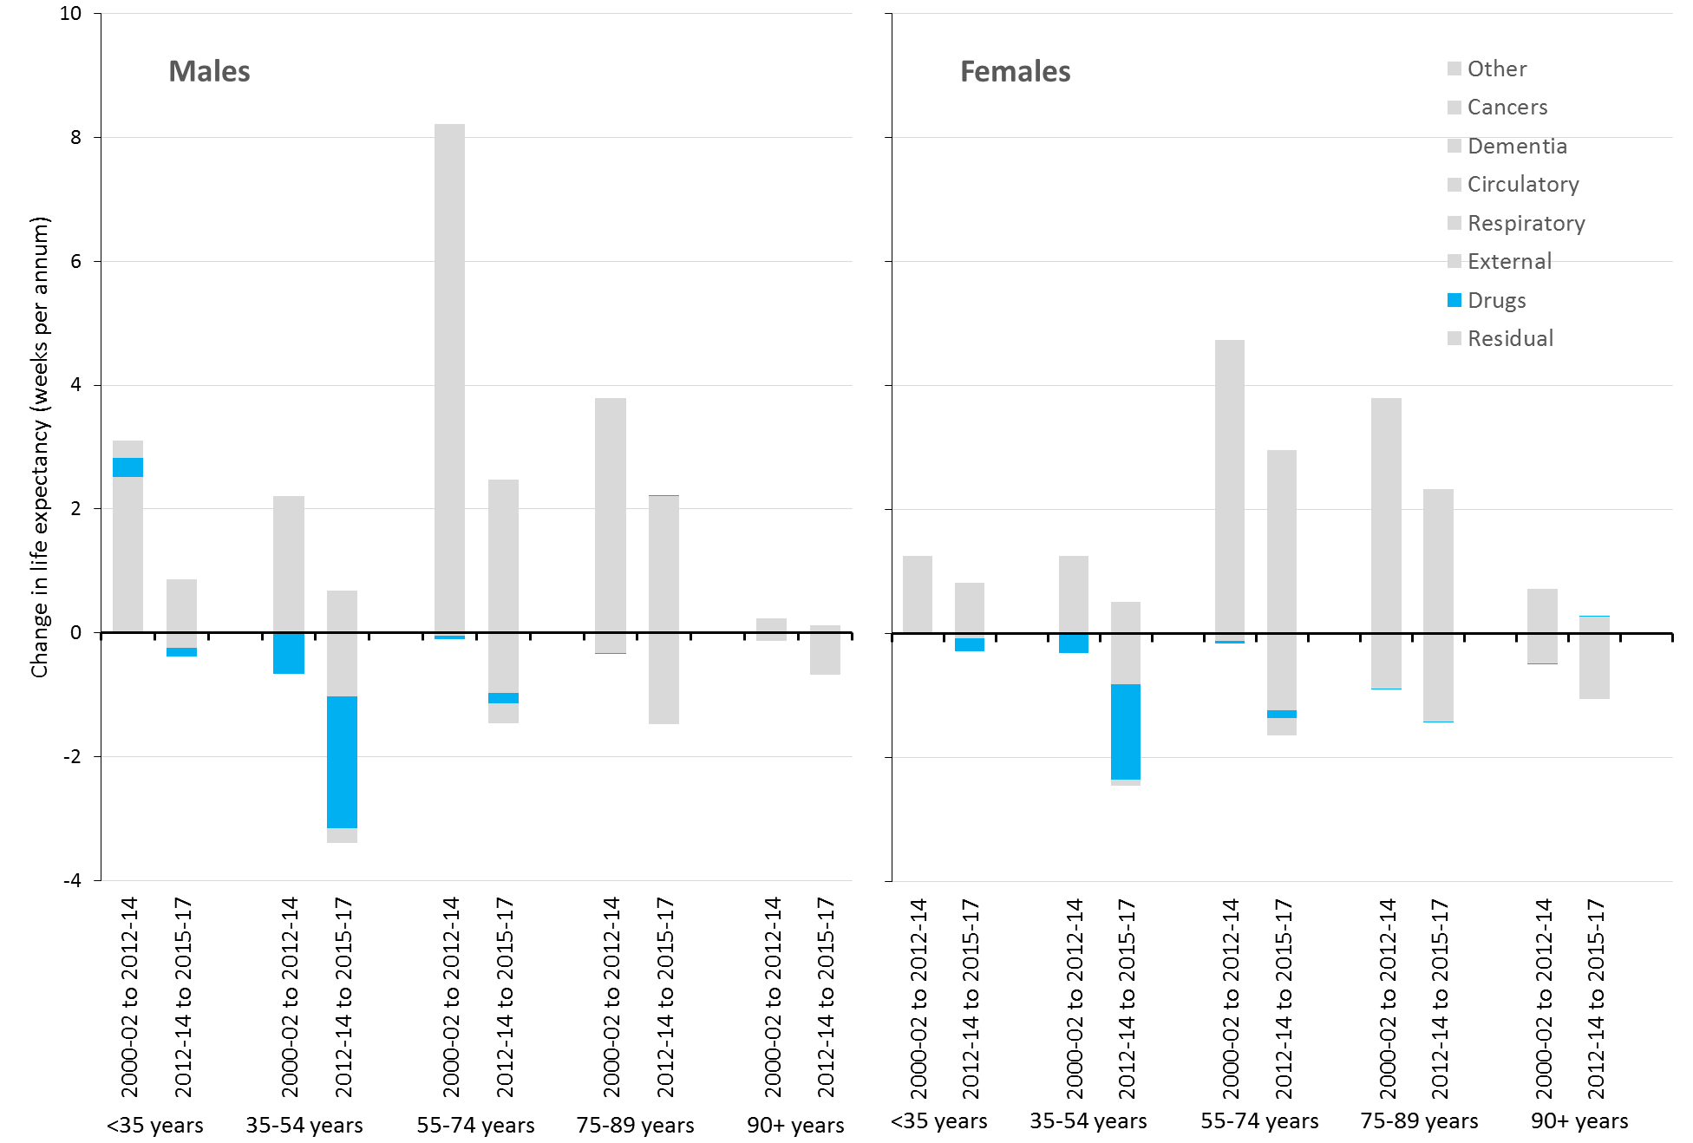

Slide 17
A rapid rise in unjust and avoidable inequalities

Slide 18
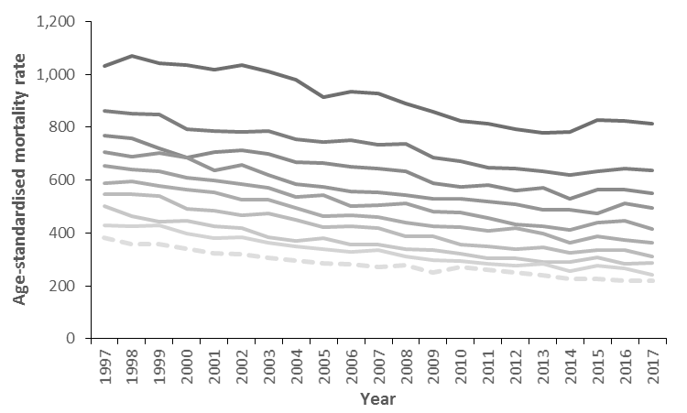
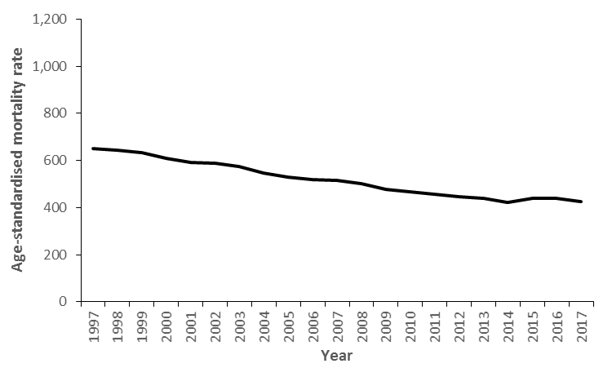
Scotland, men & women <75 years
Most deprived 10th
Least deprived 10th

Slide 19
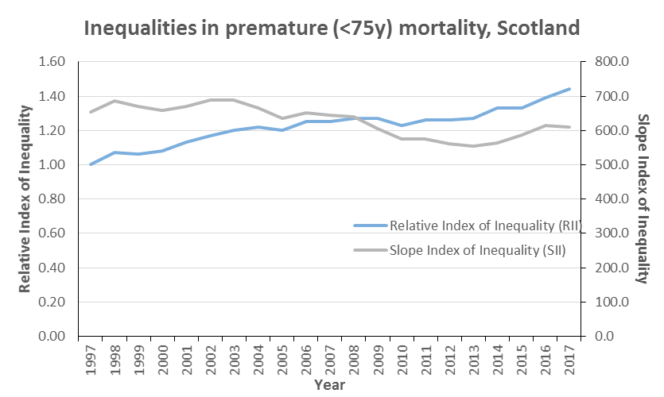

Slide 20
The causes are economic, working through a variety of pathways

Slide 21
What are the causes?
Not due to influenza
> All causes of death impacted including implausible causes such as drug-related deaths
> Trends changed in 2012, not in the ‘flu-year’ 2015, and have been sustained subsequently
> All age groups impacted

Slide 22
What are the causes?
Not due to natural ‘biological’ limit
> Trends have changed at all age groups, not just the oldest
> Trends are worst in the most deprived groups where life expectancy is already lowest
> Life expectancy continues to improve in countries who lead the world such as Japan

Slide 23
What are the causes?
‘Austerity’
> Yes, working through multiple pathways for different groups
> Social security benefit cuts and increased conditions
> Cuts to public services and pressures on health & social care services
> Household incomes squeezed
> Precarious work
> Plethora of international and UK-based research

Slide 24
Percentage impact of reforms to taxes and transfer payments by household net income decile and type of reform 2010-2011 to 2021-22 tax year, Great Britain
Source: Portes et al. The cumulative impact of tax and welfare reforms. Manchester, Equality and Human Rights Commission, 2018.

Slide 25
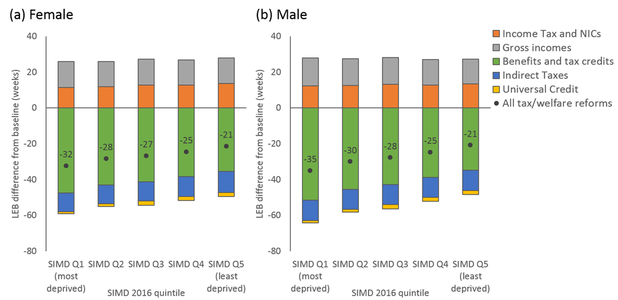
Modelled impact of changes to taxes and transfer payments (2010-2011 to 2021-22) on life expectancy, Scotland (preliminary analysis using Triple I tool)
84.2 years to 83.7 years (-29 weeks)
79.5 years to 78.9 years (-30 weeks)

Slide 26
Rajmil, Luis; Fernández de Sanamed, María-José. Austerity Policies and Mortality Rates in European Countries, 2011–2015. AJPH 2019; 109: 768-870, doi:10.2105/AJPH.2019.304997.
Austerity measured as Cyclically Adjusted Primary Balance (CAPB) in terciles
Europe (15 countries), 2011-2015
Compared with countries in the low-austerity group, countries with intermediate austerity had excess mortality of 40 per 100,000 per year and those with high austerity had excess mortality of 31 per 100,000 per year.
Generally good quality study
No data beyond 2015 – likely to underestimate effects

Slide 27
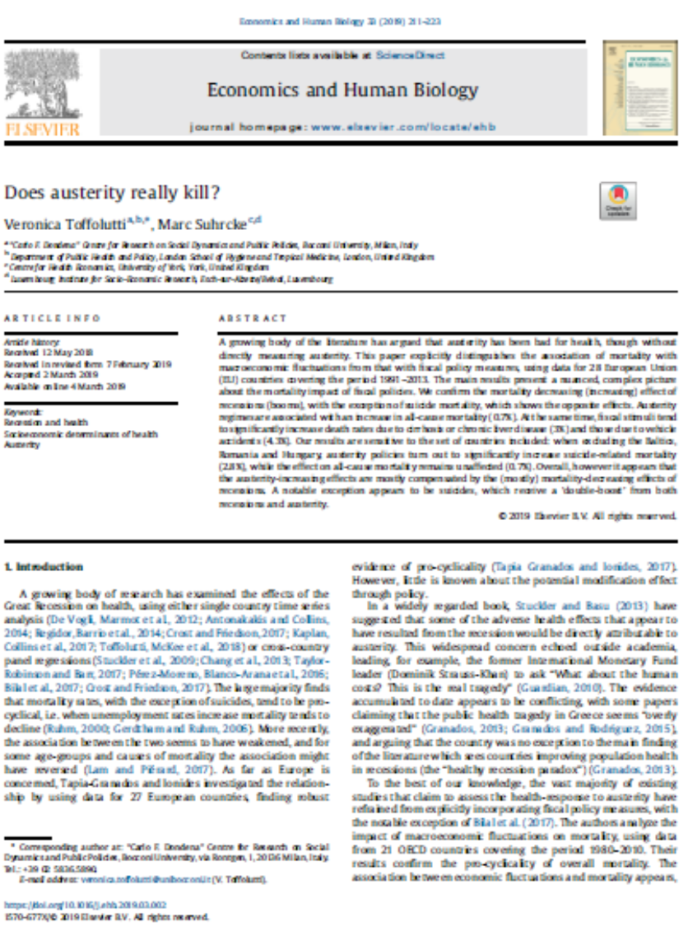
Toffoluttia V, Suhrcke M. Does austerity really kill? Economics and Human Biology 2019; 33: 211-3.
Austerity measured using the Alesina-Ardagna Fiscal Index (AAFI) (also called ‘Blanchard Fiscal Index’)
Europe (28 countries), 1991-2013 (many up to 2012)
Austerity regimes are associated with an increase in mortality of 0.7% after adjusting for recession effects
Good quality study
No data beyond 2012/3 – likely to underestimate effects

Slide 28
van der Wel, Kjetil A.; Saltkjel, Therese; Chen, Wen-Hao; Dahl, Espen; Halvorsen, Knut. European health inequality through the ‘Great Recession’: social policy matters. Sociology of Health & Illness 2018; 40(4): 750-768, doi:10.1111/1467-9566.12723
Austerity measured by welfare spending, adjusted for unemployment and GDP
2002-2014, Europe (25)
GDP drops and increasing unemployment were associated with decreasing health inequalities. Austerity, however, was related to increasing health inequalities, an association that grew stronger with time.
Good quality study though response rate for European Social Survey is highly variable across countries, and only self-rated health measures.
No data beyond 2014 – likely to underestimate effects

Slide 29
Loopstra R, McKee M, Katikireddi SV, Taylor-Robinson D, Barr B, Stuckler D. Austerity and old-age mortality in England: a longitudinal cross-local area analysis, 2007–2013. Journal of the Royal Society of Medicine 2016; 109(3):109-116, doi:10.1177/0141076816632215.
Austerity measured as change in Pension Credit and social care spending; local authorities in England, 2007-2013
Each 1% decline in Pension Credit was associated with a 0.68% increase in mortality. Each 1% decline in social care spending was associated with a rise of 0.08% but not after adjusting for pension credit spending changes.
Moderate quality study which could be confounded by deprivation, only to 2013, only oldest age group.

Slide 30
Taulbut M, Agbato D, McCartney G. Working and hurting? Monitoring the health and health inequalities impacts of the economic downturn and chanes to the social security system. Glasgow, NHS Health Scotland, 2018.
Observational evidence that many health trends have worsened for those groups most exposed to benefit cuts and increased conditionality in the social security system.
High quality evidence that some specific changes (e.g. increased conditionality for lone mothers receiving income support) have been detrimental for mental health.
It is proving impossible to do better studies on this because the DWP will not co-operate to release relevant linked data.

Slide 32
What are the causes?
Other factors could be playing a role
> Mental health problems and social isolation as mechanisms linking economic factors and mortality
> Obesity could be a mechanism linking economic factors to cardiovascular disease
> Large programme of work underway to investigate all causes at present

Slide 33
Summary and implications
This is the biggest public health challenge for many decades – encompassing the sub-plots on drug deaths, homelessness, poverty, etc.
Austerity, social security cuts, service cuts/pressures all likely to be causal
We need to reverse these economic and social policies and mitigate what we can
We need to design our services to meet the unmet needs of the population and ensure accessibility to those who need those services most
We need a public health approach to substance misuse
We need your leadership to ensure all relevant policymakers and service managers at all levels understand the contribution they can make
We have a duty to explain and champion action for our population/patients

Slide 34
All the data and evidence is summarised at: www.scotpho.org.uk/population-dynamics/recent-mortality-trends/
The programme of research and dissemination is detailed here:
https://www.scotphn.net/groups/public-health-mortality-monitoring/mortality-sig-introduction/
Contact me at:
Email: gmccartney@nhs.net
Twitter: @gerrymccartney1

