Slide 1
Why life expectancy trends have changed, health inequalities are increasing, and our duty to respond: a view from Scotland
Gerry McCartney
Consultant in Public Health
NHS Health Scotland
December 2019

Slide 2
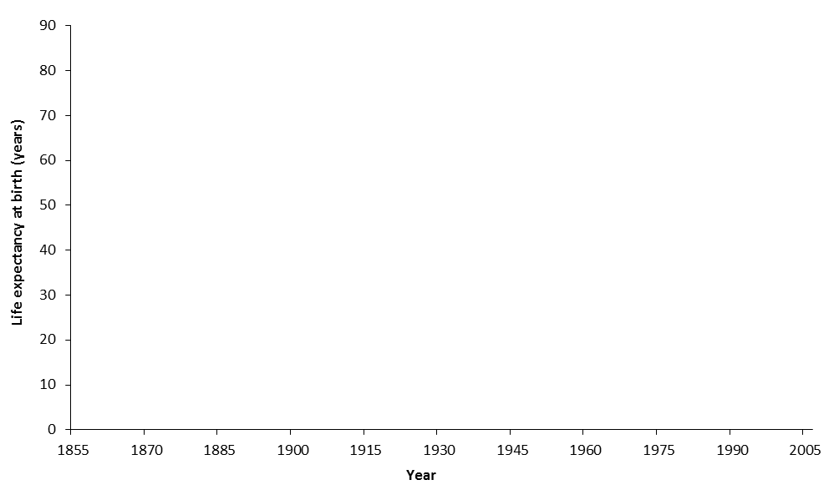
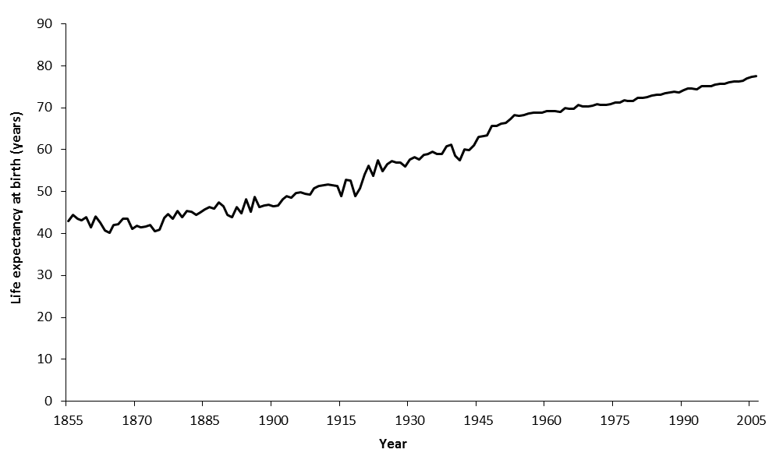
Infectious disease outbreaks, food supplies, wars
WWI and Spanish flu
Continuous improvement
WWII
Life expectancy in Scotland, 1855-2005

Slide 3
Life expectancy trends changed from 2012

Slide 4
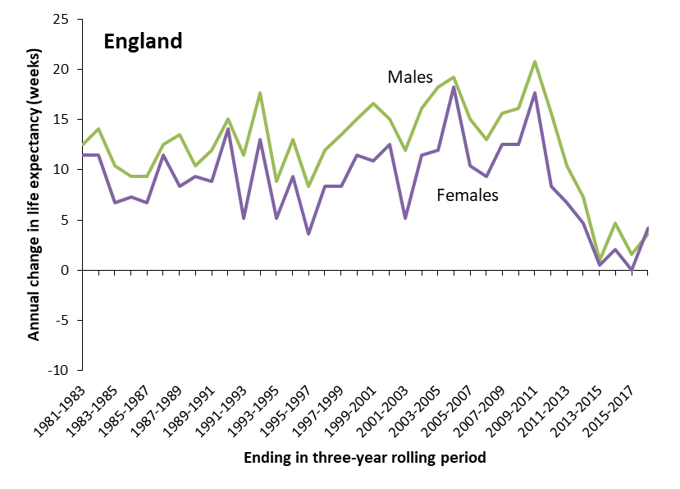
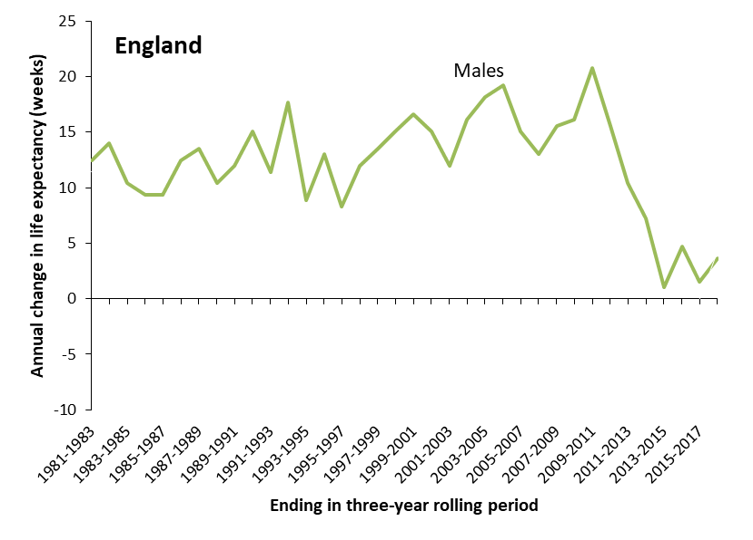

Slide 5
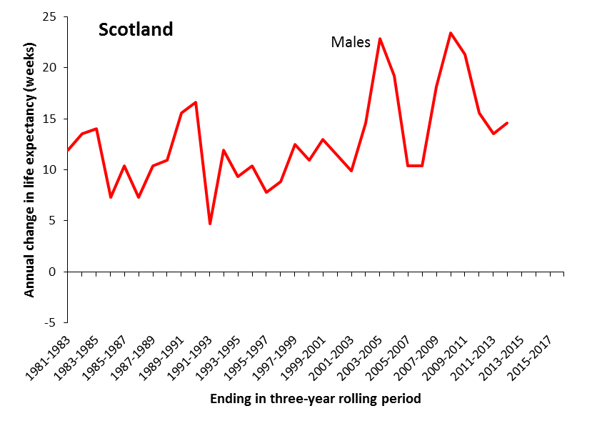
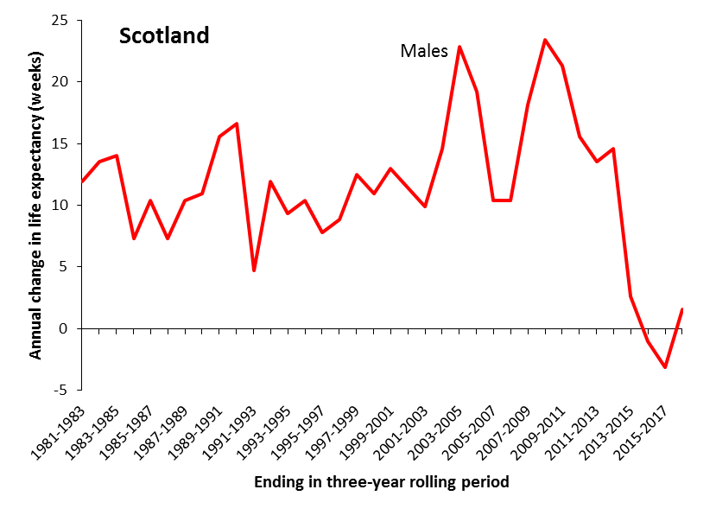
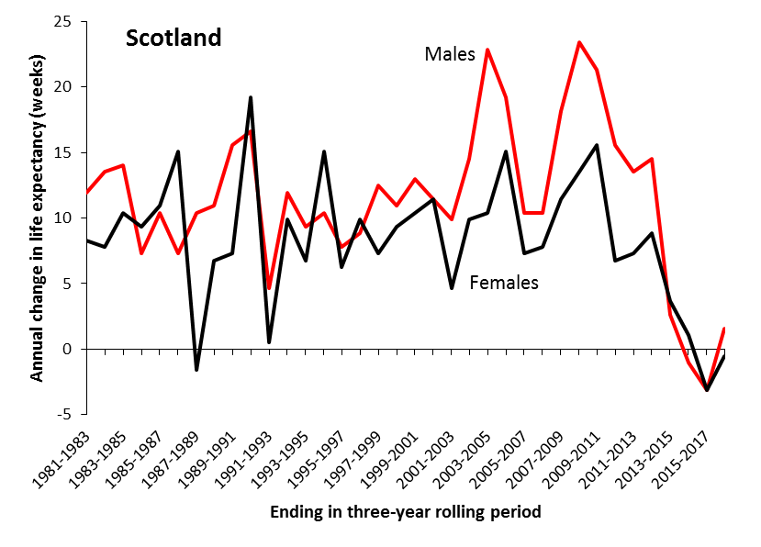

Slide 6
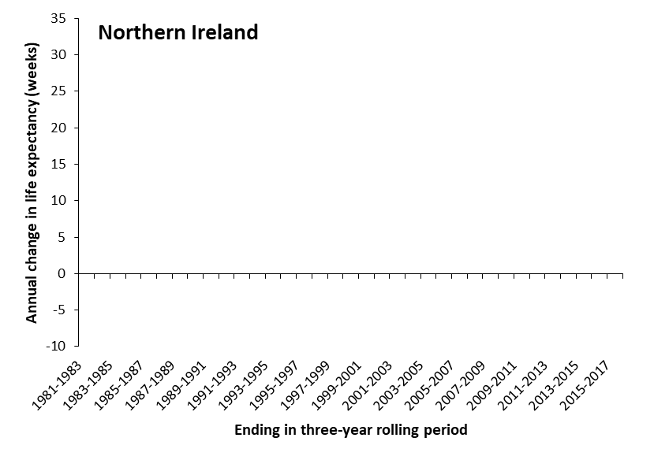
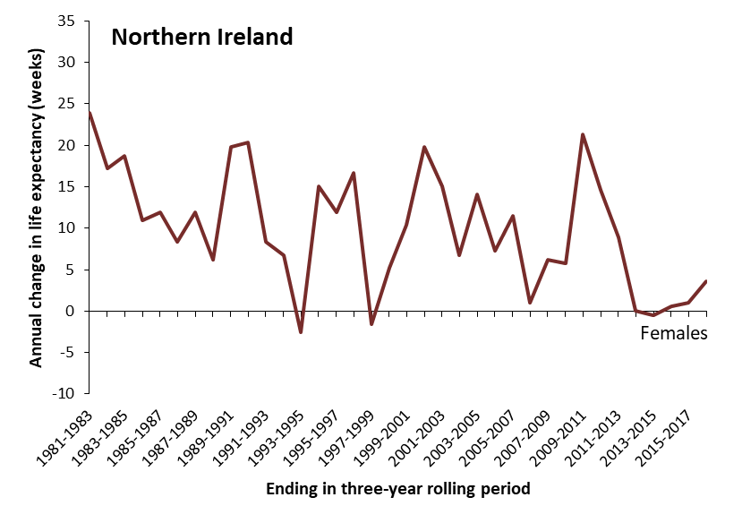
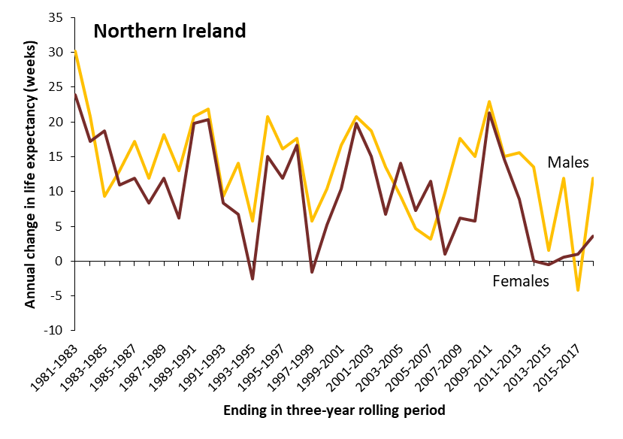

Slide 7
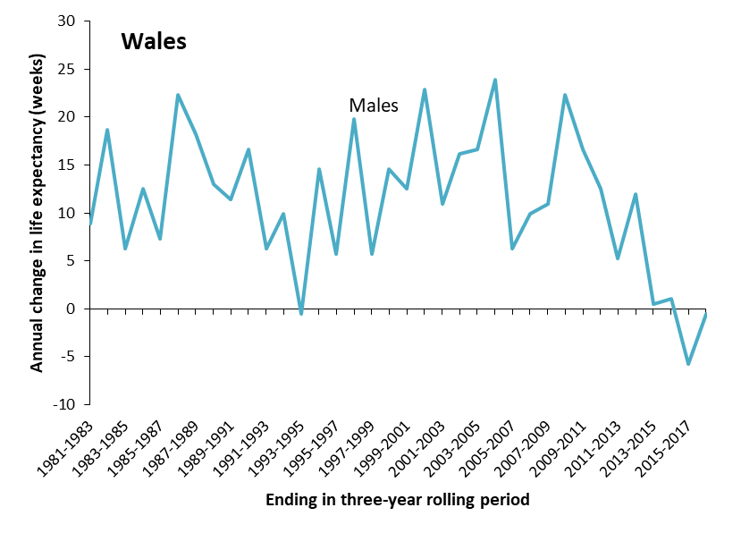
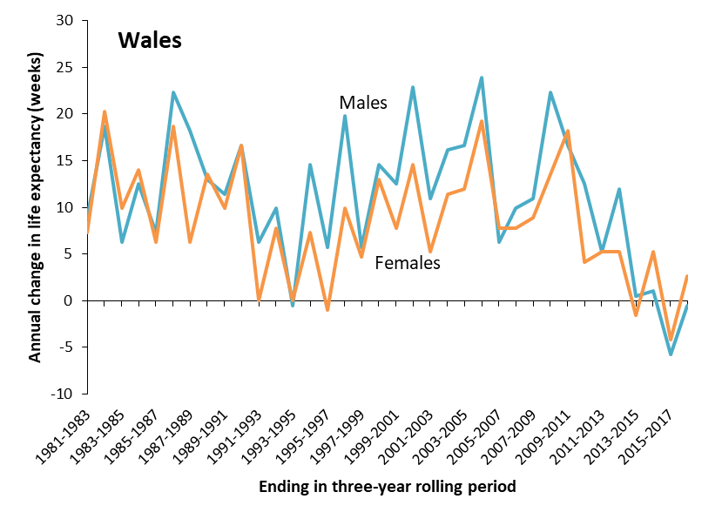

Slide 8
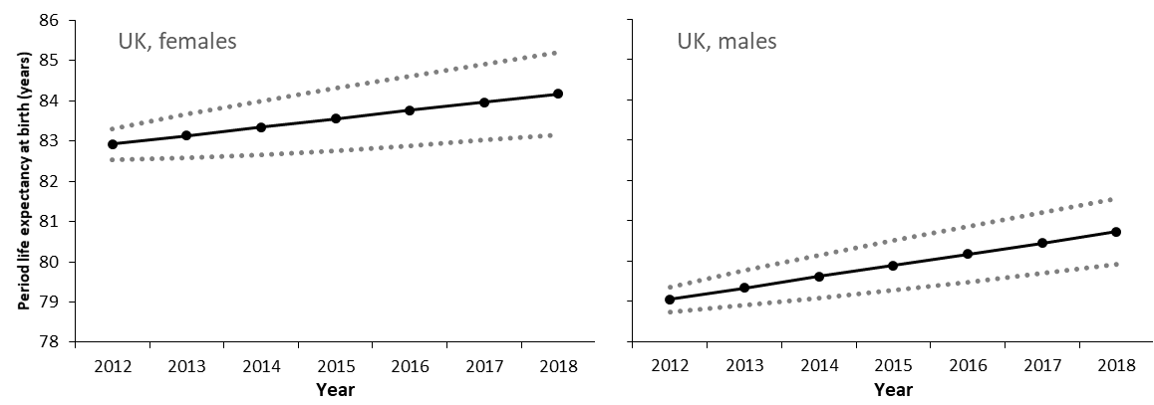
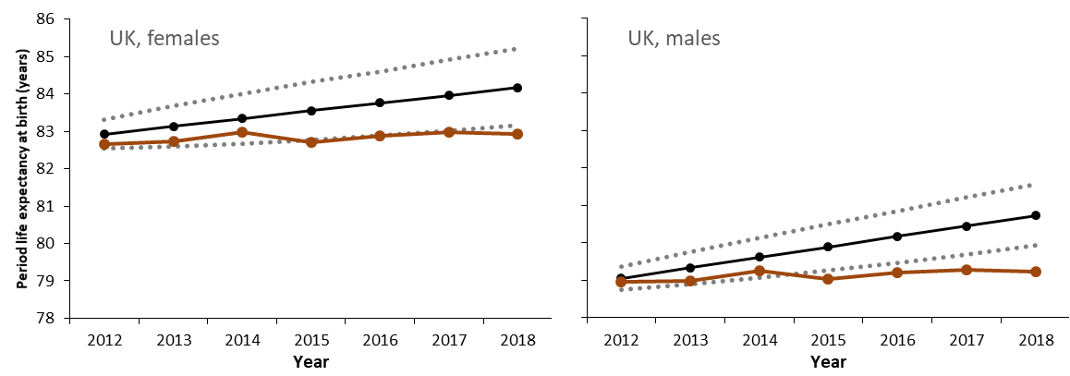
Actual versus projected life expectancy
(based on the 1990-2011 baseline)

Slide 9
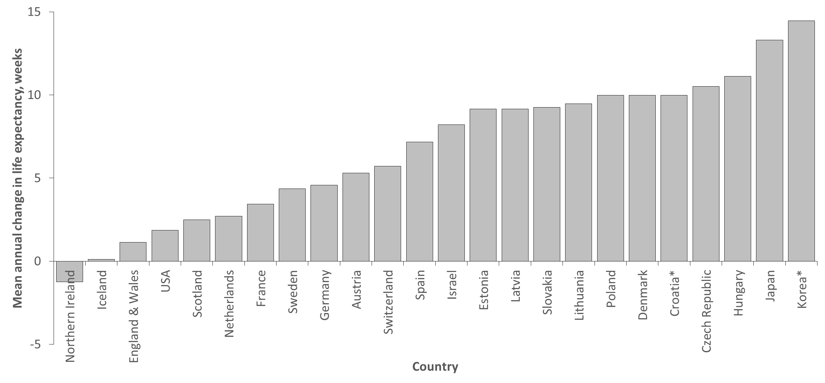
Mean annual change in female life expectancy, 2012-6

Slide 10
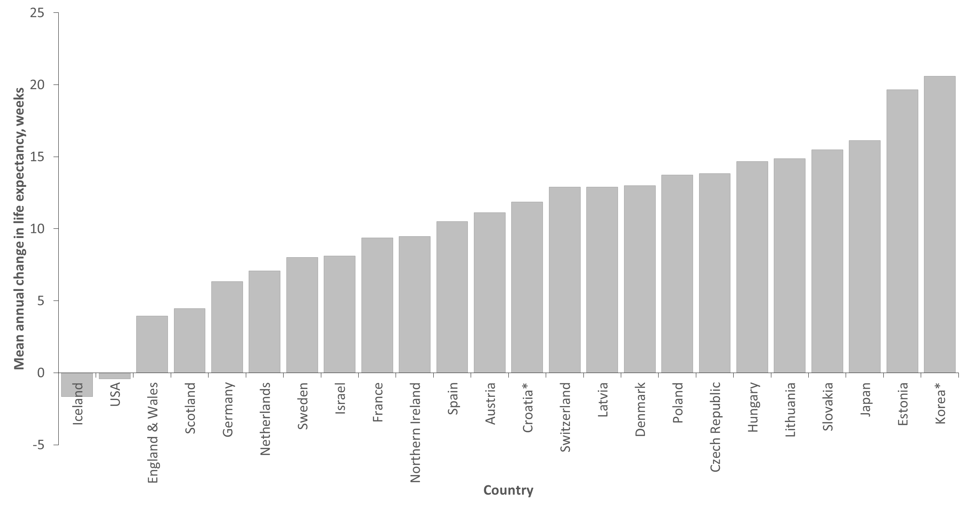
Mean annual change in male life expectancy, 2012-6

Slide 11
Almost all age groups and causes of death

Slide 12
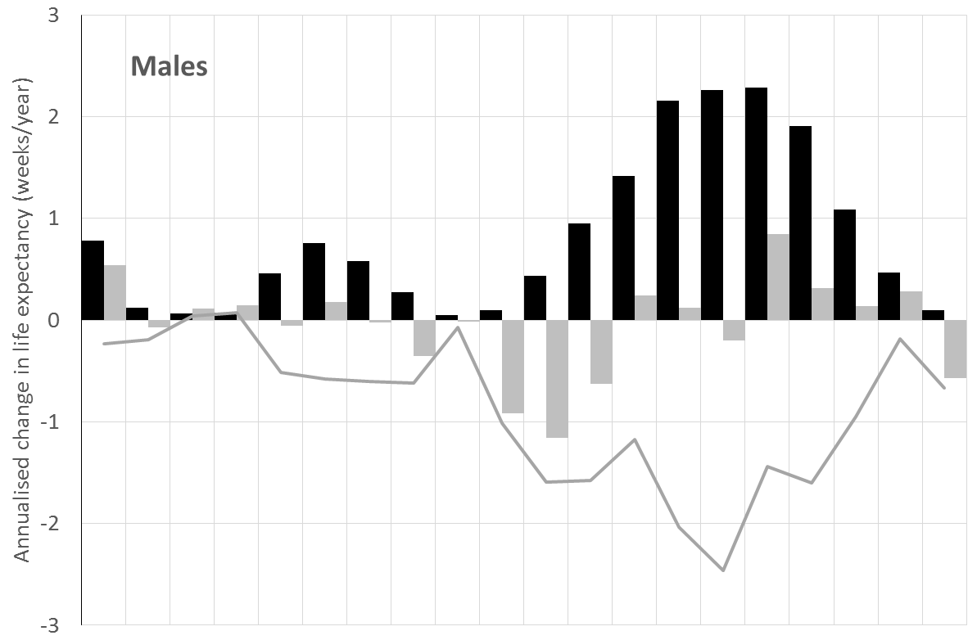
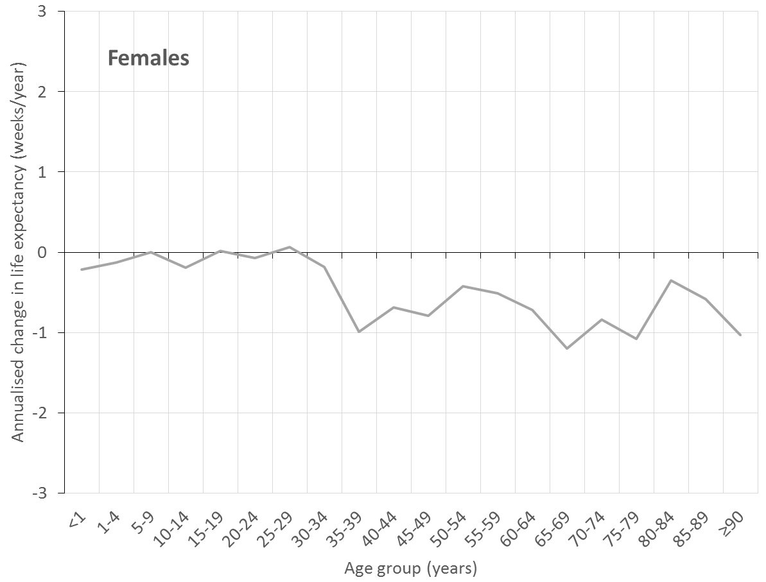
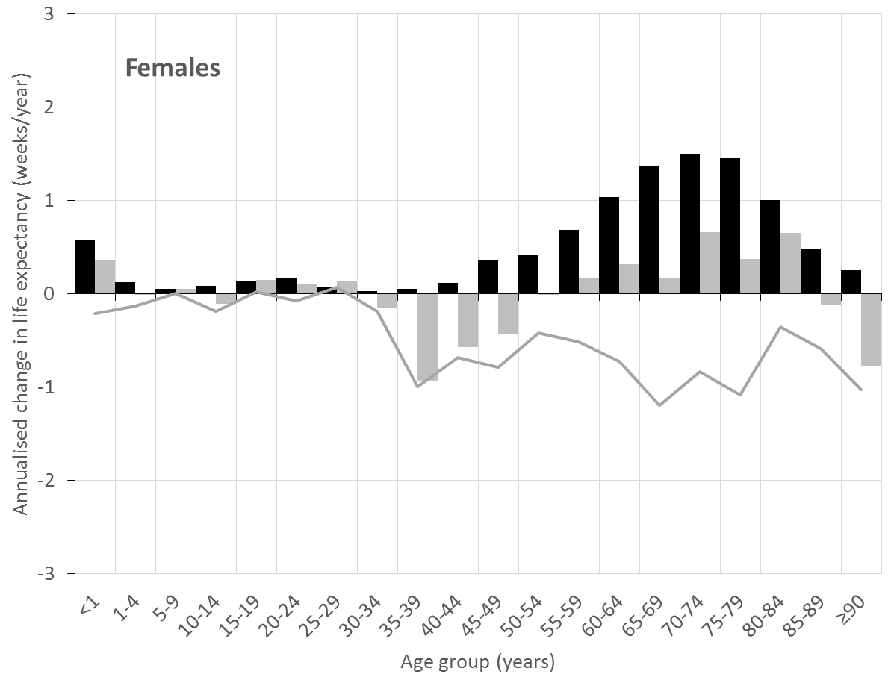
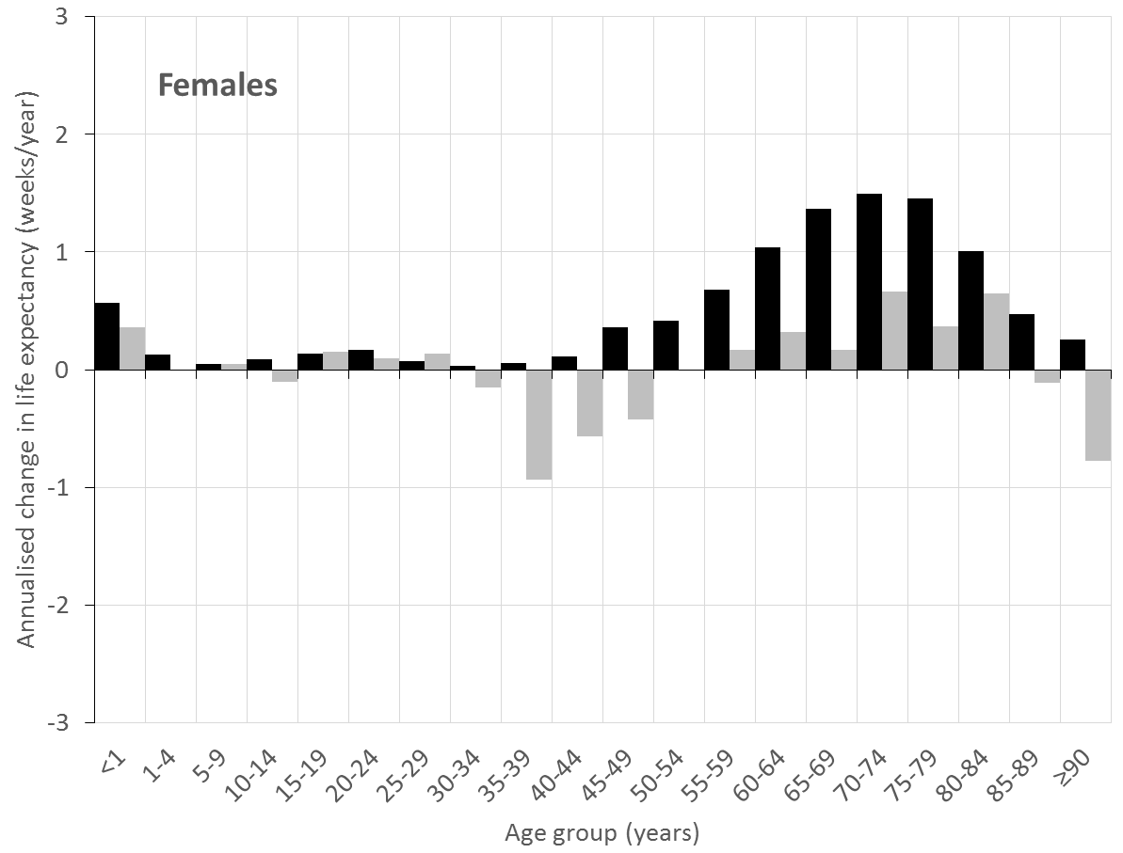
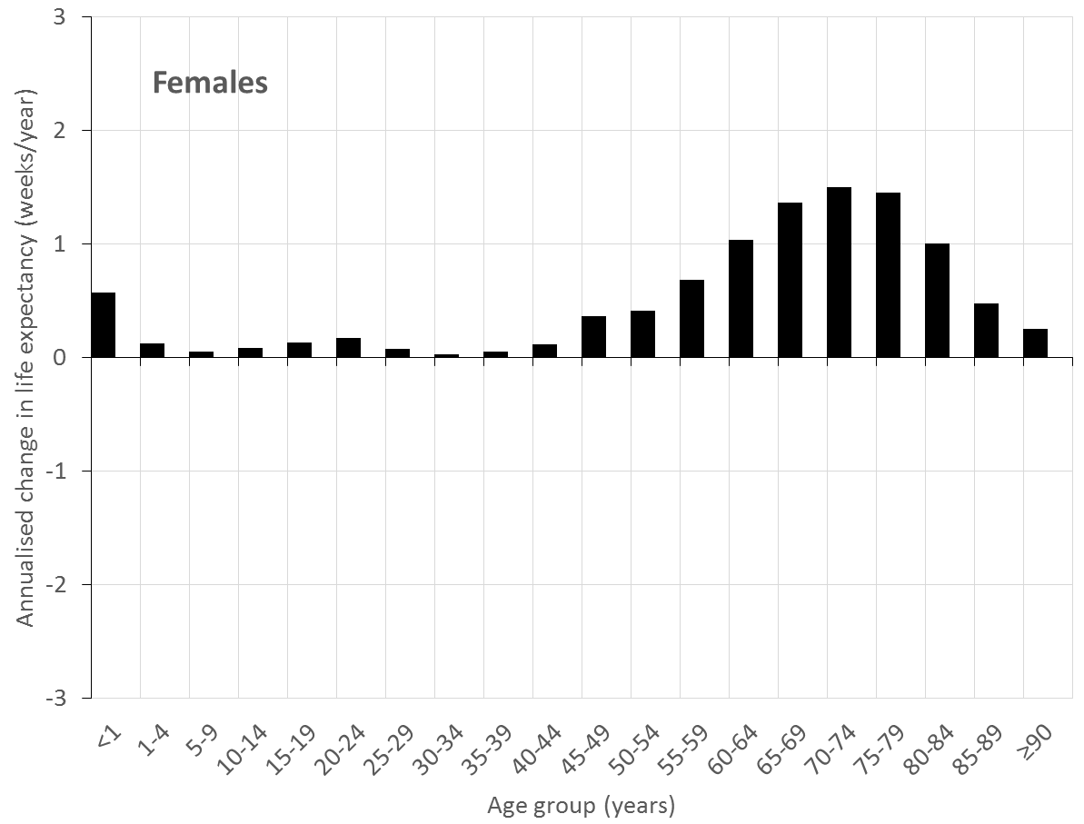
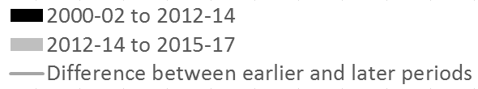
All age groups improving
Worsening in trend has happened at (almost) all ages

Slide 13
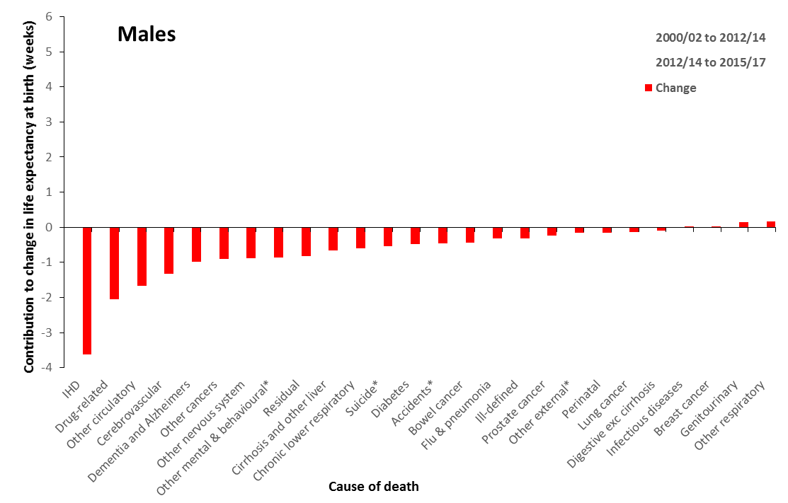
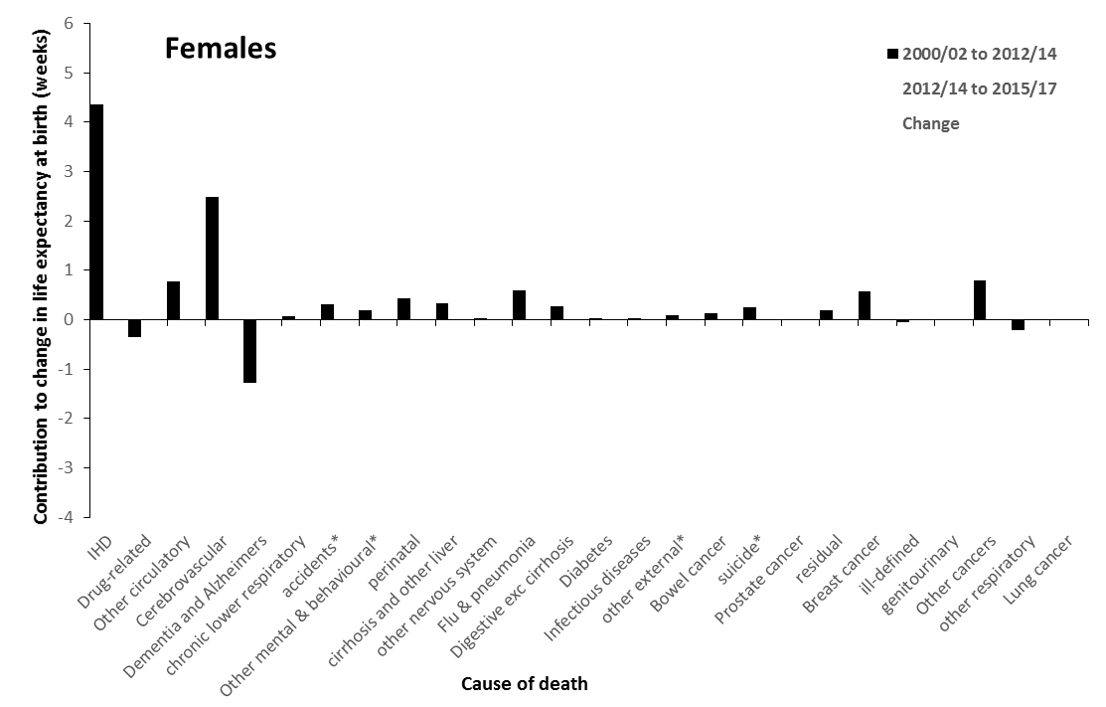
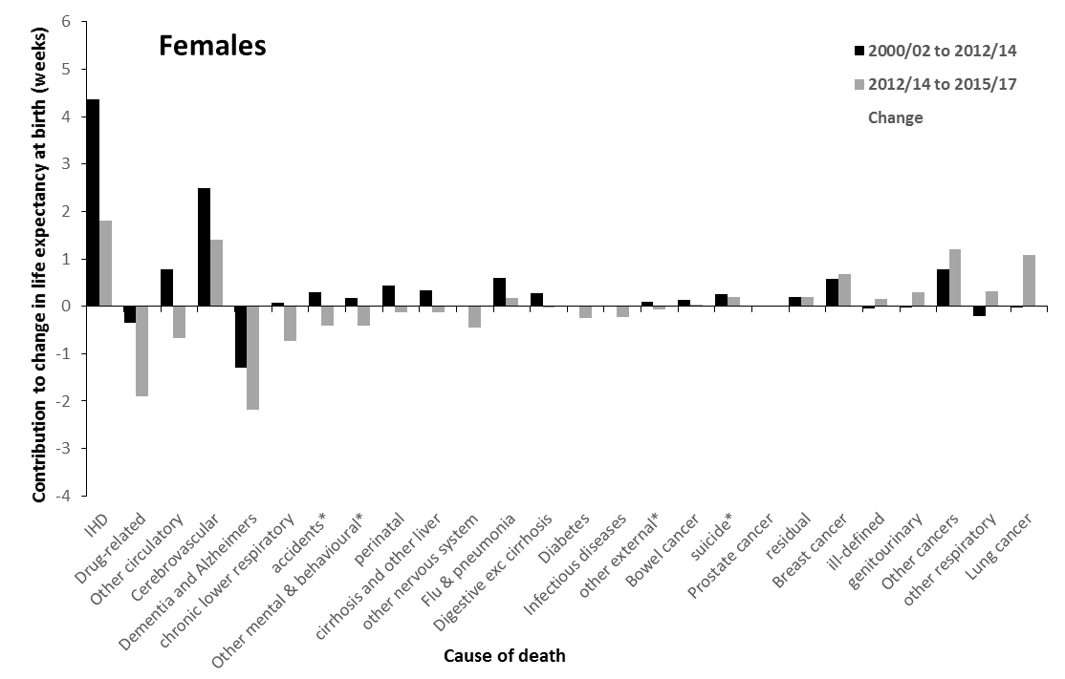
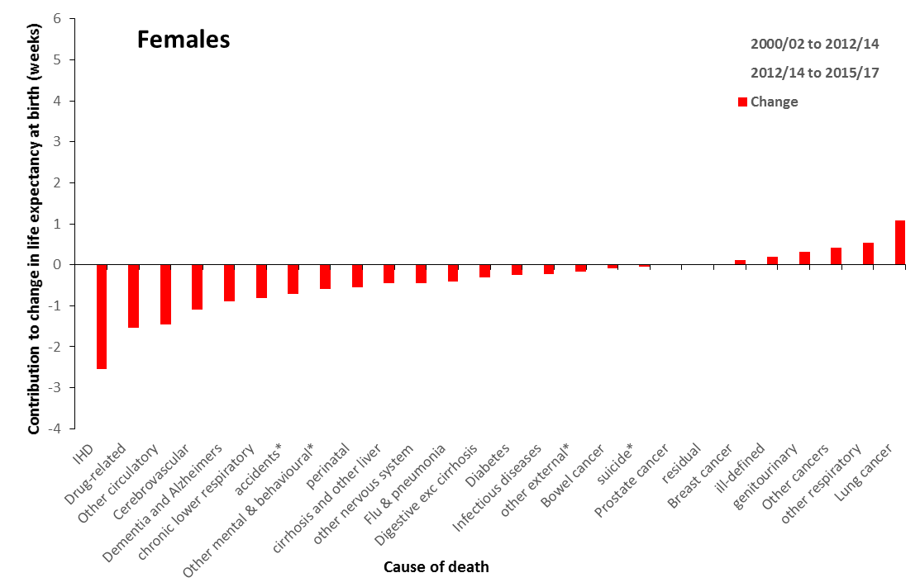
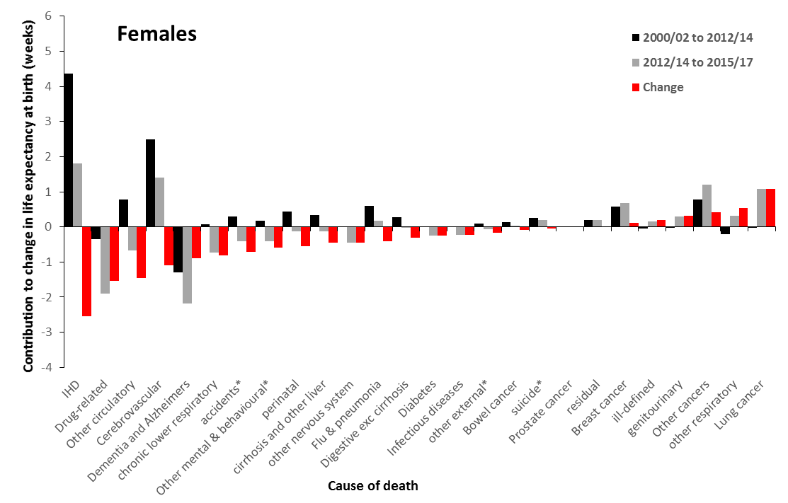

Slide 14
A rapid rise in unjust and avoidable inequalities

Slide 15
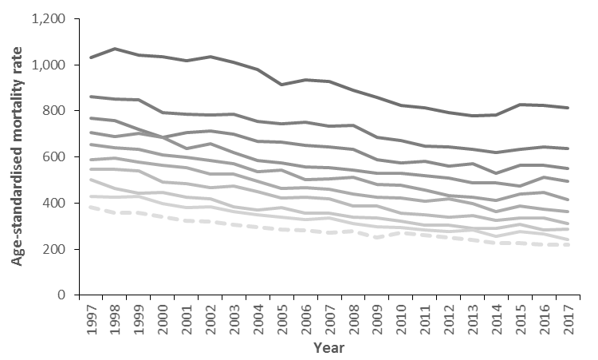
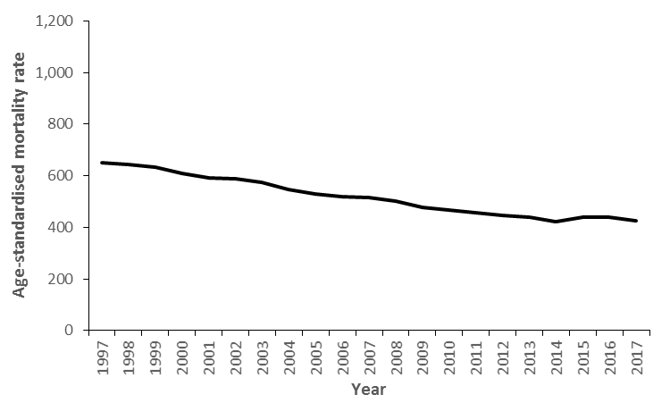
Scotland, men & women <75 years
Most deprived 10th
Least deprived 10th

Slide 16
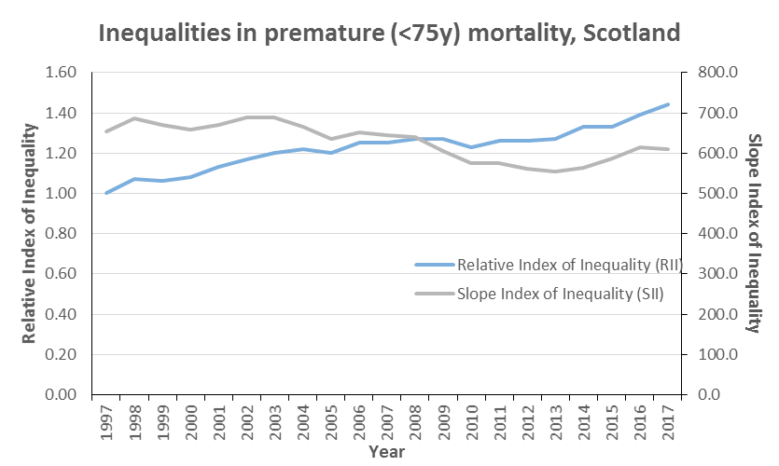

Slide 17
The causes are economic, working through a variety of pathways

Slide 18
Theory for the economic causes of the life expectancy trends
Pressures on:
Social care
NHS
Local government
Public spending squeezed
Change to value and conditionality of social security benefits
Wages squeezed
Precarious work

Slide 19
Theory for the economic causes of the life expectancy trends
Pressures on:
Social care
NHS
Local government
Public spending squeezed
Change to value and conditionality of social security benefits
Wages squeezed
Precarious work
Decreased incomes
Increased poverty
Decreased security

Slide 20
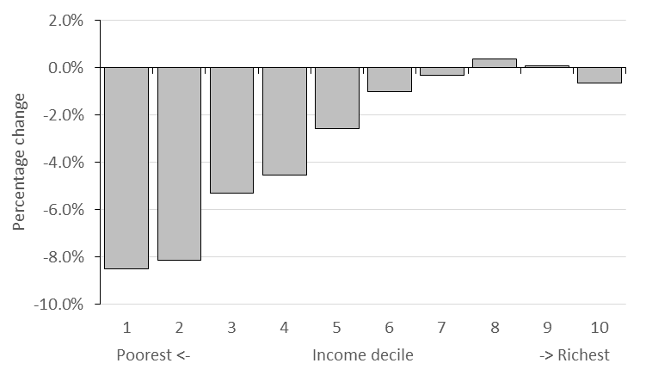
Percentage impact of reforms to taxes and transfer payments by household net income decile, 2010-2011 to 2021-22 tax year, Great Britain
Source: Portes et al. The cumulative impact of tax and welfare reforms. Manchester, Equality and Human Rights Commission, 2018.

Slide 21
Theory for the economic causes of the life expectancy trends
Pressures on:
Social care
NHS
Local government
Public spending squeezed
Poor housing
Poor nutrition
Less ability to maintain healthy behaviours
Risk of rough sleeping
Destructive coping mechanisms
Poor mental health
Social isolation
Change to value and conditionality of social security benefits
Wages squeezed
Precarious work
Decreased incomes
Increased poverty
Decreased security

Slide 22
Theory for the economic causes of the life expectancy trends
Pressures on:
Social care
NHS
Local government
Public spending squeezed
Poor housing
Poor nutrition
Less ability to maintain healthy behaviours
Risk of rough sleeping
Destructive coping mechanisms
Poor mental health
Social isolation
Stalling of most causes of death
Change to value and conditionality of social security benefits
Increased inequalities in mortality
Wages squeezed
Precarious work
Decreased incomes
Increased poverty
Decreased security

Slide 23
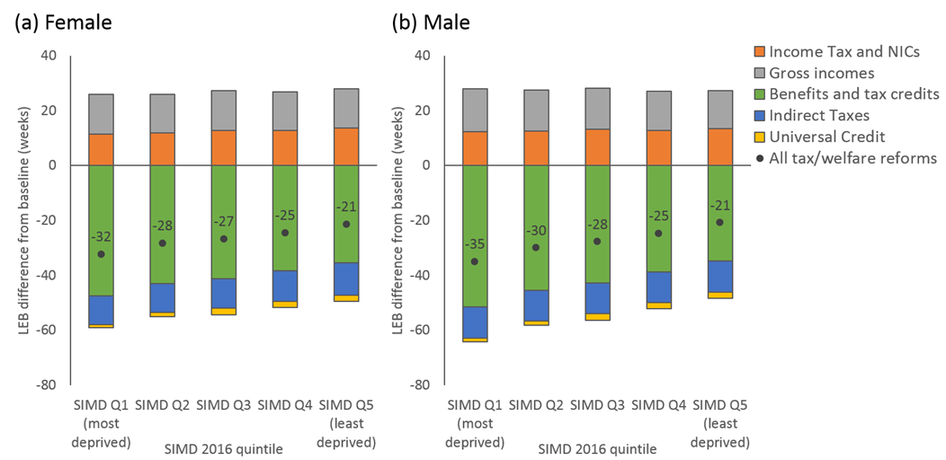
Modelled impact of changes to taxes and transfer payments (2010-2011 to 2021-22) on life expectancy, Scotland (preliminary analysis using Triple I tool)
84.2 years to 83.7 years (-29 weeks)
79.5 years to 78.9 years (-30 weeks)

Slide 24
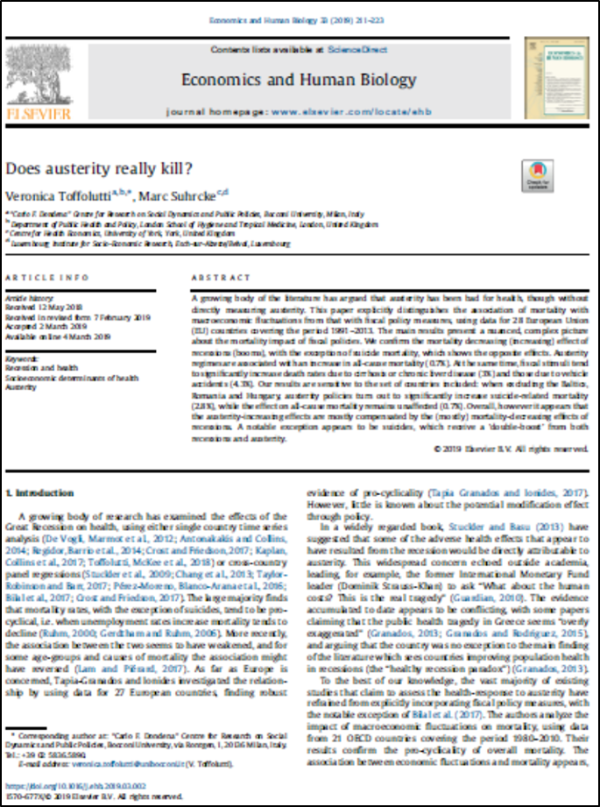
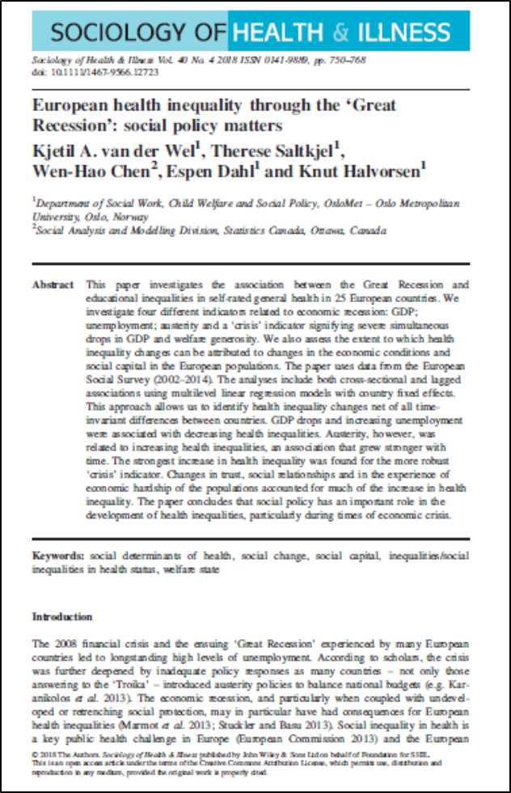
Austerity
regimes are associated with an increase in all-cause mortality (0.7%).
Austerity, however, was
related to increasing health inequalities, an association that grew stronger with
time.
The results suggest a negative effect on mortality in those countries that
apply a higher level of austerity.

Slide 25
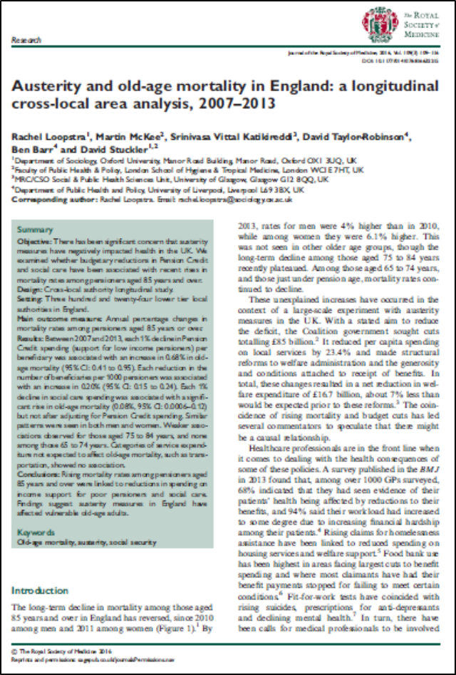

Slide 26
It’s not an ageing population
These trends are shown in life expectancy and age-standardised mortality data

Slide 27
It’s not a ‘natural’ limit
Trends have changed at all age groups, not just the oldest
Trends are worst in the most deprived groups where life expectancy is already lowest
Life expectancy continues to improve in countries who lead the world such as Japan

Slide 28
It’s not all ‘flu
All causes of death impacted including implausible causes such as drug-related deaths
Trends changed in 2012 across most countries, not in the ‘flu-year’ 2015, and have been sustained subsequently
All age groups impacted

Slide 29
Summary and implications
This is the biggest public health challenge for many decades – encompassing the sub-plots on drug deaths, homelessness, poverty, etc.
Austerity, social security cuts, service cuts/pressures all likely to be causal
We need to reverse and mitigate these economic and social policies
We need to design our services to meet the unmet needs of the population and ensure accessibility to those who need those services most
We need a public health approach to substance misuse
We need your leadership to ensure all relevant policymakers and service managers at all levels understand the contribution they can make
We have a duty to explain and champion action for our population/patients

Slide 30
Towards a shared narrative?
There are different emphases about the causes of the life expectancy trends across agencies at present
We have been working towards a more collaborative and shared approach to this
There is some way to go to develop a shared narrative across agencies, not least because of different governance arrangements and political pressures
Dialogue ongoing

Slide 31
All the data and evidence is summarised at: www.scotpho.org.uk/population-dynamics/recent-mortality-trends/
The programme of research and dissemination is detailed here:
https://www.scotphn.net/groups/public-health-mortality-monitoring/mortality-sig-introduction/
Contact me at:
Email: gmccartney@nhs.net
Twitter: @gerrymccartney1

