Slide 1
Why life expectancy trends have changed, health inequalities are increasing, and our duty to respond
Gerry McCartney
…on behalf of a new and fantastic collaboration of people working across public health
Faculty of Public Health conference, November 2019

Slide 2
My objectives for the next 25 minutes:
To demonstrate that life expectancy trends changed from 2012, but not everywhere
…that this is due to changes for almost all age groups and causes of death
…that this is leading to a rapid rise in unjust and avoidable health inequalities
…that the causes are most likely to be economic, working through a variety of pathways
To convince you that you all have a vital role in reversing these trends

Slide 3
Why does this matter?
Life expectancy is a very good marker of overall societal progress

Slide 4
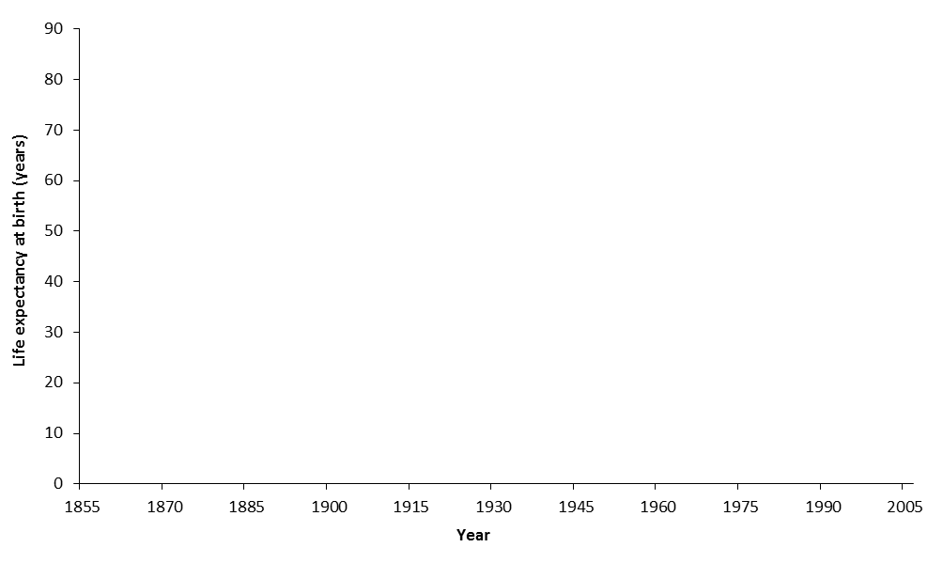
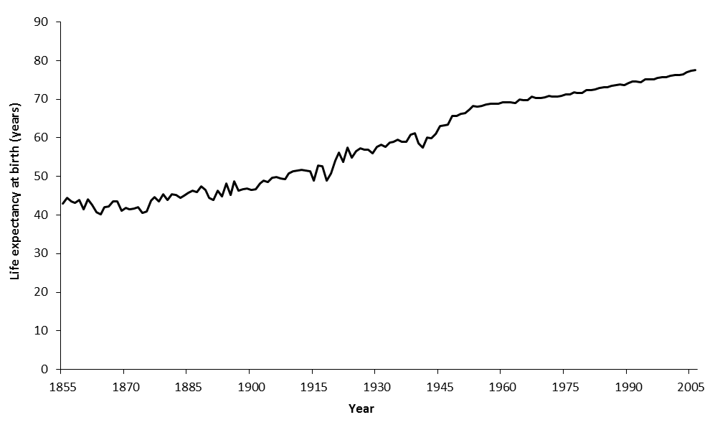
Infectious disease outbreaks, food supplies, wars
WWI and Spanish flu
Continuous improvement
WWII
Life expectancy in Scotland, 1855-2005

Slide 5
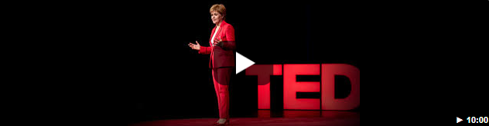
Why does this matter?
Life expectancy is a very good marker of overall societal progress
Underneath these numbers are personal and community tragedies
The First Minister is now explicit that population well-being is a top priority for the Scottish Government
We can change these trends

Slide 6
Life expectancy trends changed from 2012

Slide 7
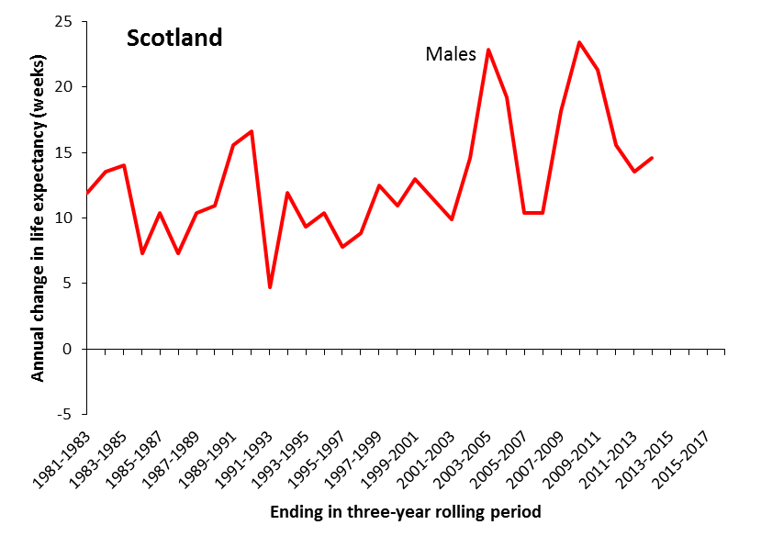
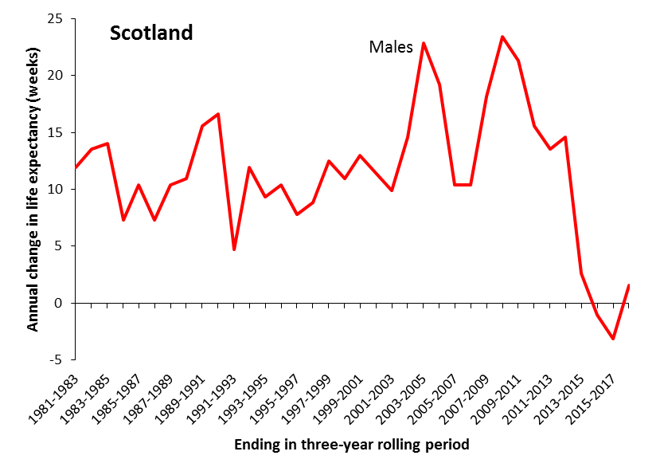
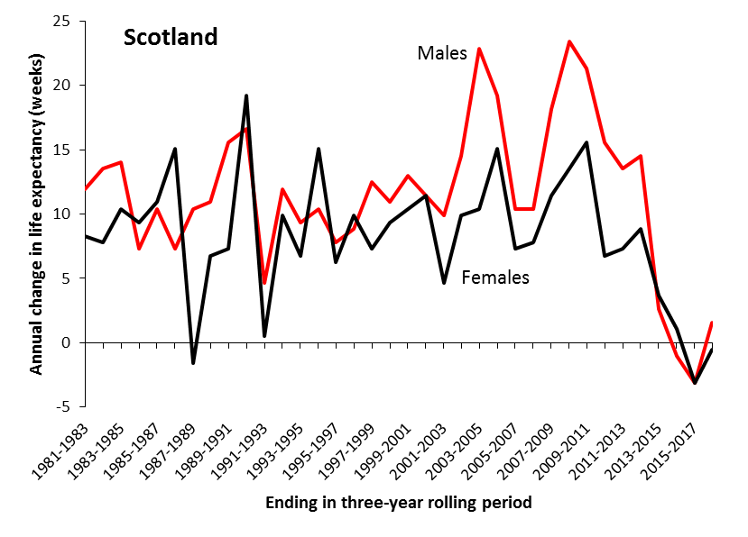

Slide 8
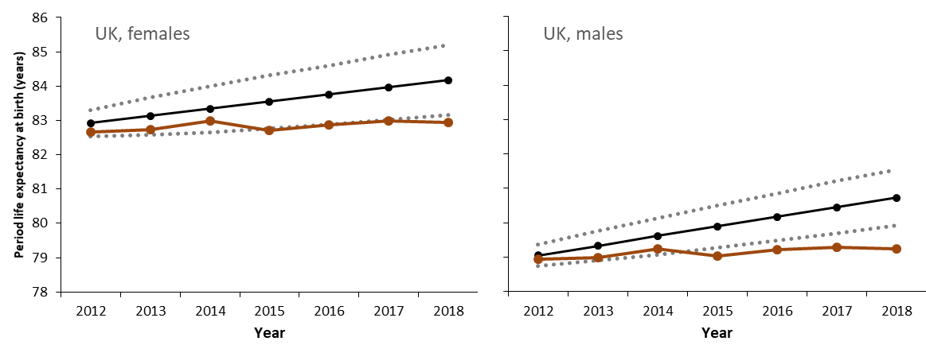
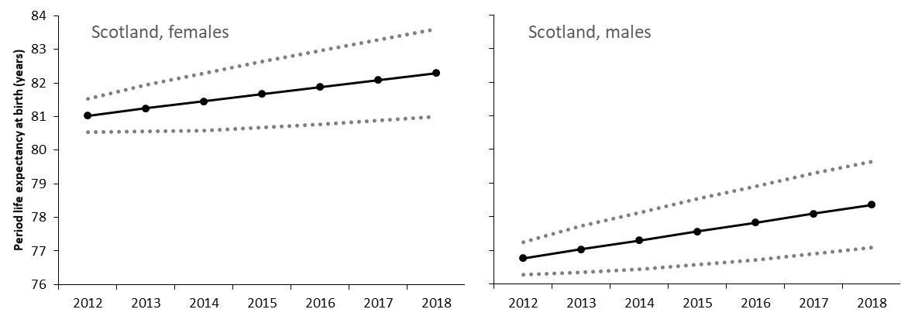
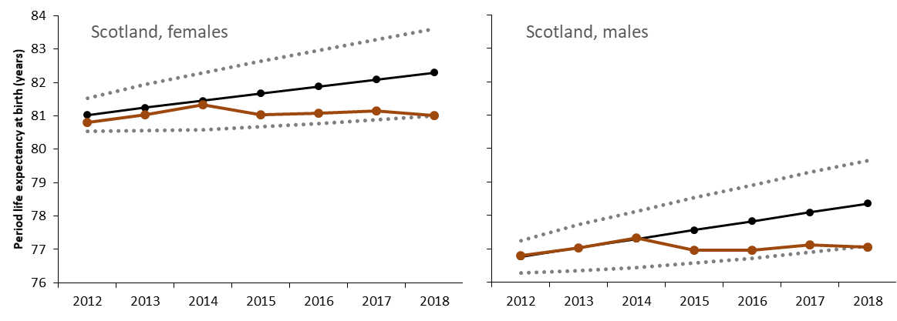
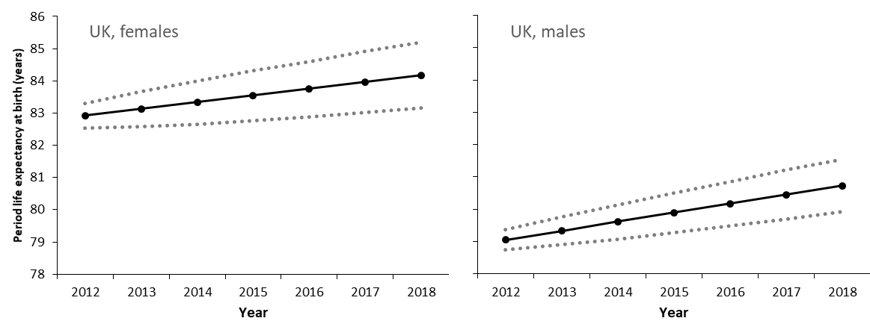
Projected versus actual life expectancy trends
Projection based on year-to-year variance between 1990 and 2011

Slide 9
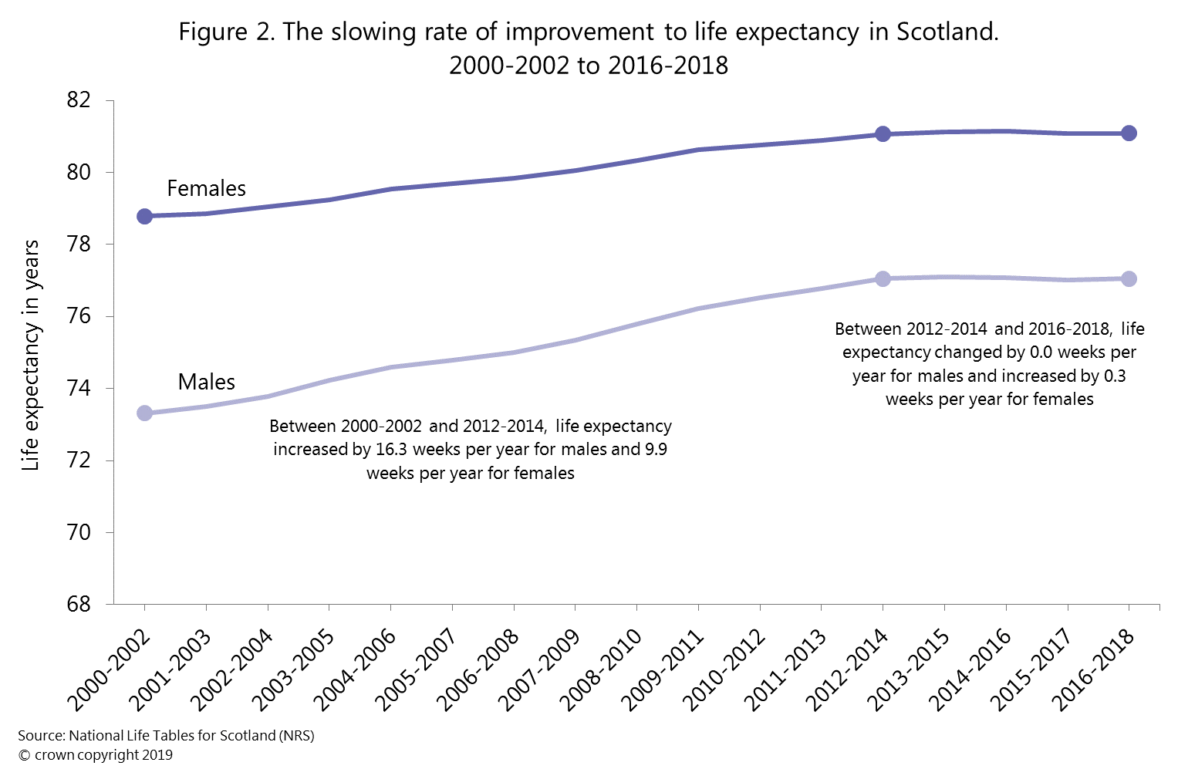

Slide 10
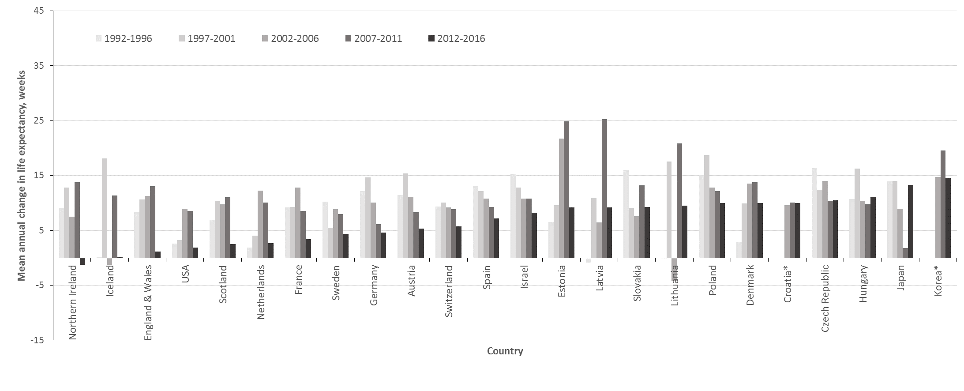
Mean annual change in female life expectancy

Slide 11
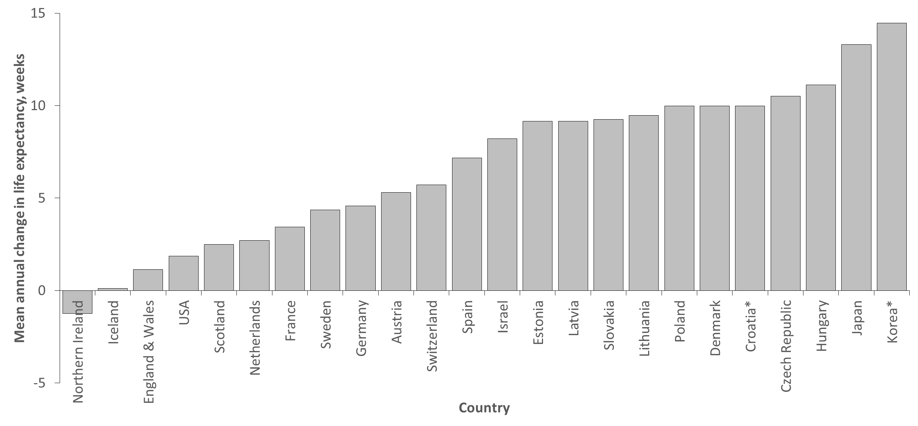
Mean annual change in female life expectancy, 2012-6

Slide 12
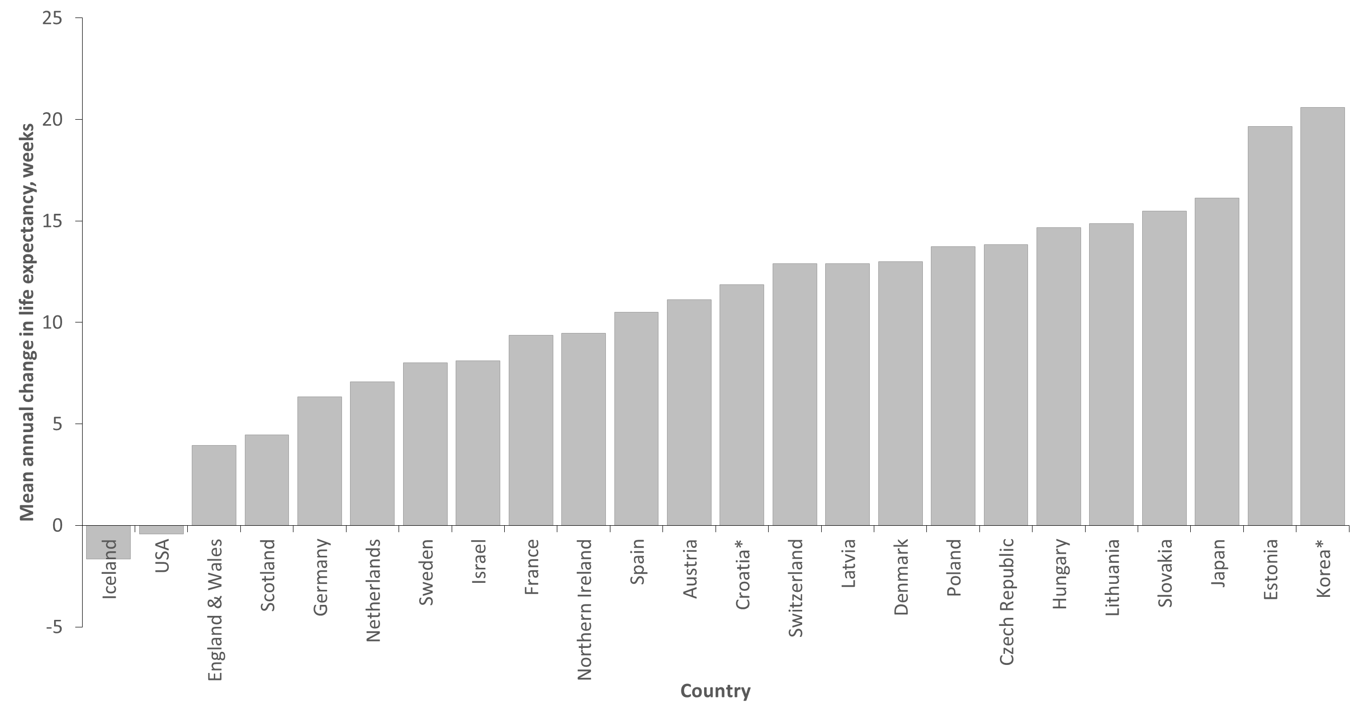
Mean annual change in male life expectancy, 2012-6

Slide 13
Almost all age groups and causes of death

Slide 14
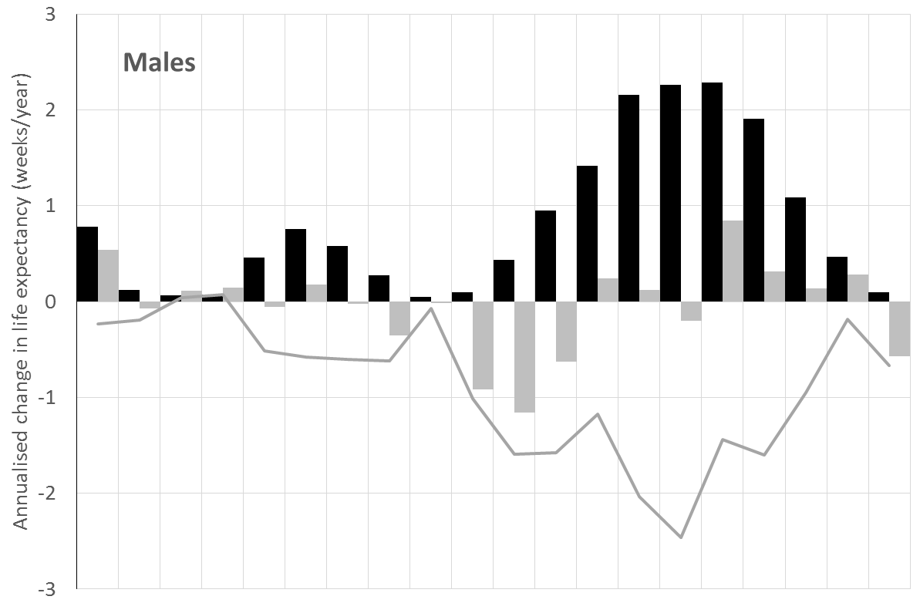
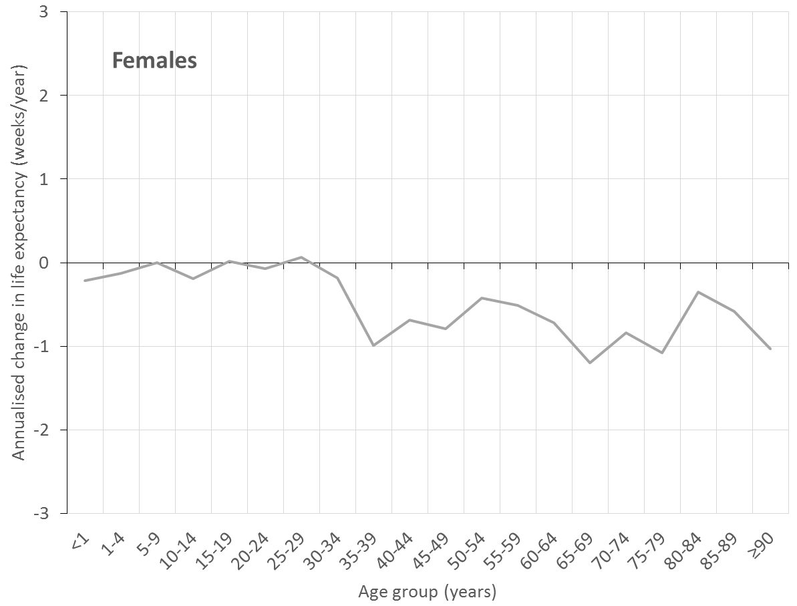
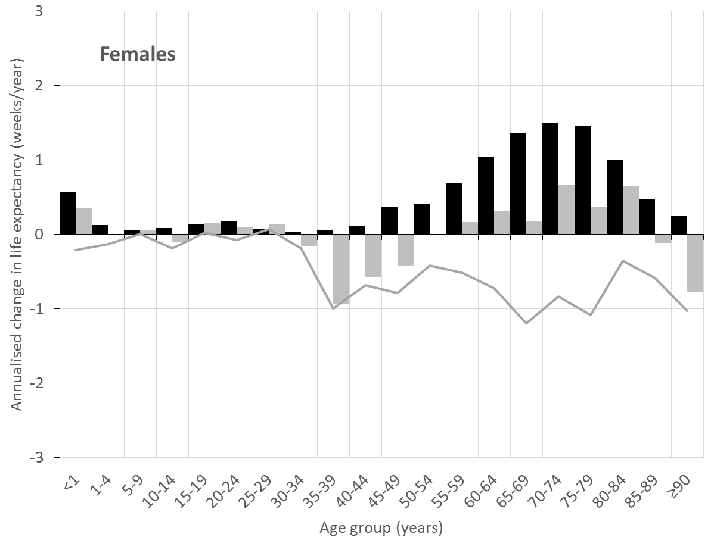
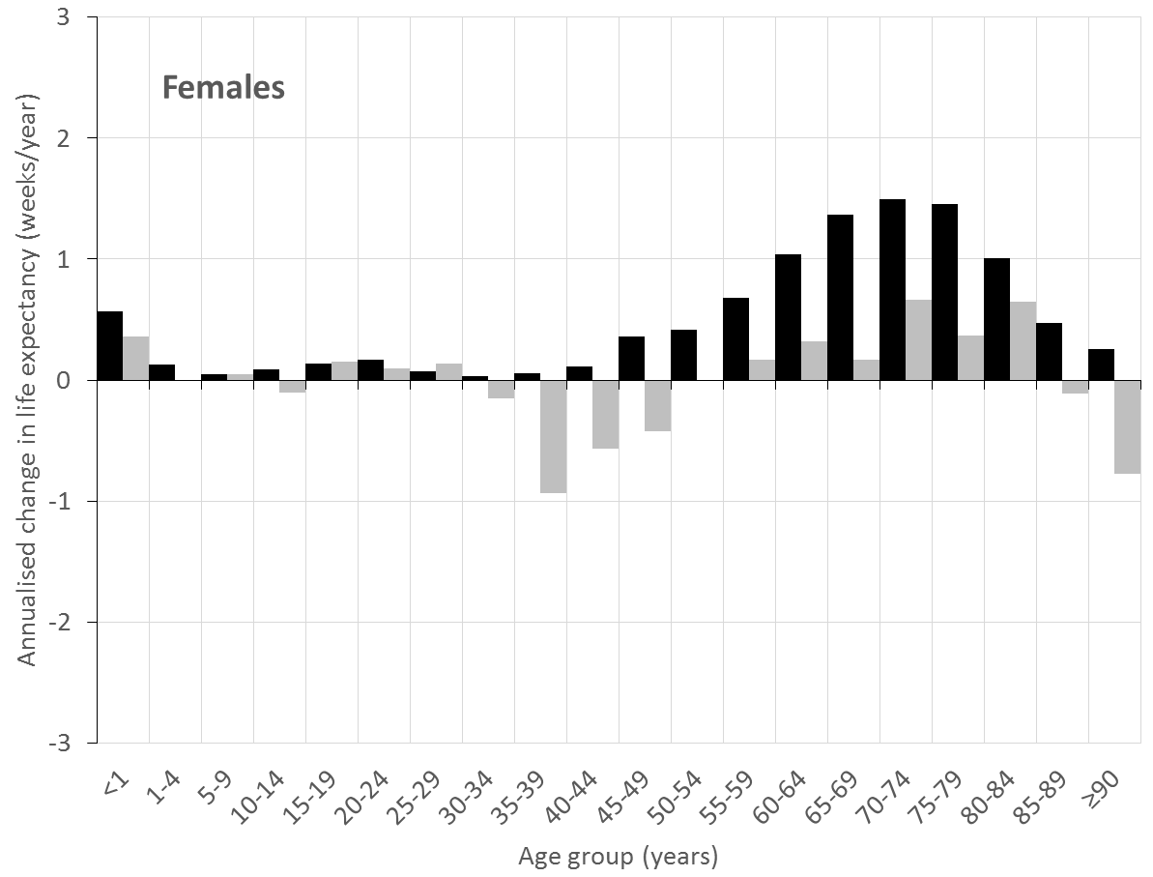
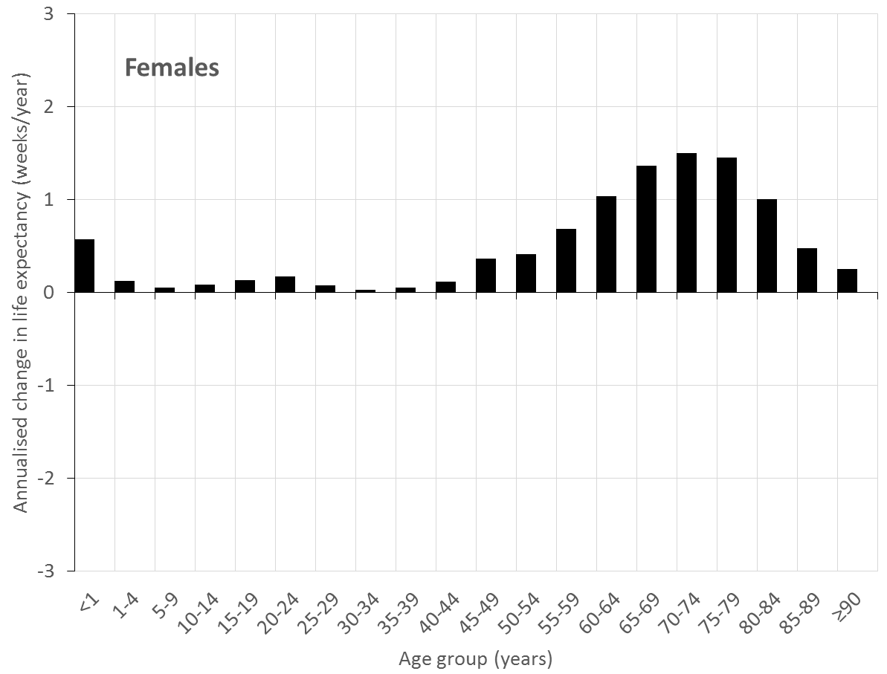
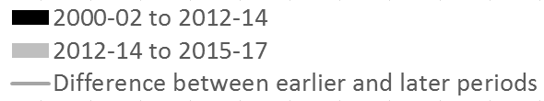
All age groups improving
Worsening in trend has happened at (almost) all ages

Slide 15
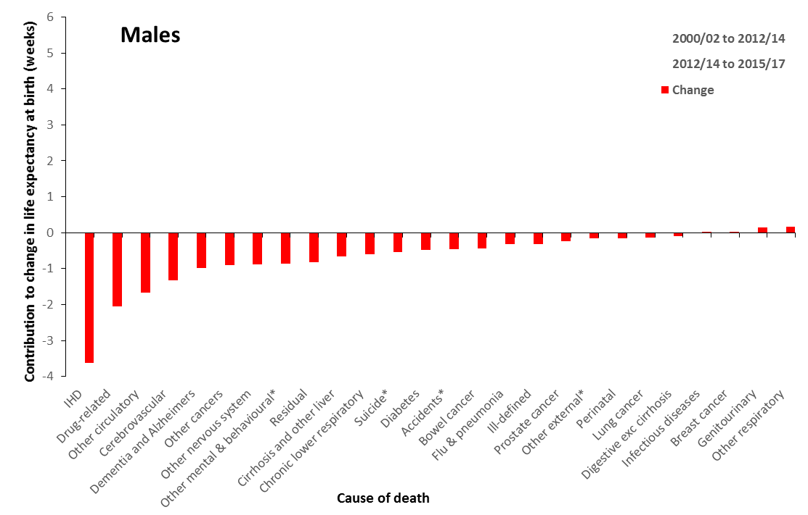
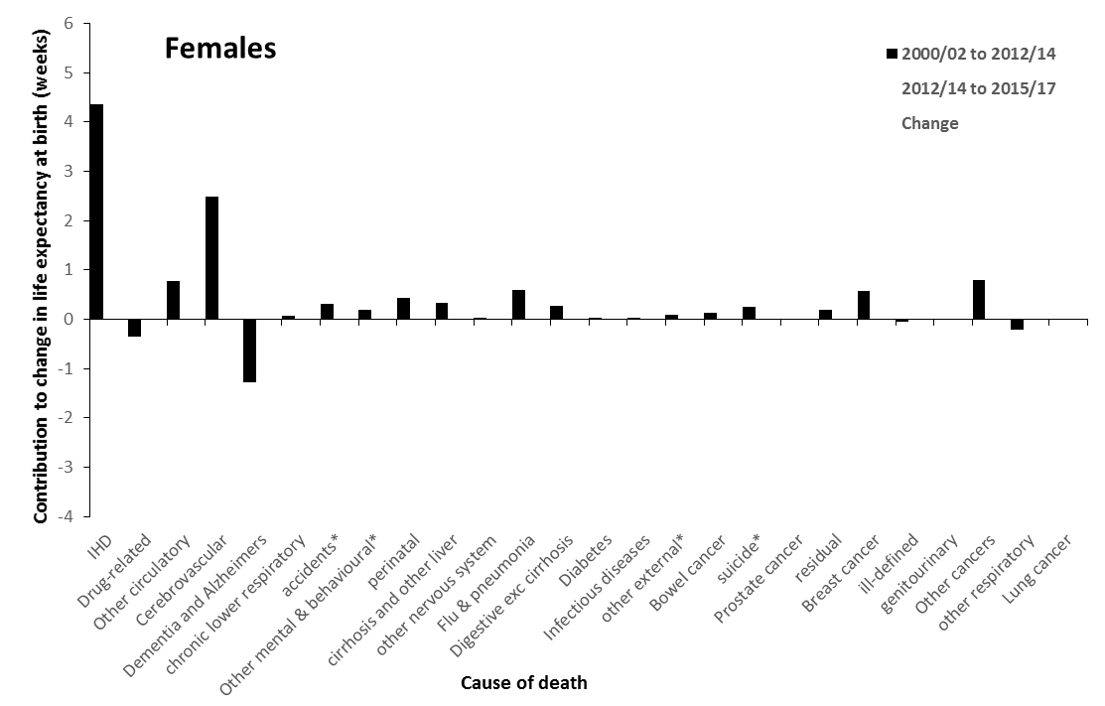
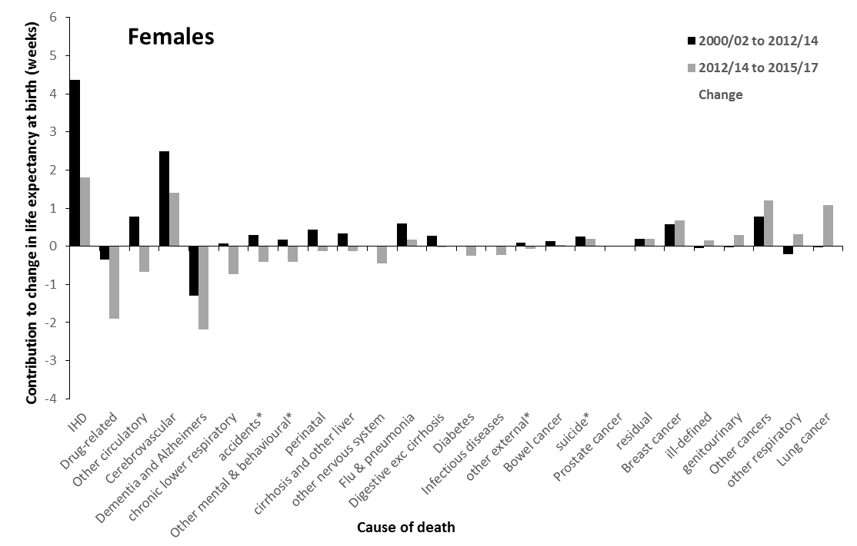
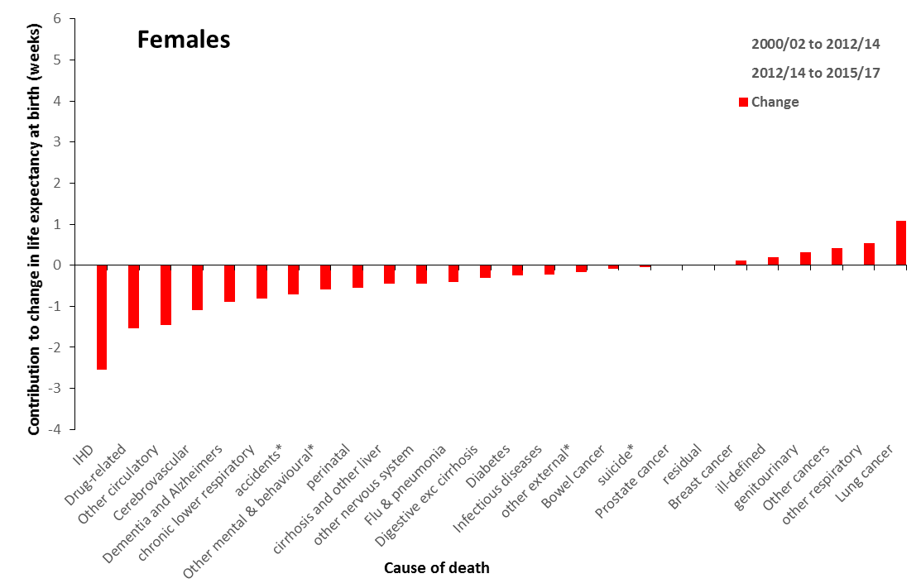
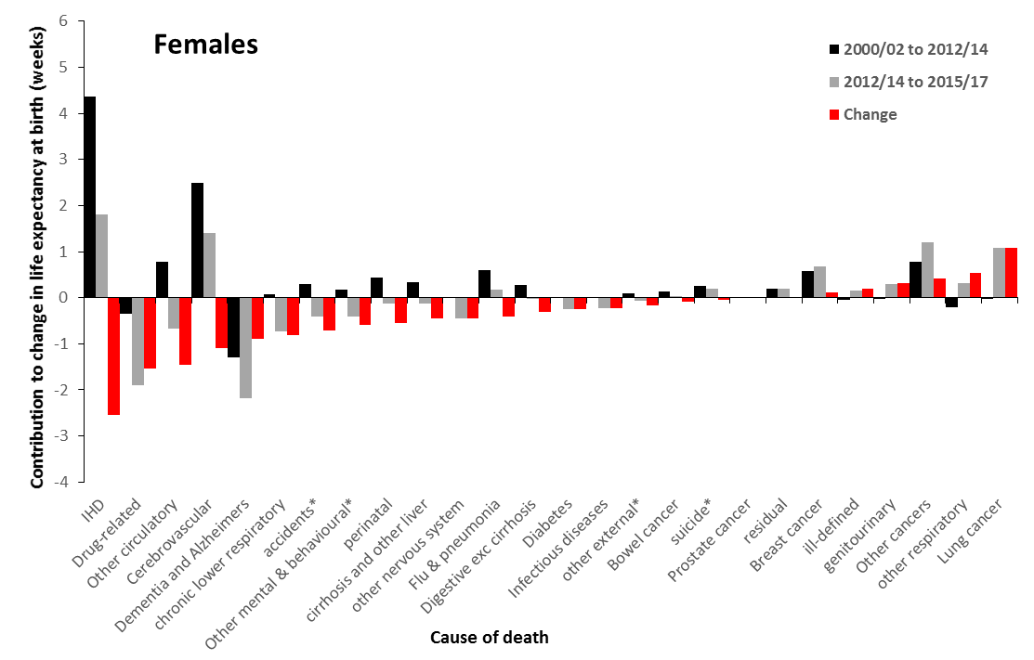

Slide 16
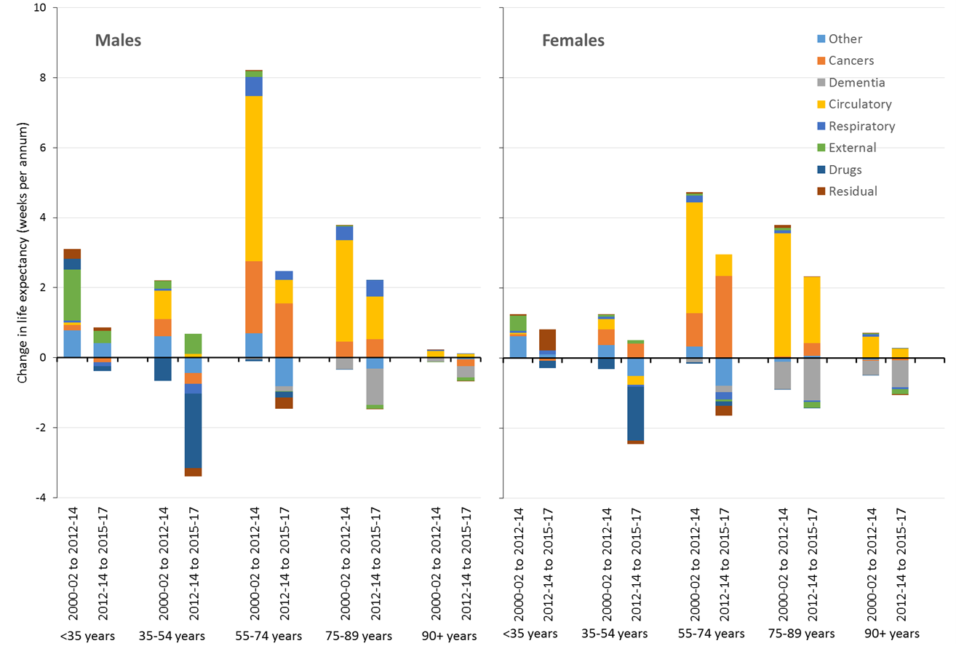

Slide 17
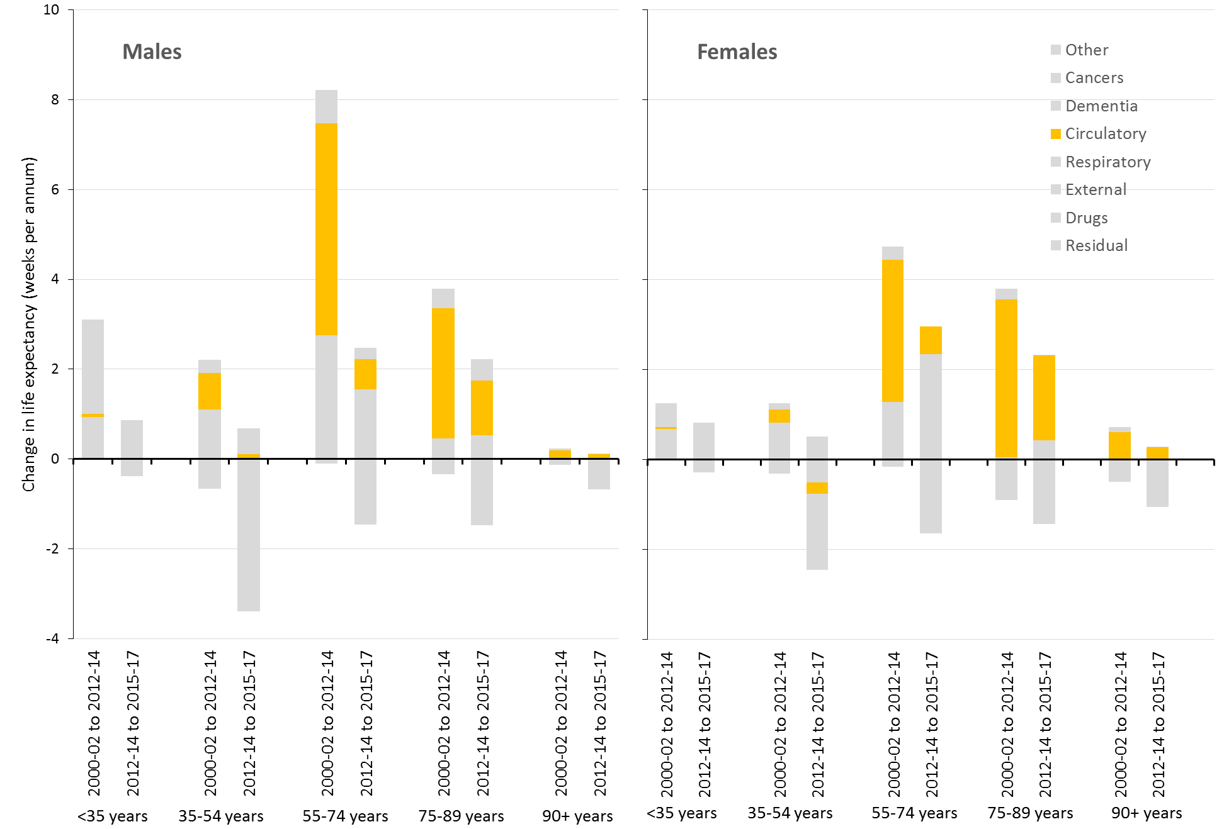

Slide 18
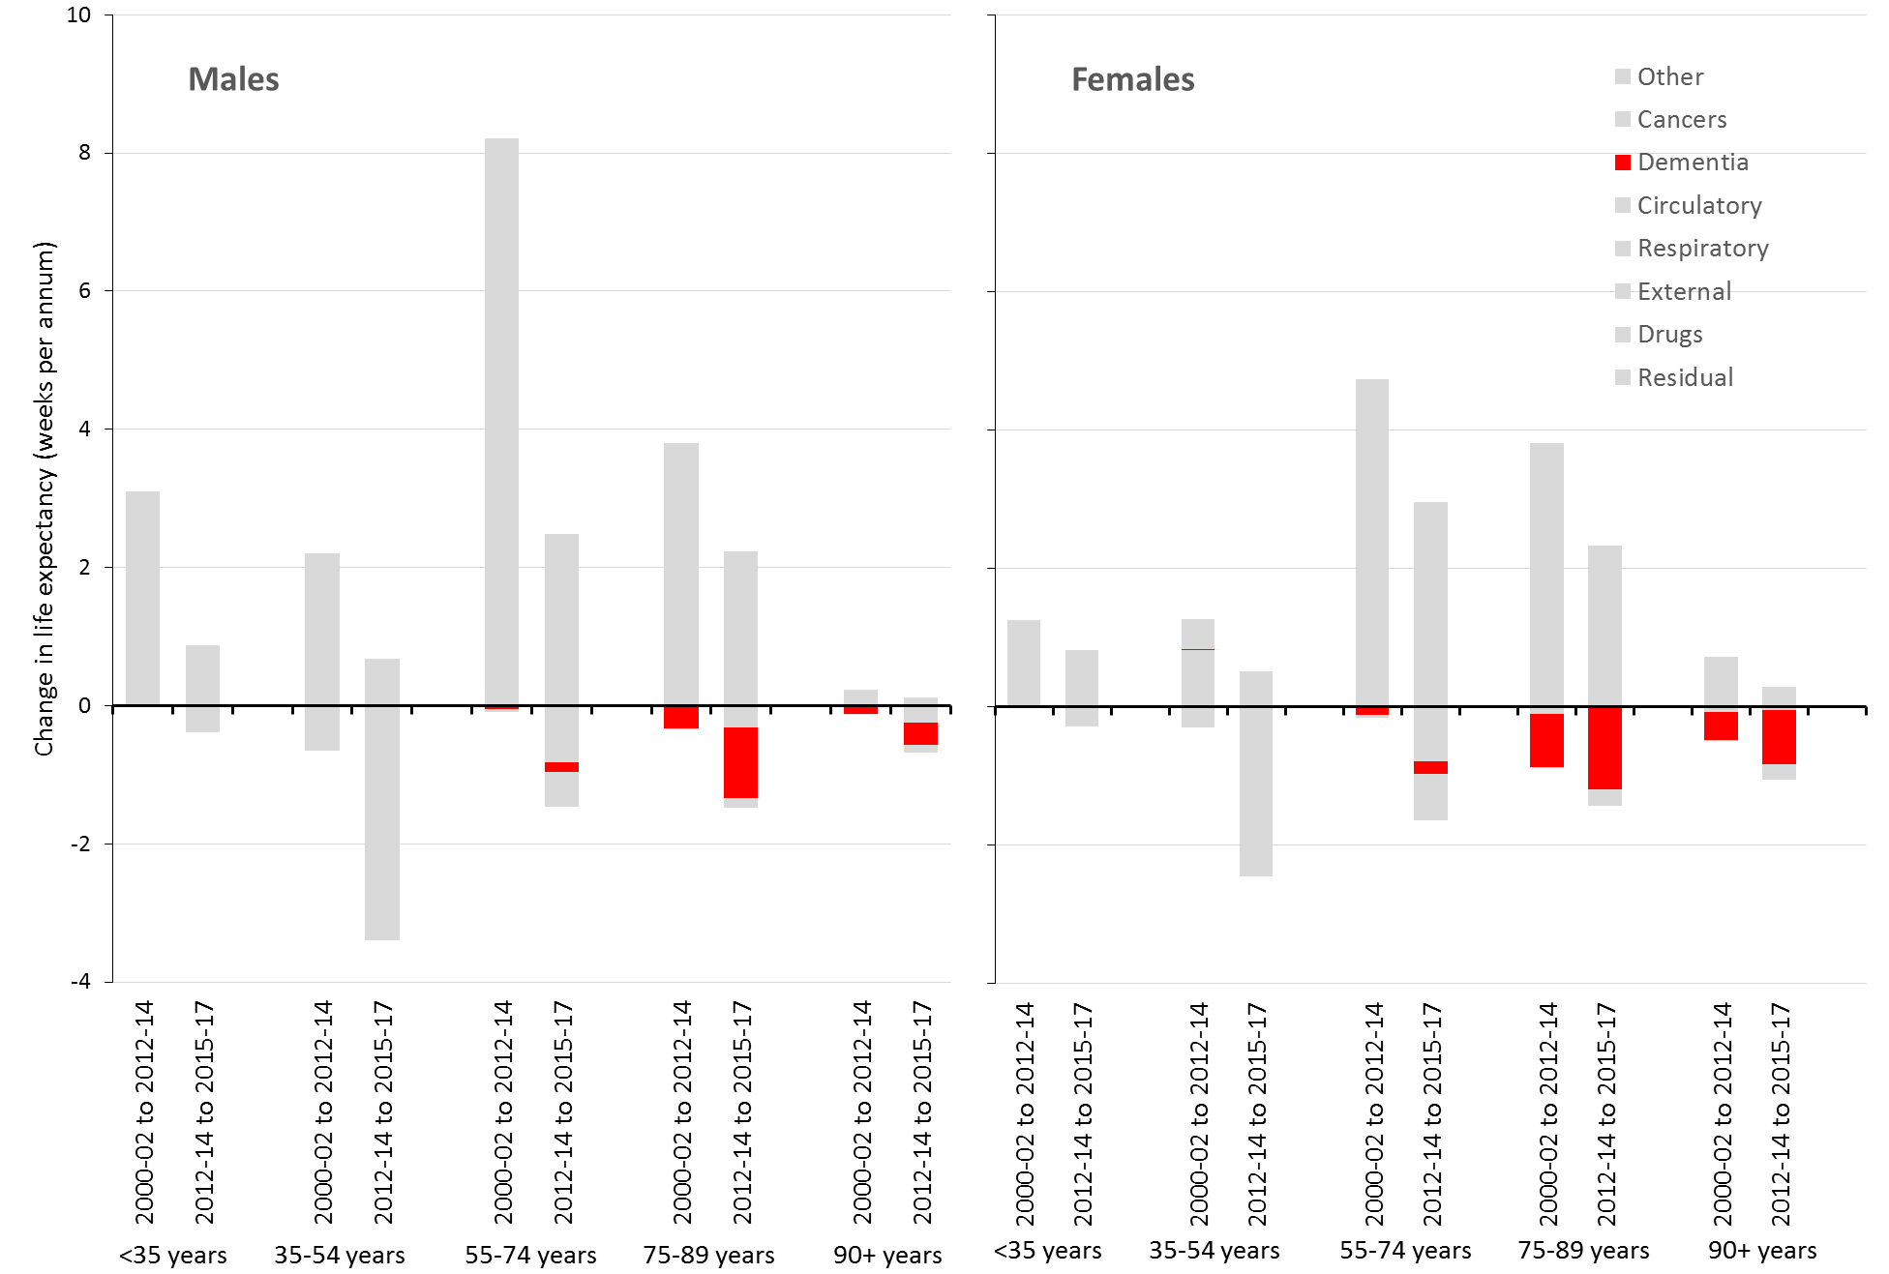

Slide 19
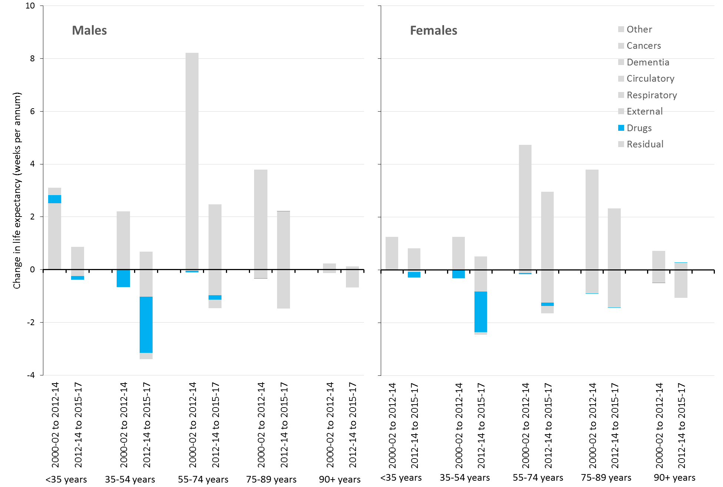

Slide 20
A rapid rise in unjust and avoidable inequalities

Slide 21
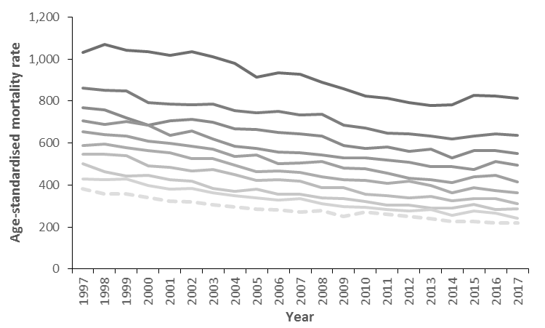
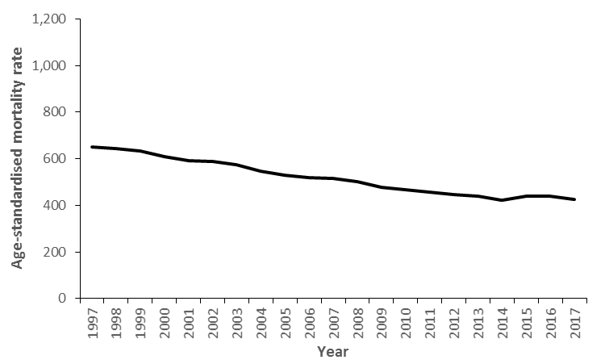
Scotland, men & women <75 years
Most deprived 10th
Least deprived 10th

Slide 22
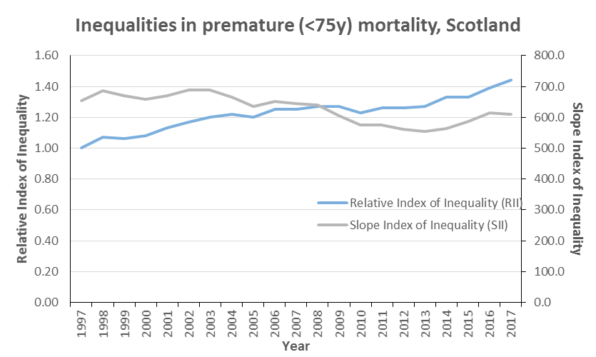

Slide 23
The causes are economic, working through a variety of pathways

Slide 24
Theory for the economic causes of the life expectancy trends
Pressures on:
Social care
NHS
Local government
Public spending squeezed
Change to value and conditionality of social security benefits
Wages squeezed
Precarious work

Slide 25
Theory for the economic causes of the life expectancy trends
Pressures on:
Social care
NHS
Local government
Public spending squeezed
Change to value and conditionality of social security benefits
Wages squeezed
Precarious work
Decreased incomes
Increased poverty
Decreased security

Slide 26
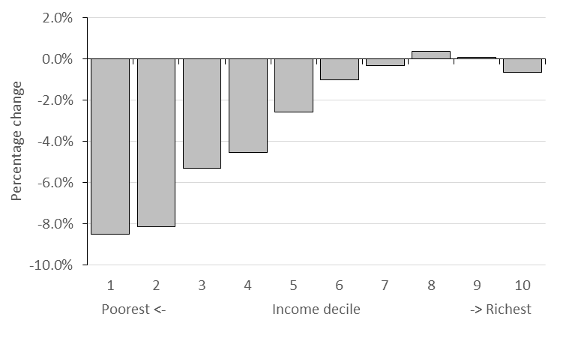
Percentage impact of reforms to taxes and transfer payments by household net income decile, 2010-2011 to 2021-22 tax year, Great Britain
Source: Portes et al. The cumulative impact of tax and welfare reforms. Manchester, Equality and Human Rights Commission, 2018.

Slide 27
Theory for the economic causes of the life expectancy trends
Pressures on:
Social care
NHS
Local government
Public spending squeezed
Poor housing
Poor nutrition
Less ability to maintain healthy behaviours
Risk of rough sleeping
Destructive coping mechanisms
Poor mental health
Social isolation
Change to value and conditionality of social security benefits
Wages squeezed
Precarious work
Decreased incomes
Increased poverty
Decreased security

Slide 28
Data from the CPAG Early Warning System [‘Mary’], with thanks to Morag Treanor, Heriot Watt University, CPAG and the study participants
‘It has just gone overboard now. I was actually at the doctors today about it. But again, that’s money worries. My anxiety is making me really, really ill.
My anxiety has gone through the roof. I can sleep, but the minute I wake up, all I’m thinking about is money, money, money.
What have I to pay tomorrow? How am I going to get the electricity to do another two days?
It’s quite scary’.

Slide 29
‘I’ve got two really good friends that I used to see them all the time. I’ve just not got the heart to… I just…there’s nothing to tell them.
I’ve not been nowhere, I’ve not done nothing. And it comes down to, as well, I think no money, I’ve, ken, they talk about their work and stuff, and their families, where they’ve been and where they’re going on holiday, and I just, I kinda… like for my birthday, it was my 40th in April, and one of my friends had organised all the girls to come over and I just felt like the chicken with one wing.
Because… I was the only one sitting there with no job, no money, and I didn’t ken what I was going to eat that night. It was quite a sad situation to be in.’
Data from the CPAG Early Warning System [‘Mary’],
with thanks to Morag Treanor, Heriot Watt University, CPAG and the study participants

Slide 30
Theory for the economic causes of the life expectancy trends
Pressures on:
Social care
NHS
Local government
Public spending squeezed
Poor housing
Poor nutrition
Less ability to maintain healthy behaviours
Risk of rough sleeping
Destructive coping mechanisms
Poor mental health
Social isolation
Stalling of most causes of death
Change to value and conditionality of social security benefits
Increased inequalities in mortality
Wages squeezed
Precarious work
Decreased incomes
Increased poverty
Decreased security

Slide 31
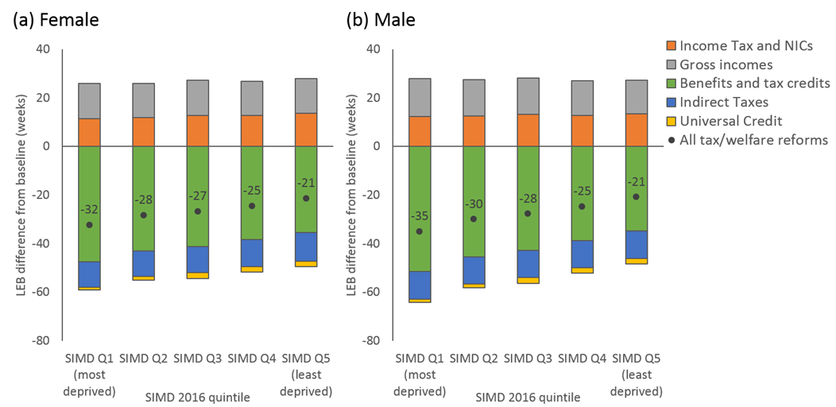
Modelled impact of changes to taxes and transfer payments (2010-2011 to 2021-22) on life expectancy, Scotland (preliminary analysis using Triple I tool)
84.2 years to 83.7 years (-29 weeks)
79.5 years to 78.9 years (-30 weeks)

Slide 32
Economic causes
Different pathways for different groups
Social security benefit cuts and increased conditions
Cuts to public services and pressures on health & social care services
Household incomes squeezed, precarious work

Slide 33
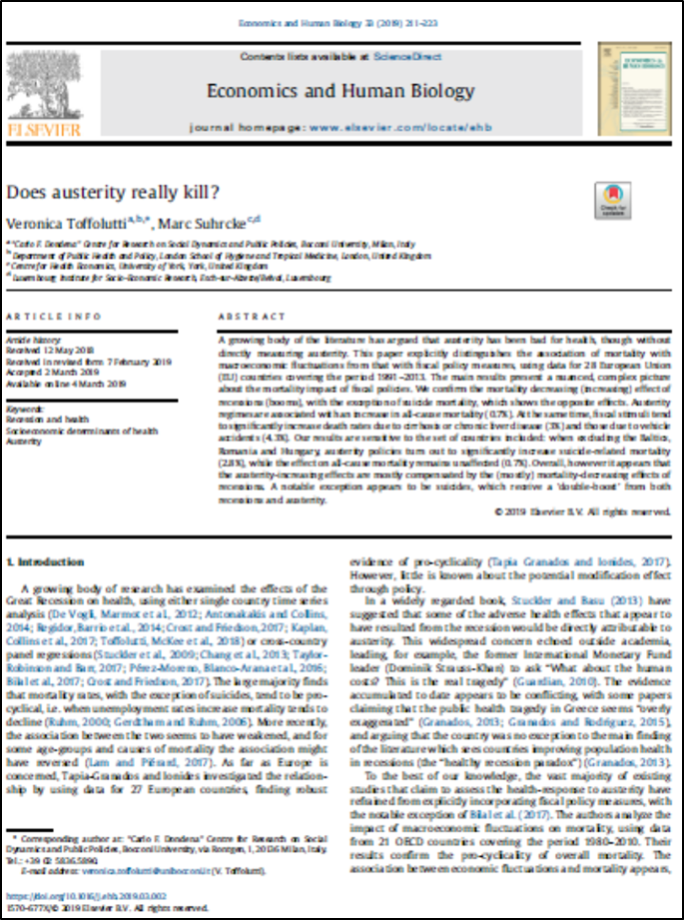
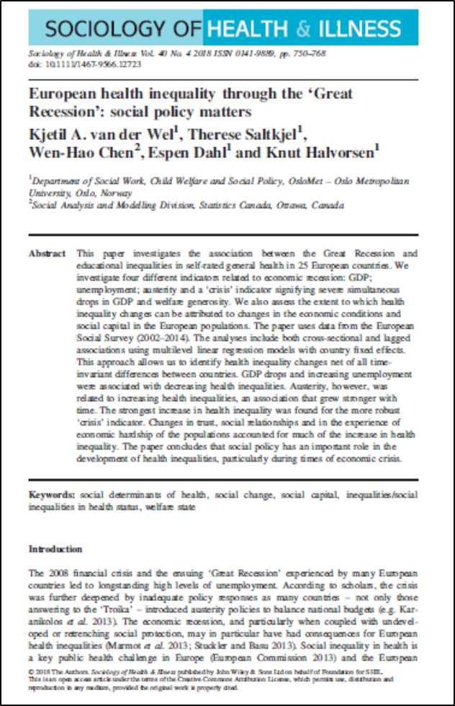
Austerity
regimes are associated with an increase in all-cause mortality (0.7%).
Austerity, however, was
related to increasing health inequalities, an association that grew stronger with
time.
The results suggest a negative effect on mortality in those countries that
apply a higher level of austerity.

Slide 34
Rajmil, Luis; Fernández de Sanamed, María-José. Austerity Policies and Mortality Rates in European Countries, 2011–2015. AJPH 2019; 109: 768-870, doi:10.2105/AJPH.2019.304997.
Austerity measured as Cyclically Adjusted Primary Balance (CAPB) in terciles
Europe (15 countries), 2011-2015
Compared with countries in the low-austerity group, countries with intermediate austerity had excess mortality of 40 per 100,000 per year and those with high austerity had excess mortality of 31 per 100,000 per year.
Generally good quality study
No data beyond 2015 – likely to underestimate effects

Slide 35
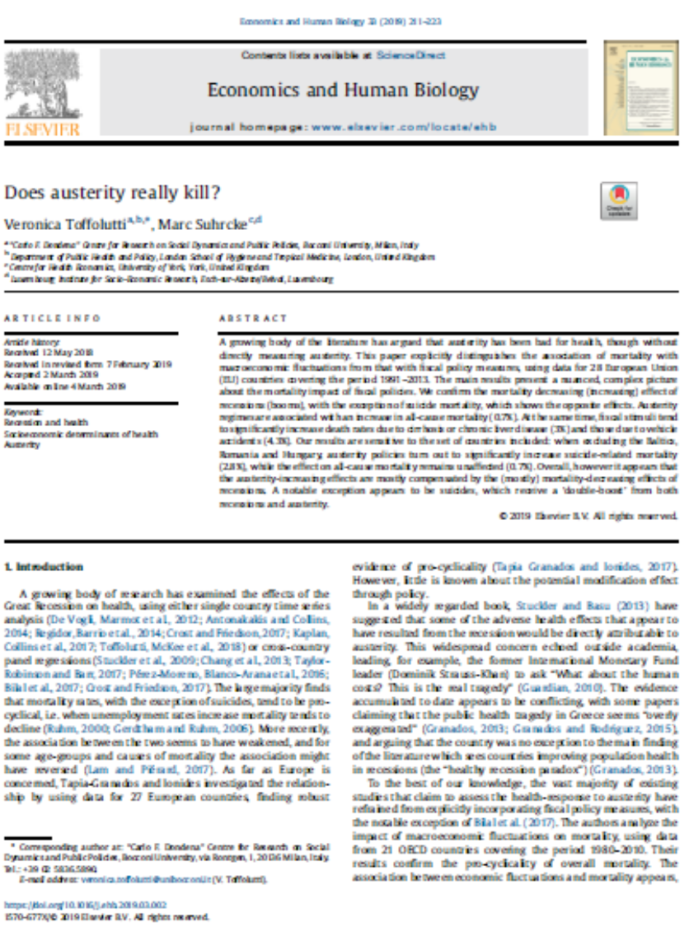
Toffoluttia V, Suhrcke M. Does austerity really kill? Economics and Human Biology 2019; 33: 211-3.
Austerity measured using the Alesina-Ardagna Fiscal Index (AAFI) (also called ‘Blanchard Fiscal Index’)
Europe (28 countries), 1991-2013 (many up to 2012)
Austerity regimes are associated with an increase in mortality of 0.7% after adjusting for recession effects
Good quality study
No data beyond 2012/3 – likely to underestimate effects

Slide 36
van der Wel, Kjetil A.; Saltkjel, Therese; Chen, Wen-Hao; Dahl, Espen; Halvorsen, Knut. European health inequality through the ‘Great Recession’: social policy matters. Sociology of Health & Illness 2018; 40(4): 750-768, doi:10.1111/1467-9566.12723
Austerity measured by welfare spending, adjusted for unemployment and GDP
2002-2014, Europe (25)
GDP drops and increasing unemployment were associated with decreasing health inequalities. Austerity, however, was related to increasing health inequalities, an association that grew stronger with time.
Good quality study though response rate for European Social Survey is highly variable across countries, and only self-rated health measures.
No data beyond 2014 – likely to underestimate effects

Slide 37
Loopstra R, McKee M, Katikireddi SV, Taylor-Robinson D, Barr B, Stuckler D. Austerity and old-age mortality in England: a longitudinal cross-local area analysis, 2007–2013. Journal of the Royal Society of Medicine 2016; 109(3):109-116, doi:10.1177/0141076816632215.
Austerity measured as change in Pension Credit and social care spending; local authorities in England, 2007-2013
Each 1% decline in Pension Credit was associated with a 0.68% increase in mortality. Each 1% decline in social care spending was associated with a rise of 0.08% but not after adjusting for pension credit spending changes.
Moderate quality study which could be confounded by deprivation, only to 2013, only oldest age group.

Slide 38
Taulbut M, Agbato D, McCartney G. Working and hurting? Monitoring the health and health inequalities impacts of the economic downturn and chanes to the social security system. Glasgow, NHS Health Scotland, 2018.
Observational evidence that many health trends have worsened for those groups most exposed to benefit cuts and increased conditionality in the social security system.
High quality evidence that some specific changes (e.g. increased conditionality for lone mothers receiving income support) have been detrimental for mental health.
It is proving impossible to do better studies on this because the DWP will not co-operate to release relevant linked data.

Slide 39
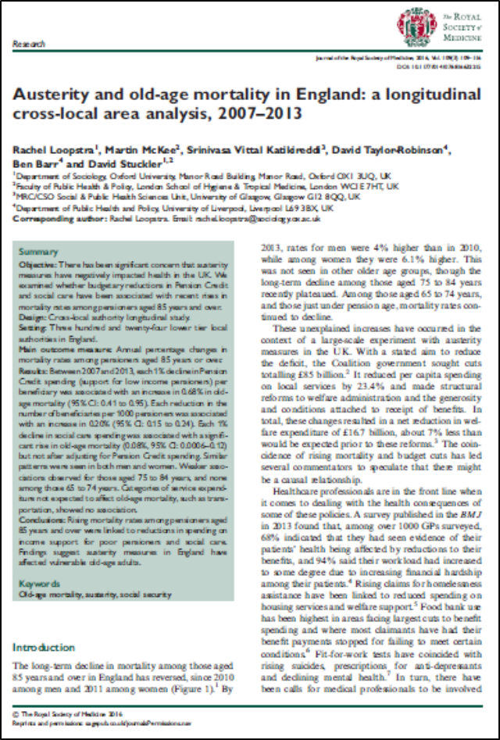

Slide 40
What are the causes?
Other factors could be playing a role
> Mental health problems and social isolation as mechanisms linking economic factors and mortality
> Obesity could be a mechanism linking economic factors to cardiovascular disease
> Large programme of work underway to investigate all causes at present

Slide 41
It’s not an ageing population
These trends are shown in life expectancy and age-standardised mortality data

Slide 42
It’s not a ‘natural’ limit
Trends have changed at all age groups, not just the oldest
Trends are worst in the most deprived groups where life expectancy is already lowest
Life expectancy continues to improve in countries who lead the world such as Japan

Slide 43
It’s not ‘flu
All causes of death impacted including implausible causes such as drug-related deaths
Trends changed in 2012 across most countries, not in the ‘flu-year’ 2015, and have been sustained subsequently
All age groups impacted

Slide 44
Summary and implications
This is the biggest public health challenge for many decades – encompassing the sub-plots on drug deaths, homelessness, poverty, etc.
Austerity, social security cuts, service cuts/pressures all likely to be causal
We need to reverse and mitigate these economic and social policies
We need to design our services to meet the unmet needs of the population and ensure accessibility to those who need those services most
We need a public health approach to substance misuse
We need your leadership to ensure all relevant policymakers and service managers at all levels understand the contribution they can make
We have a duty to explain and champion action for our population/patients

Slide 45
But what can I do (if I work in public health)?
Ensure everyone is in receipt of the benefits they are entitled to through high quality service outreach.
Ensure mitigation of inequalities through employment and procurement processes (see ‘Maximising the role of NHSScotland in reducing health inequalities’).
Design our services to meet the unmet needs of the population and ensure accessibility to those who need those services most.
Lead and influence across the ‘whole system’ for change.
Ensure all your teams, managers, elected representatives, friends, etc., know what is going on and what is needed.

Slide 46

Leadership
Research Administration
Policy advice and navigation
Resourcing
Communications
Engagement
Data preparation
Networking
Challenge and support
Policy influence
All the data and evidence is summarised on ‘Recent Mortality Trends’ page of ScotPHO.
The programme of research and dissemination is on the Mortality Special Interest Group page of ScotPHN website.
Contact: gmccartney@nhs.net @gerrymccartney1

Slide 47
All the data and evidence is summarised at: www.scotpho.org.uk/population-dynamics/recent-mortality-trends/
The programme of research and dissemination is detailed here:
https://www.scotphn.net/groups/public-health-mortality-monitoring/mortality-sig-introduction/
Contact me at:
Email: gmccartney@nhs.net
Twitter: @gerrymccartney1

